Slide 1

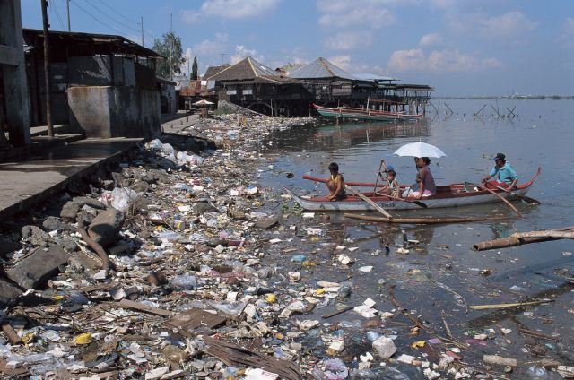




Slide 2
ASTIM:
Genlerle çevrenin bir öyküsü
Dr. Ömer KALAYCI

Slide 3
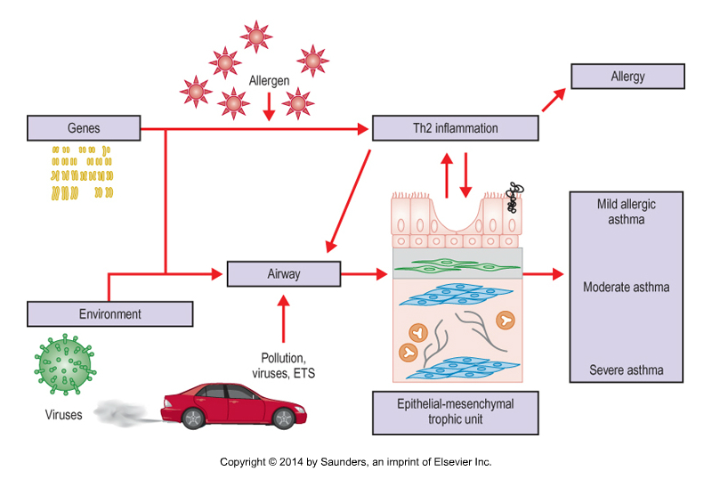

Slide 4
Heritability
Kalıtılabilirlik
Fenotipteki bir değişkenliğin
ne kadarının
genotipik değişkenliğe
bağlı olduğunun tahmini.

Slide 5
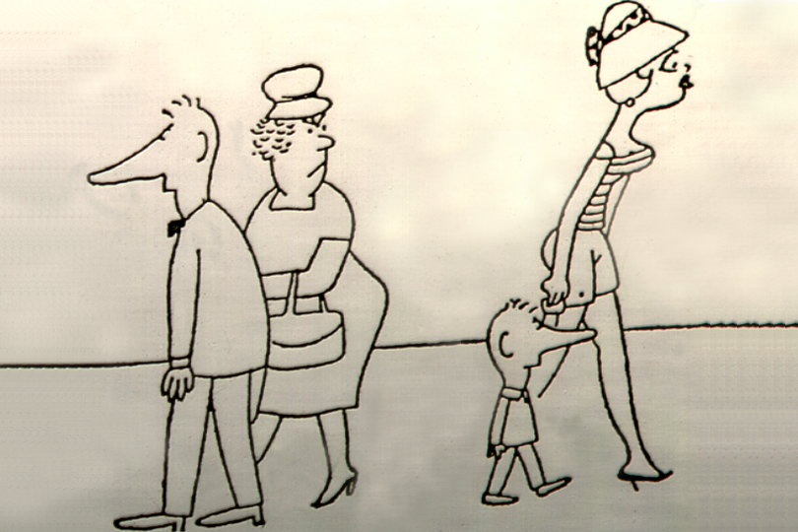

Slide 6

Genome-wide Association Studies
GWAS
Belirteçler: Milyonlarca SNP and LD patternleri
Örnekler: İyi tanımlanmış kohortlardan elde edilen DNA (n= x1000)

Slide 7
GWAS for ASTHMA
Gen/bölge | EVE Amerika 15,000 | GABRIEL Avrupa 11,000
17q21 (ORMDL3) | 1.2x10⁻¹⁴ | 6.4x10⁻²³
IL1RL1/IL18R1 Chr 2 | 1.4x10⁻⁸ | 3.4x10⁻⁹
TSLP Chr 5 | 7.3x10⁻¹⁰ | 7.52x10⁻⁸
IL-33 Chr 9 | 2.5x10⁻⁷ | 9.2x10⁻¹⁰
SMAD3Chr 15 | 1.9x10⁻⁴ | 3.9x10⁻⁹
RORA Chr 15 | 2.1x10⁻³ | 1.1x10⁻⁷
HLA-DQ Chr 5 | 0.014 | 7.0x10⁻¹⁴
PHYN Chr1 | 3.6x10⁻⁷ | -
IL-2RB Chr 22 | ns | 1.1x10⁻⁸
SLC22A5 Chr5 | ns | 2.2x10⁻⁷
IL-13 Chr5 | ns | 1.4x10⁻⁷

Slide 8
ORMDL 3
ASTHMA
7904 hasta
10,874 sağlıklı kontrol
rs7216389 polymorphism
Beyaz ırk – Asya ırk
Y.-F. Zhao et al. Human Immunology 2014;75: 960–967

Slide 9
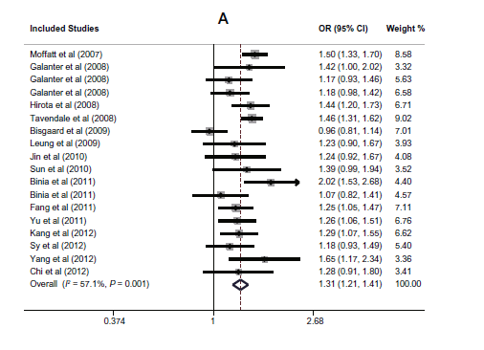

Slide 10
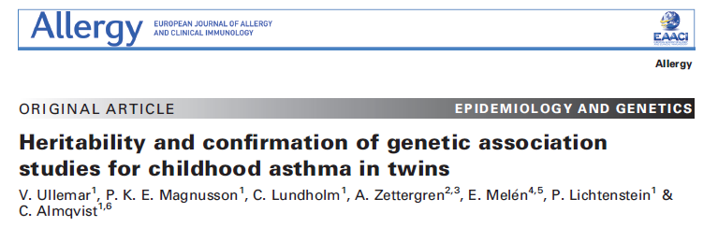
Allergy 2016; 71: 230–238.

Slide 11
The Child and Adolescent Twin Study in Sweden (CATSS)
n | 25306
Monozigotik | 7028
Dizigotik aynı cins | 8854
Dizigotik farklı cins | 8834
Allergy 2016; 71: 230–238.

Slide 12
Kayıtlara dayalı astım tanısı
N= 1710 (% 10.8)
rMZ | rDZ ss | Model | A | C | E
0.81 | 0.51 | ACE | 0.62 | 0.19 | 0.19
A: genetic component
C: shared environment component
E: unique environment component.
Allergy 2016; 71: 230–238.

Slide 13
Missing heritability
(Eksik kalıtılabilirlik)
Aile çalışmalarının açıkladığı kalıtılabilirlik
-
GWAS çalışmalarının açıkladığı kalıtılabilirlik
=

Slide 14
Missing heritability
Eksik kalıtılabilirlik
Nadir genetik değişkenlikler
Copy number variants
GWAS çalışmalarında bakılmayan etkileşimler
    Epistasis
    Gen-çevre etkileşimleri

Slide 15
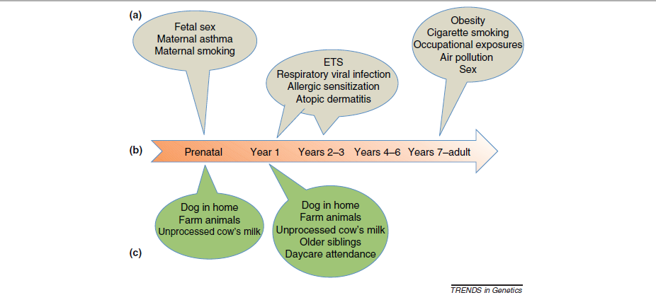
Vercelli, Ober. Trends in Genetics March 2011
Notes:
Risk and protection factors influence asthma risk throughout the life cycle. Epidemiologic studies of asthma have established numerous risk and protection factorsthat exert their effects at specific stages of the life cycle. The relationship of some investigated exposures that have equivocal associations with risk or protection are notshown. These include breastfeeding effects and cat(s) in the home at birth on subsequent risk for asthma in the child, as examples. (a) Environmental exposures that have been associated with increased risk for asthma. (b) Stages of the life cycle that are ‘sensitive’ to the epidemiologic risk and to protective factors. (c) Environmental exposures associated with protection from asthma

Slide 16
Intrauterin çevre

Slide 17
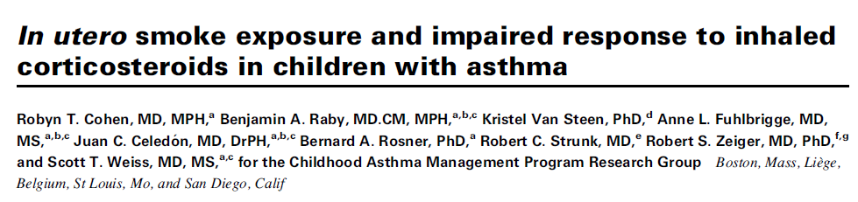
J Allergy Clin Immunol 2010;126:491-7

Slide 18
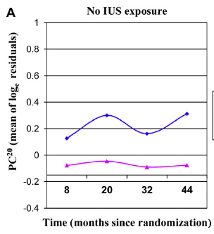
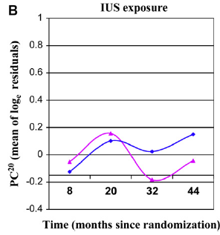


Slide 19
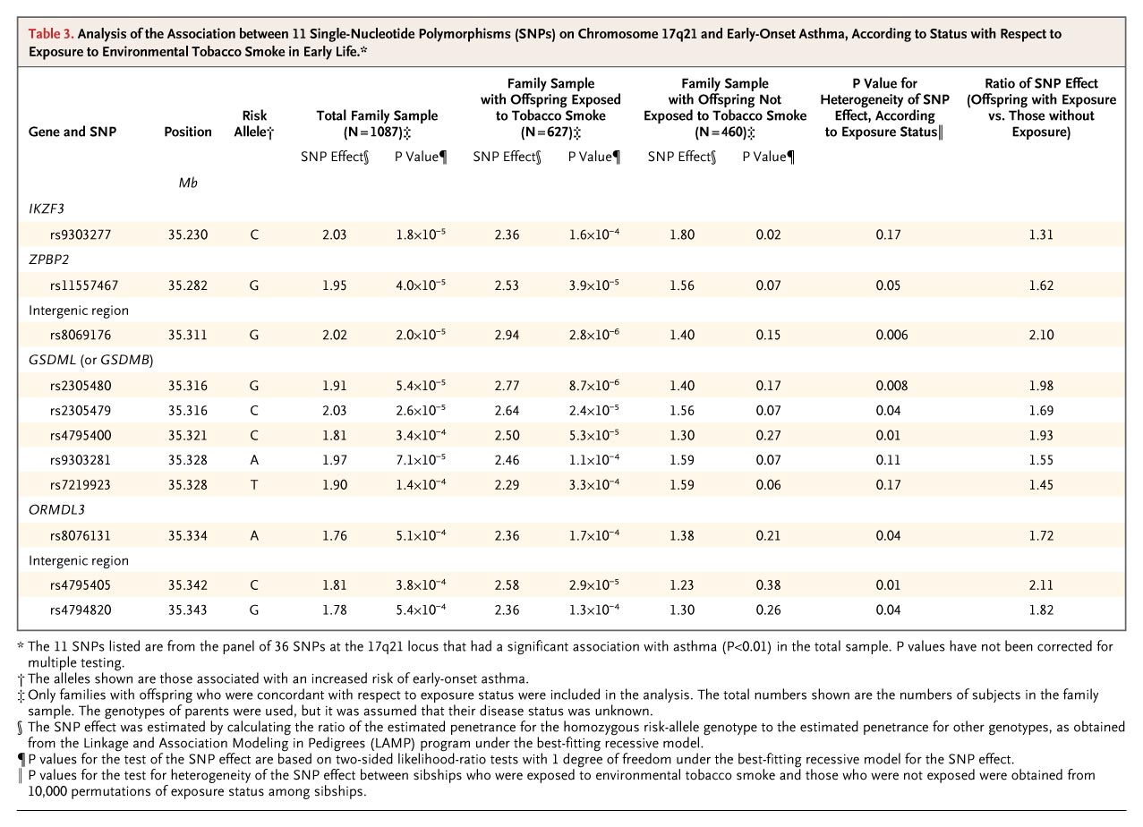

Analysis of the Association between 11 Single-Nucleotide Polymorphisms (SNPs) on Chromosome 17q21 and Early-Onset Asthma, According to Status with Respect to Exposure to Environmental Tobacco Smoke in Early Life
Bouzigon E et al. N Engl J Med 2008;359:1985-1994
Notes:
Table 3. Analysis of the Association between 11 Single-Nucleotide Polymorphisms (SNPs) on Chromosome 17q21 and Early-Onset Asthma, According to Status with Respect to Exposure to Environmental Tobacco Smoke in Early Life.

Slide 20
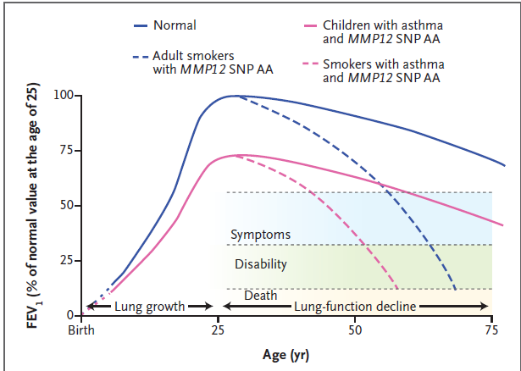

Slide 21
Tütün Dumanı
Intrauterin dönemden başlayarak astım için bir risk oluşturur
Genetik değişkenlikler hasta yanıtını etkiler

Slide 22
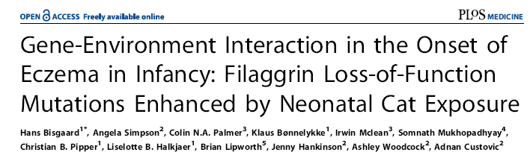

Slide 23
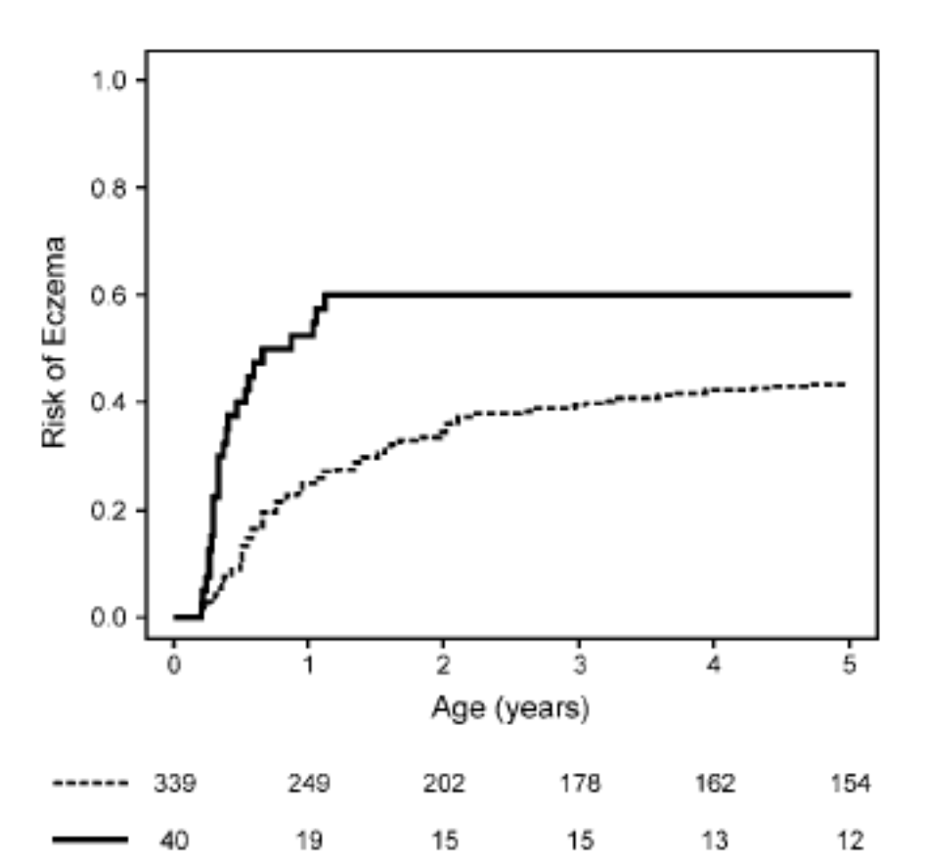
FLG MUTASYON +
FLG MUTASYON -
1. YILDA HR 2.26

Slide 24
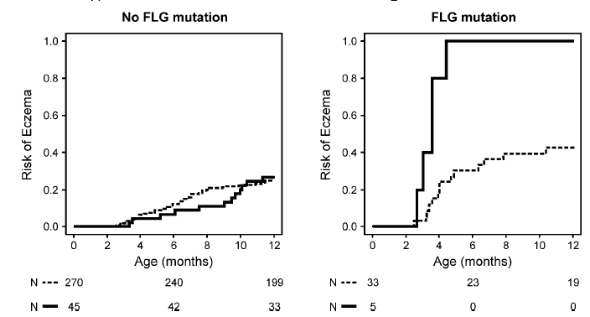
1. YILDA HR 11.11

Slide 25
ATOPİK DERMATİT RİSKİ
Filaggrin geninde null mutasyon
+
Hayatın erken döneminde kedi karşılaşması
100%

Slide 26
GWAS
GWIS

Slide 27

Genome-wide expression profiles identify potential targets for gene-environment interactions in asthma severity
Joanne E. Sordillo, et al. JACI 2015;36;4: 885-892.
Copyright © 2015 American Academy of Allergy, Asthma & Immunology Terms and Conditions

Slide 28
 | Gene expression study | Gene –environment interaction study
 | HAA | CAMP | GACRS
n | 80 | 519 | 558
YAŞ | 11.9 | 8.9 | 8.9
HAA. Home Allergens and Asthma Birth Cohort
CAMP: Childhood Asthma Management Program
GACRS: Genetics of Asthma in Costa Rica Study

Slide 29
Differentially expressed genes in patients with mite allergy (vs nonallergic subjects) in the home allergens cohort
Gene | Log fold change | Adjusted P value
IL-9 | 1.55 | 0.0002
IL-5 | 0.32 | 0.035
PRG-2 | 0.83 | 0.035
Claudin-9 | -0.21 | 0.035

Slide 30
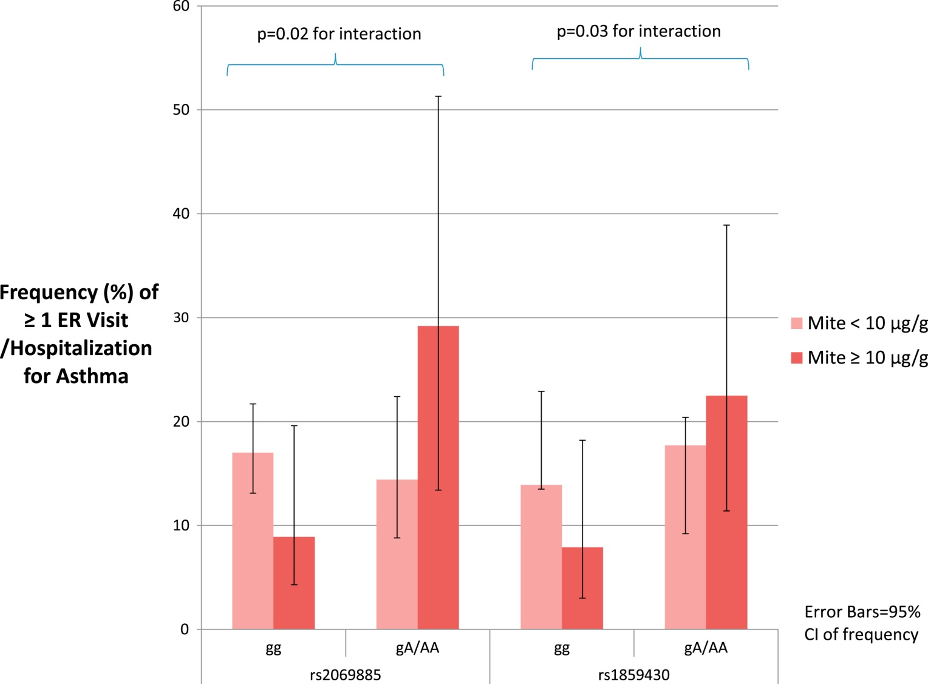
HDM - ASTHMA
IL9 SNP genotype (CAMP)
Journal of Allergy and Clinical Immunology 2015 136, 885-892.e2DOI: (10.1016/j.jaci.2015.02.035)
Copyright © 2015 American Academy of Allergy, Asthma & Immunology Terms and Conditions
Notes:
Effect of dust mite exposure on asthma severity by IL9 SNP genotype (CAMP study). ER, Emergency department.

Slide 31
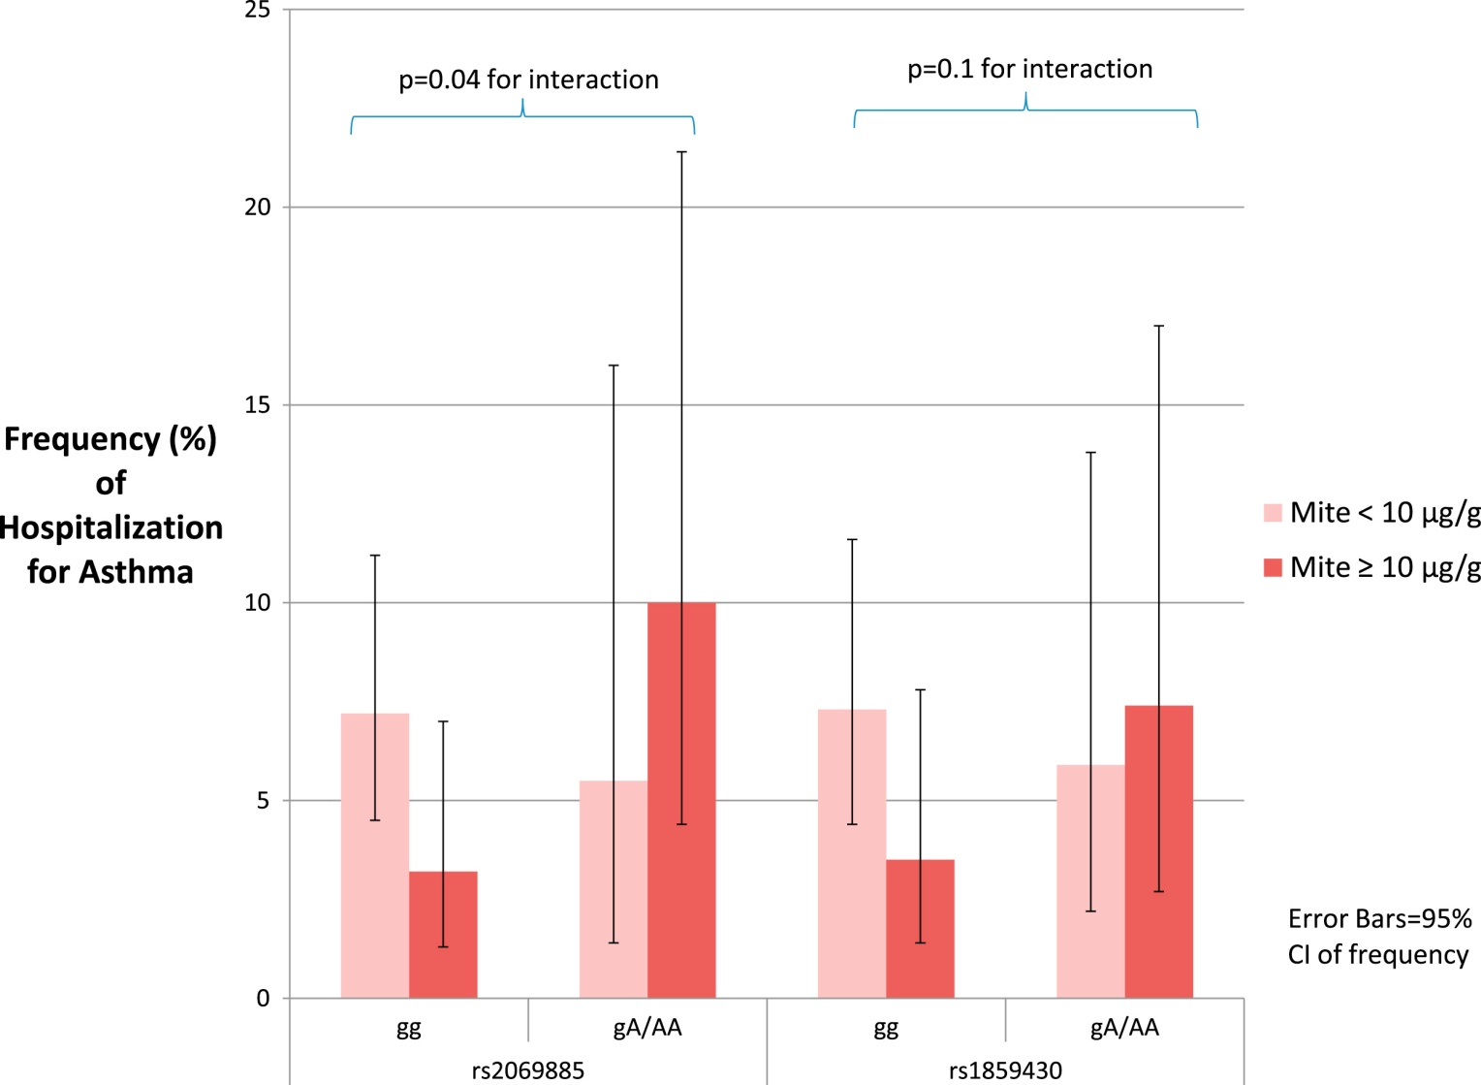
HDM - ASTHMA
IL9 SNP genotype (GACRS)
Journal of Allergy and Clinical Immunology 2015 136, 885-892.e2DOI: (10.1016/j.jaci.2015.02.035)
Copyright © 2015 American Academy of Allergy, Asthma & Immunology Terms and Conditions
Notes:
Effect of dust mite exposure on asthma severity by IL9 SNP genotype (GACRS).

Slide 32
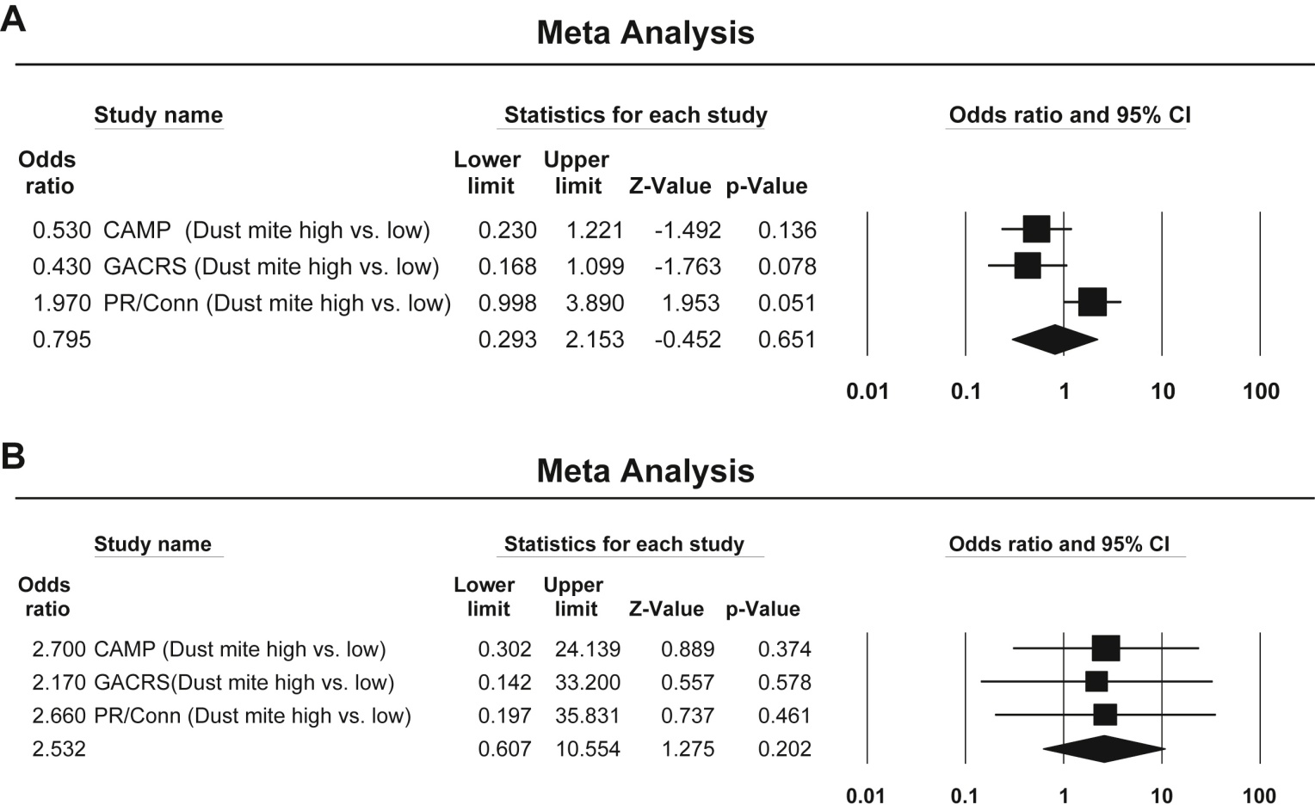
SNP -
SNP +
Journal of Allergy and Clinical Immunology 2015 136, 885-892.e2DOI: (10.1016/j.jaci.2015.02.035)
Copyright © 2015 American Academy of Allergy, Asthma & Immunology Terms and Conditions
Notes:
A, ORs for increased severe asthma exacerbations (≥1 in the past year) in response to increased dust mite allergen exposure (≥10 μg/g) for subjects without an IL9 polymorphism (rs2069885 wild-type). B, ORs for increased severe asthma exacerbations (≥1 in the past year) in response to increased dust mite allergen exposure (≥10 μg/g) for subjects with an IL9 polymorphism (rs2069885).

Slide 33
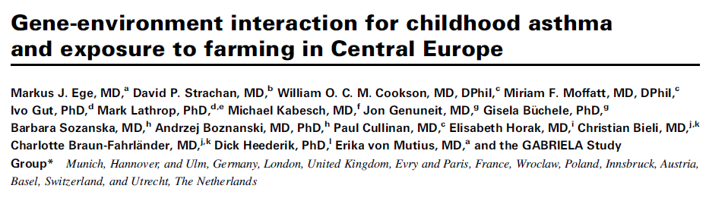
JACI 2011;127:138-44.)

Slide 34
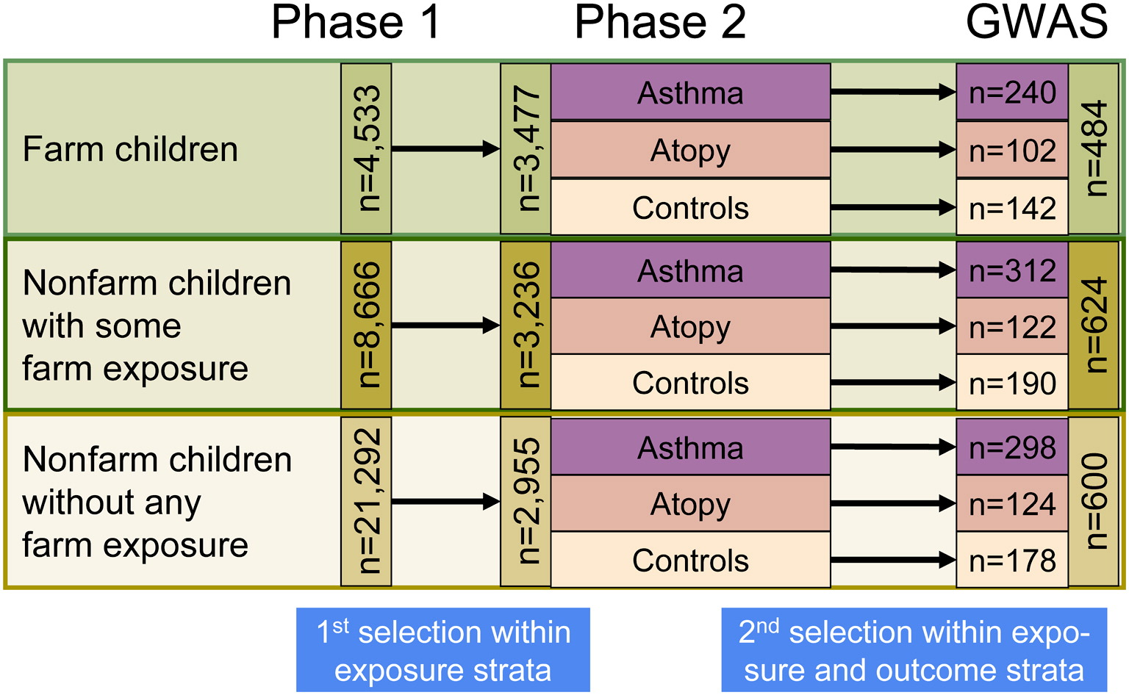
Journal of Allergy and Clinical Immunology 2011 127, 138-144.e4DOI: (10.1016/j.jaci.2010.09.041)
Copyright © 2010 American Academy of Allergy, Asthma & Immunology Terms and Conditions
Notes:
Selection of the study population.

Slide 35
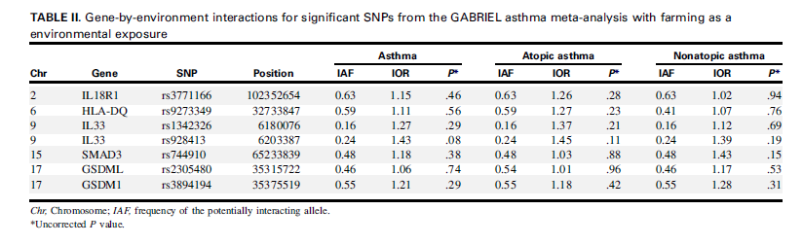

Slide 36
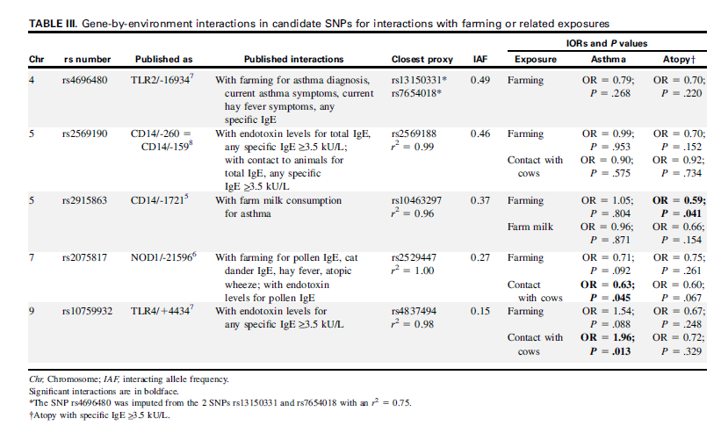

Slide 37
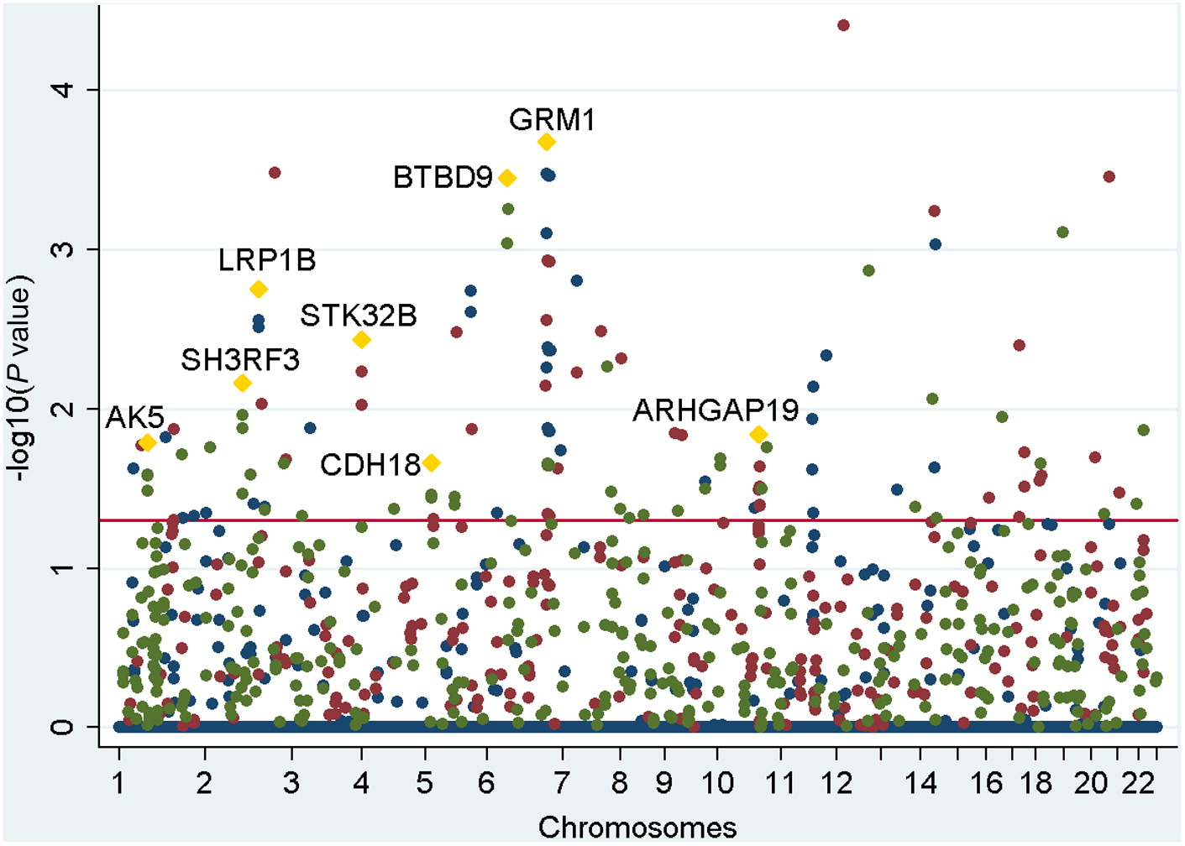
Genome-wide interaction analysis for asthma phenotypes
Journal of Allergy and Clinical Immunology 2011 127, 138-144.e4DOI: (10.1016/j.jaci.2010.09.041)
Copyright © 2010 American Academy of Allergy, Asthma & Immunology Terms and Conditions
Notes:
Genome-wide interaction analysis for asthma phenotypes. Bonferroni-corrected interaction P values are plotted against the genomic SNP position. The red line represents the effective significance level of .05. The blue dots represent the P values for interactions of farming and related exposures with asthma, the red dots with atopic asthma, and the green dots with nonatopic asthma. The yellow diamonds mark genes represented by at least 2 SNPs.

Slide 38
SONUÇLAR
Sık rastlanan SNP ler astım ve atopiyle ilgili olarak çiftlik yaşamındaki gen-çevre ilişkisine etki etmezler
Nadir değişkenler (Glutamate reseptör) etki edebilirler
Nadir değişkenlerle ilgili olarak çalışmanın gücü yetersizdir

Slide 39
Gen – çevre etkileşiminde
Endotoksin modeli

Slide 40
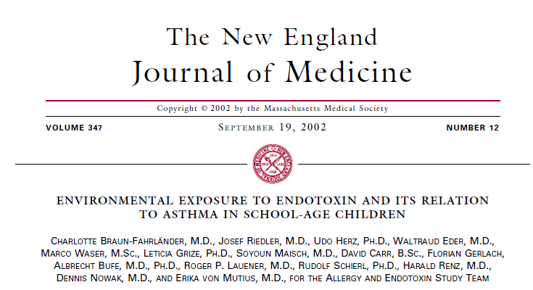

Slide 41
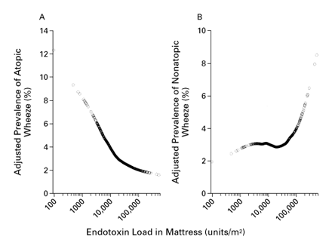

Slide 42
Astımda bir gen-çevre modeli:
Endotoksin
Allergy. 2005 Dec;60(12):1485-92.
Ann Allergy Asthma Immunol. 2006 Sep;97(3):321-8., Rheumatol Int. 2007;27:691-4
Allergy. 2011 Jan;66(1):48-57
Allergy. 2014 Dec;69(12):1648-58.

Slide 43
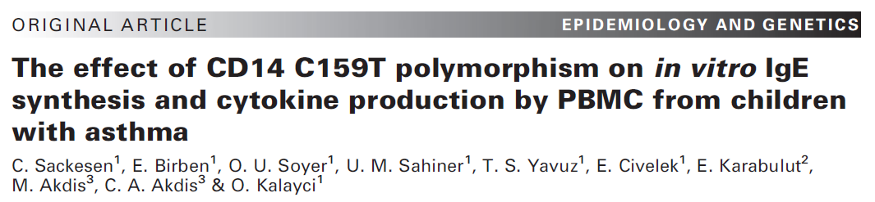

Slide 44
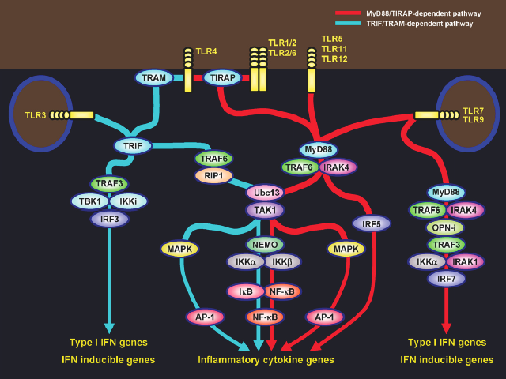
Kawai T, Akira S. SemImmunol2007;19:24-32

Slide 45
ENDOTOXIN SIGNALING PATHWAY
31 molekül
Beyaz ırk
Minor allel sıklığı > 10 %
123 SNP

Slide 46
Endotoksin yolağında in-vitro IgE sentezi ile ilişkili genler.
TRAF-6
IRF-3
TIRAP
TLR-4
ST-2
SOCS-1
IKK-1
CD14
TRIF
P < 0.05
4
3
2
1
0
0
2
200

Slide 47
LPS stimulation
In-vitro IgE synthesis
Children with asthma
Healthy children
?
Environmental endotoxin

Slide 48
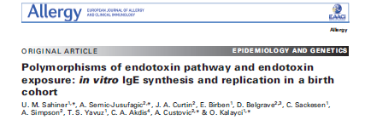

Slide 49
MAAS DOĞUM KOHORTU

Slide 50
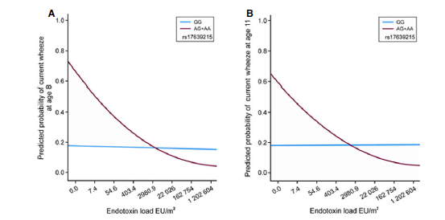
Fitted predicted probability curves for current wheeze
in relation to endotoxin load.
(A) Age 8, ST-2 SNP rs17639215;
(B) age 11, ST-2 SNP rs17639215

Slide 51
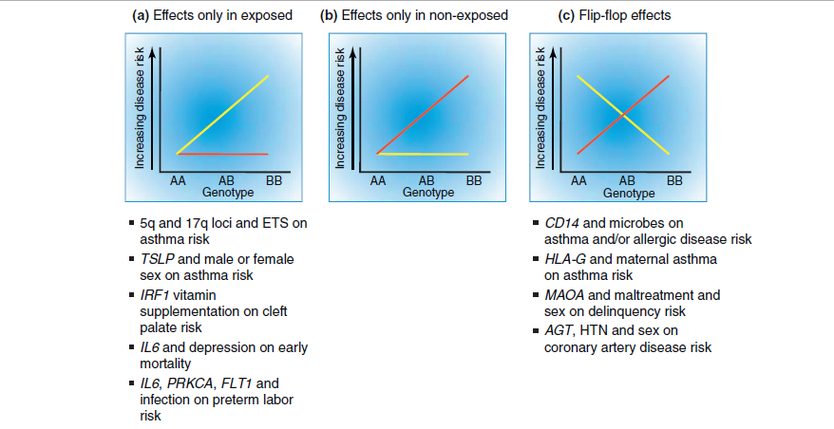

Slide 52
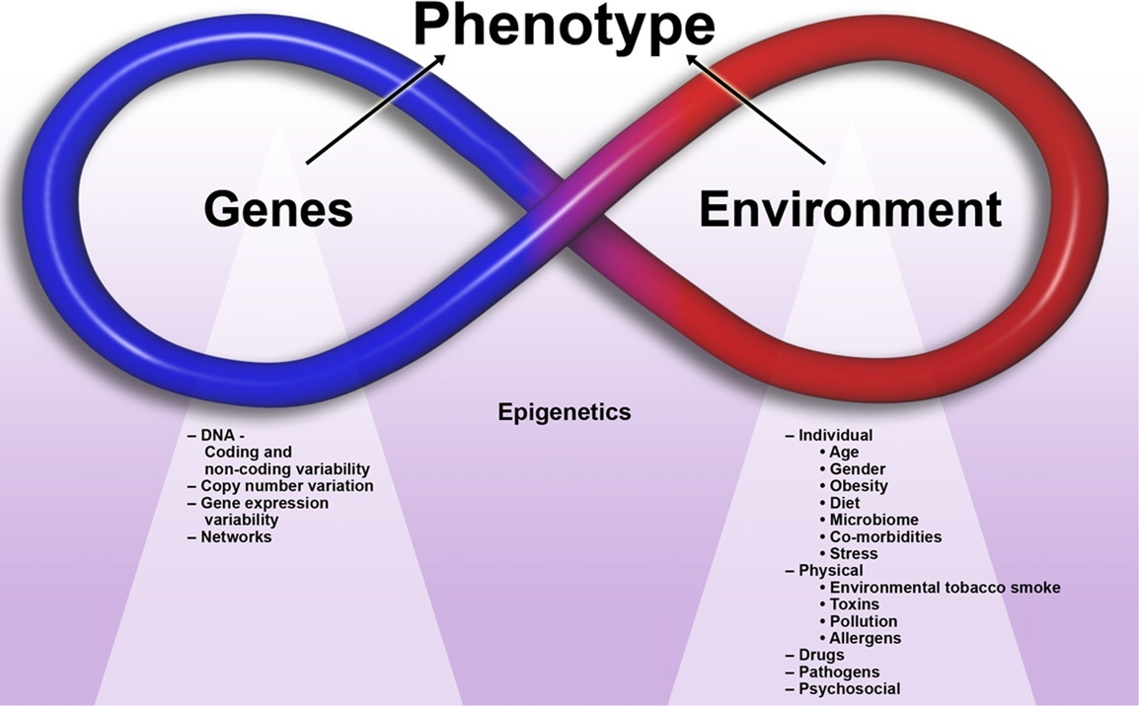
Baye TM etal., J Allergy Clin Immunol 2010;126:425-36

Slide 53
The best way out of a difficulty is through it.
Robert Frost

