Slide 1


12. Ulusal Çocuk Alerji ve Astım Kongresi
23-26 Nisan -2017
25 Nisan, 08:00-09:00
Besin Alerjisi Tanı ve Takibinde Dışkıda Kalprotektin Ölçümü Gerekli midir?
HAYIR!!!!!!!!!!!
Doç. Dr. Emin ÖZKAYA
Bezmialem Vakıf Üniv .Tıp Fak. Çocuk Alerji Bilim Dalı-İSTANBUL

Slide 2



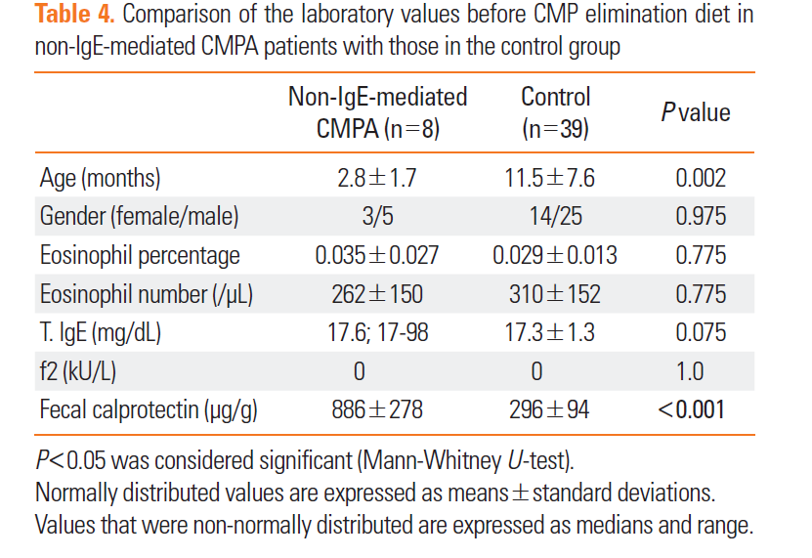
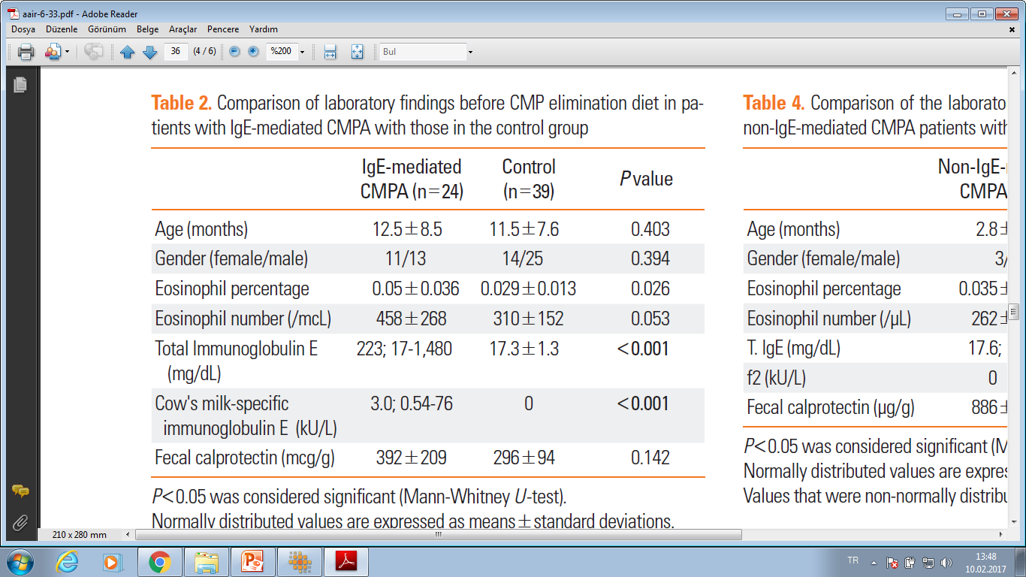
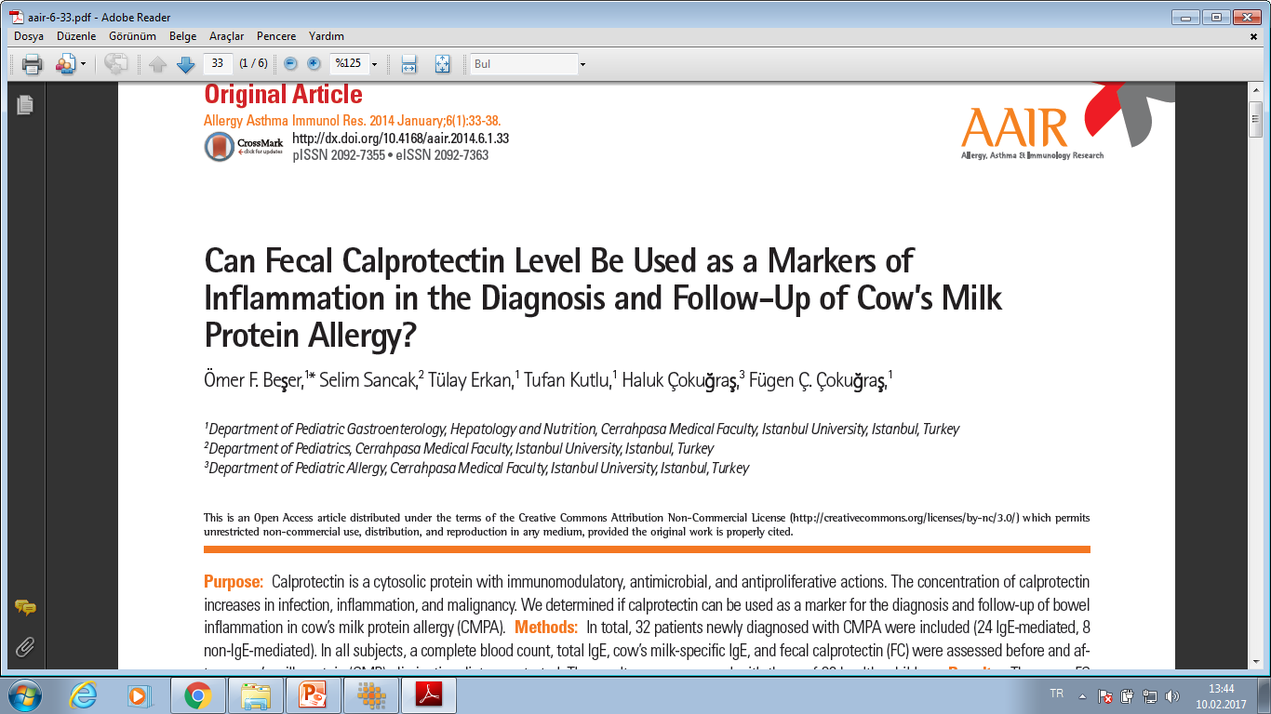
VAKA GRUBUNDA GENİŞ DAĞILIM ARALIĞI
????????
Notes:
In total, 32 patients newly diagnosed with CMPA were included (24 IgE-mediated, 8 non-IgE-mediated). In all subjects, a complete blood count, total IgE, cow’s milk-specific IgE, and fecal calprotectin (FC) were assessed before and after a cow’s milk protein (CMP) elimination diet was started. The results were compared with those of 39 healthy children.

Slide 3
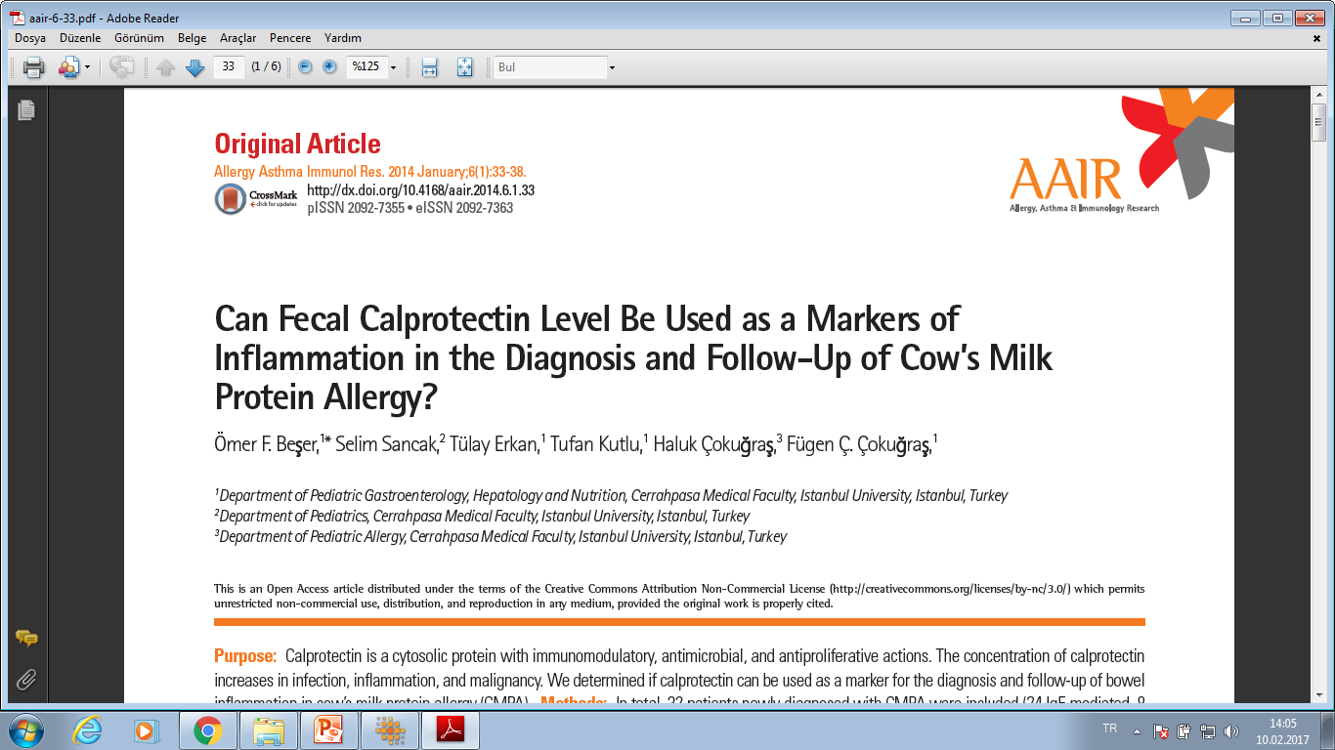
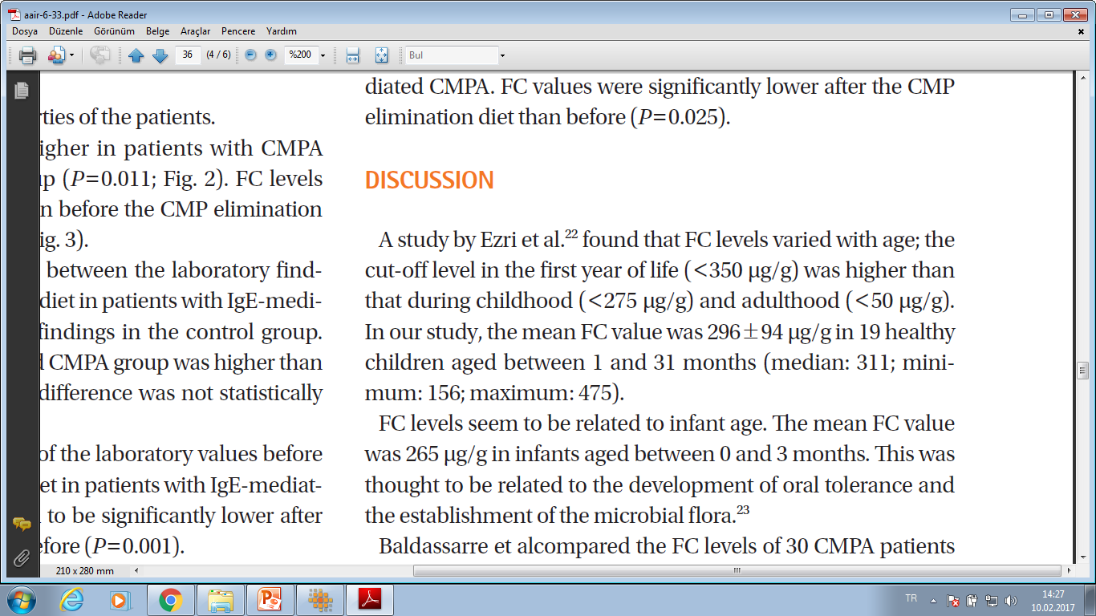
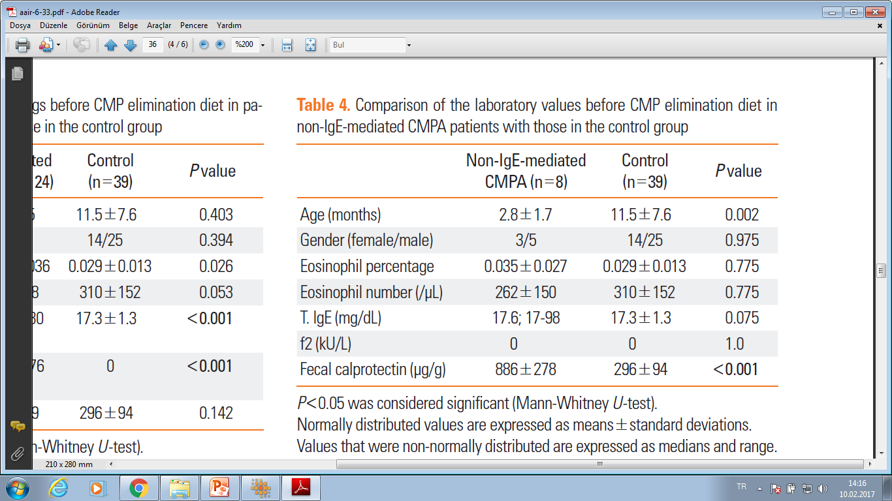

HANGİSİ DOĞRU 39 MU ?????
19 MU ?????
Notes:
İSTATİSTİKÇİ ARKADAŞIMA DANIŞTIM VE ÖNEMLİ BİR LİMİTASYON KONUSU OLABİLİR DEDİ AMA MAKALE DE BU LİMİTASYONDAN HİÇ BAHSEDİLMEMİŞ

Slide 4
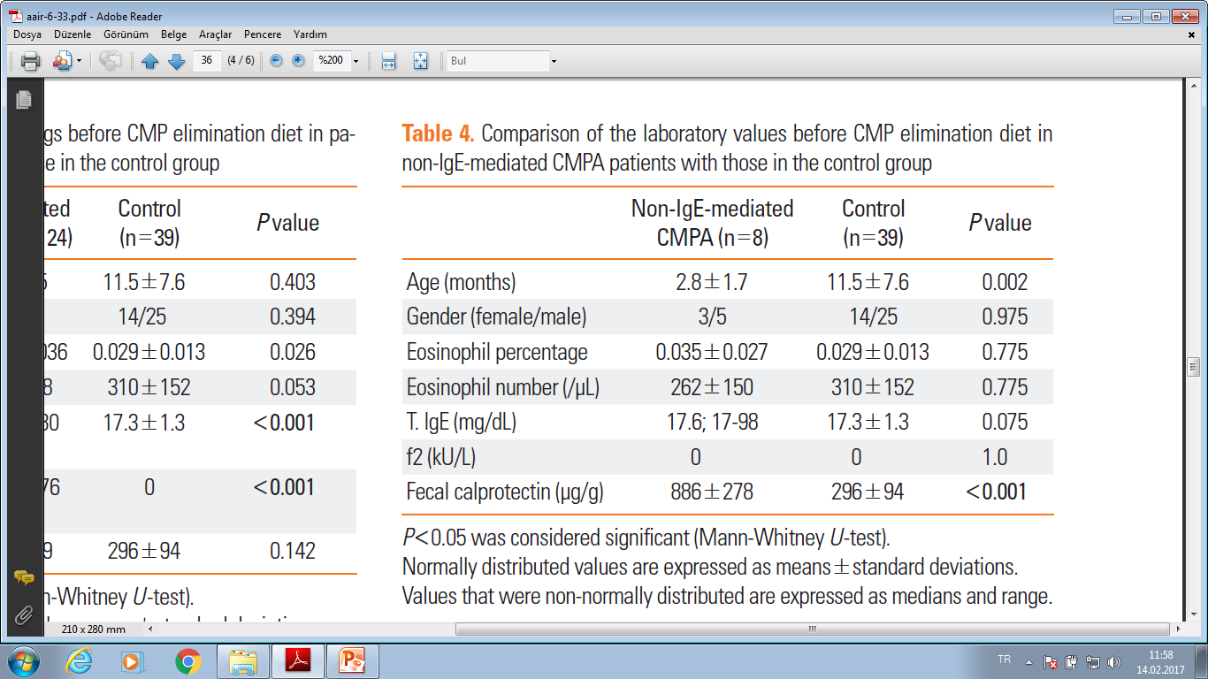
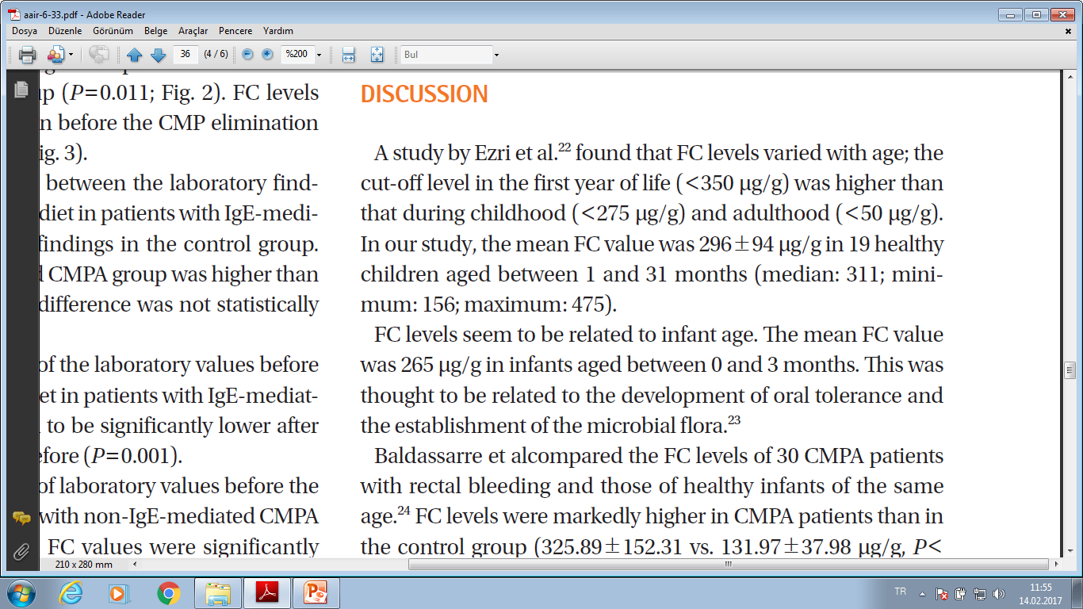
Notes:
çalışmNIN SONUÇLARINI TARTIŞMALI KILAN ÜÇÜNÇÜ KONU İSE VAKA-KONTORL GRUBUNUN YAŞLARI. LİMİTASYON OLARAK BUNDAN DA BAHSEDİLMEMİŞ. ORTALAMASI 3 AY OLAN ÇOCUKLAR , BESLENME ŞEKLİ NET OLARAK BELİRTİLMEMİŞ VE BARSAK FOLARASINDAN ETKİLENDİĞİ BELİRTİLEN KALPROTEKTİN SEVİYELERİ AY ORTALAMASI 12 AYLIK OLAN ÇOCUKLARLA KARŞILAŞRIRILMIŞ. İSTATİSTİKSEL ANLAMDA FARKLILIK VAR. DOĞRU BİR SONUÇ ÇIKMASI İÇİN YAŞ ORTALAMASI BENZER BİR GRUPLA YAPILMASI GEREKİRDİ.??????
Manystudies have shown that FClevels have a nonparametric distribution and should be evaluated with appropriate statistical tools.2-6 Nevertheless, the authors report FC concentration as mean SD because it was parametric, but no data are reported about distribution assessment. Although the P values are highly significant, they have not been obtained with the most proper statistical tools and might lose strength.

Slide 5
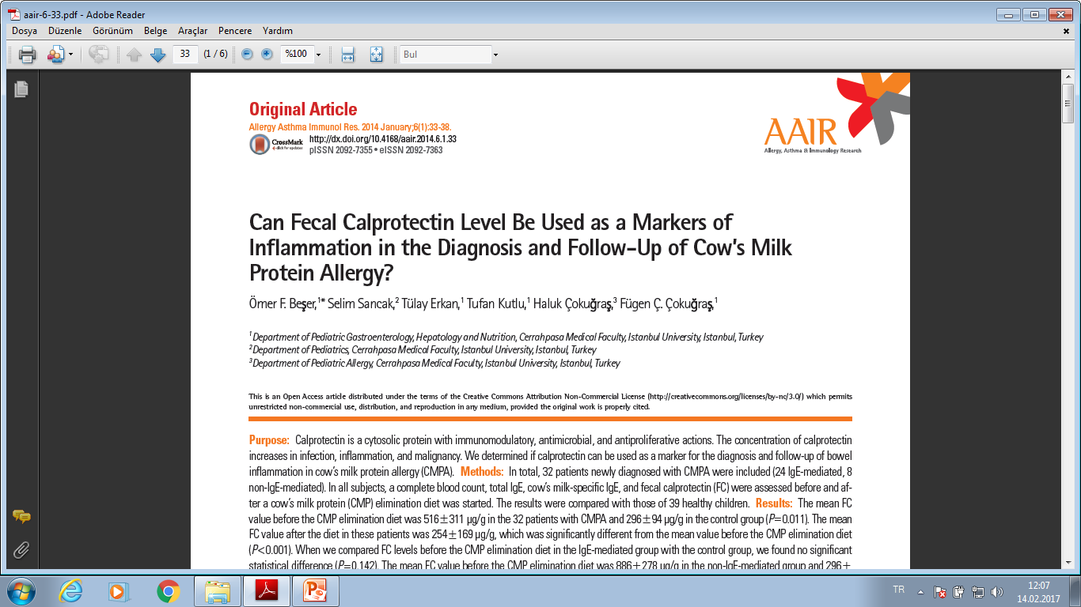
VAKA –KONTROL SAYILARINDAKİ ANLAMLI SAYI FARKLILIĞI ????????
VAKA-KONTROL GRUBUNDAKİ OLGULARIN YAŞ OLARAK HETEROJEN OLMASI ????
KONTROL GRUBUNDAKİ OLGULARIN BESLENME ŞEKLİNDEN BAHSEDİLMEMESİ???
DİĞER İNFLAMASYON BELİRTEÇLERİYLE KARŞILAŞTIRILMAMASI ??????
Notes:
ALFA-1 ANTİTİRPSİN, TNF –ALFA, BETA-DEFENSİN, SALGISAL IGA, EOZİNOFİL KAYNAKLI NÖROTOKSİN VE BENZERİ EOZİNOFİL KÖKENLİ MARKIRLAR YOK.

Slide 6


Slide 7
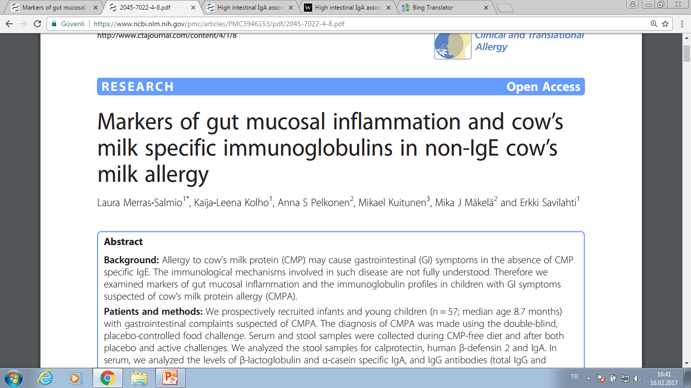
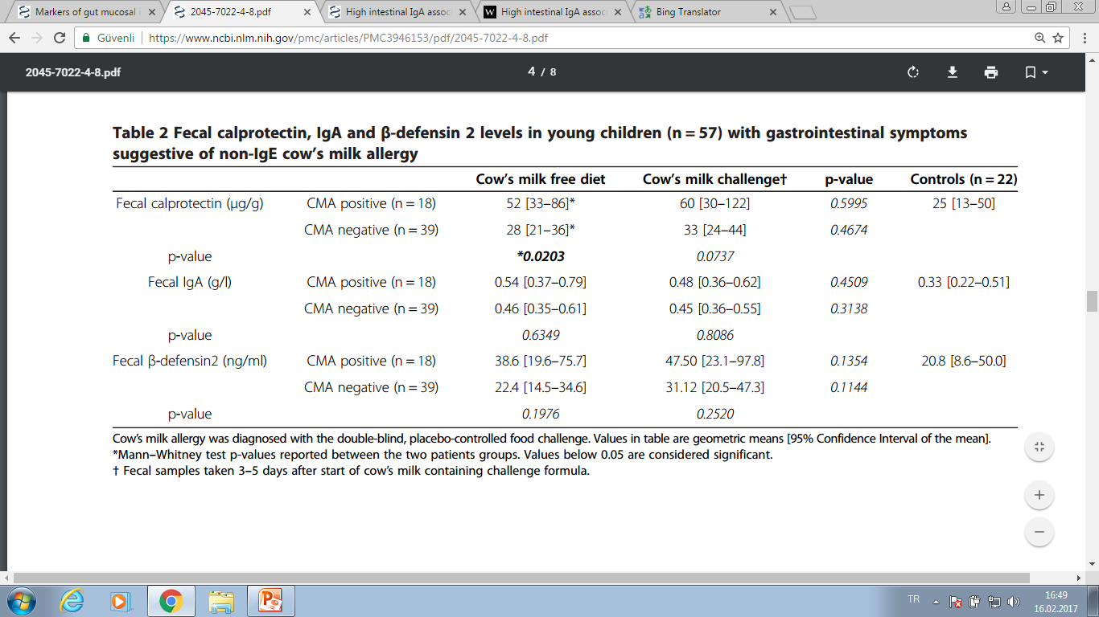

Clinical and Translational Allergy 2014, 4:8
Notes:
The within-group variation in calprotectin levels was high in both patient groups, compared to controls with a slightly higher median age. Fecal calprotectin correlated weakly with fecal IgA in the DBPCFC positive group (Spearman correlation coefficient 0.4583, p = 0.0567) and in the control group (Spearman correlation coefficient 0.5875, p = 0.0272), but not in the DBPCFC negative group.

Slide 8
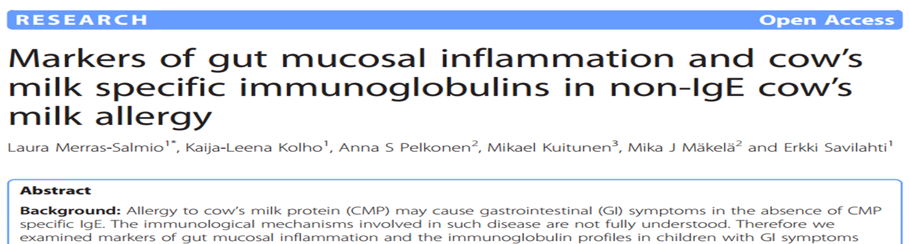
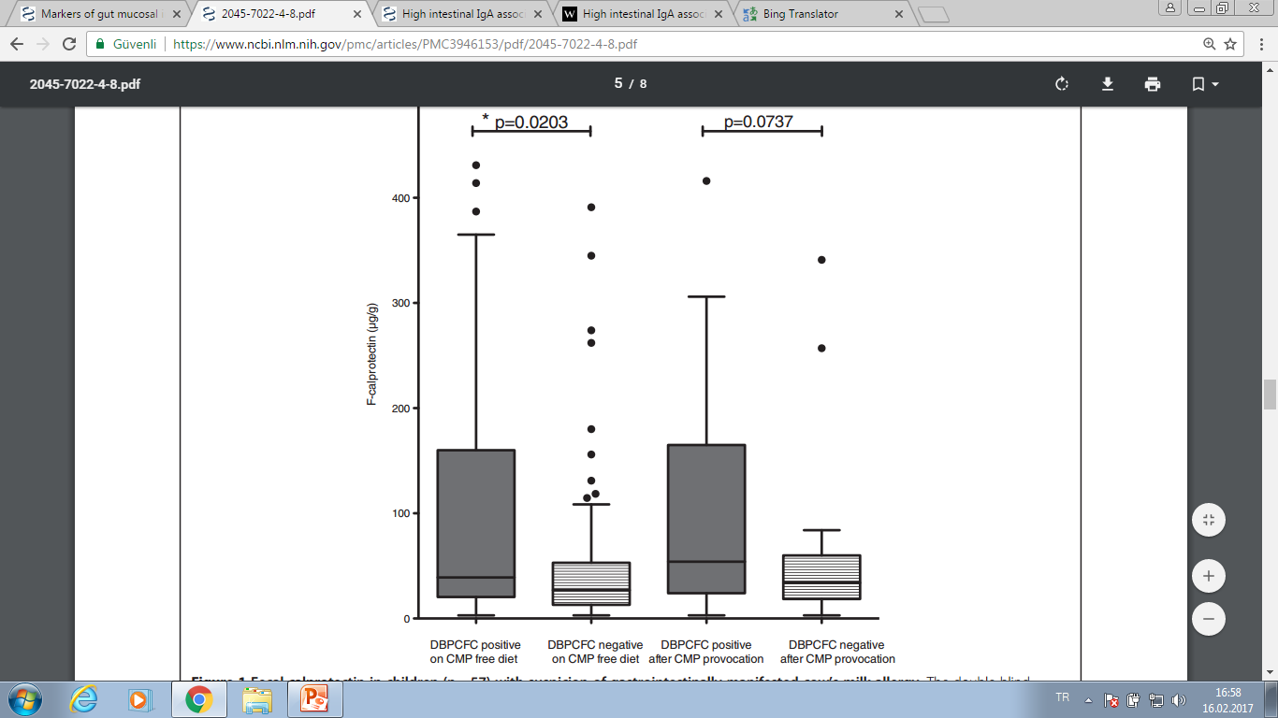

Notes:
The within-group variation in calprotectin levels was high in both patient groups, compared to controls with a slightly higher median
age. Fecal calprotectin correlated weakly with fecal IgA in the DBPCFC positive group (Spearman correlation coefficient 0.4583, p = 0.0567) and in the control group (Spearman correlation coefficient 0.5875, p = 0.0272), but not in the DBPCFC negative group.

Slide 9
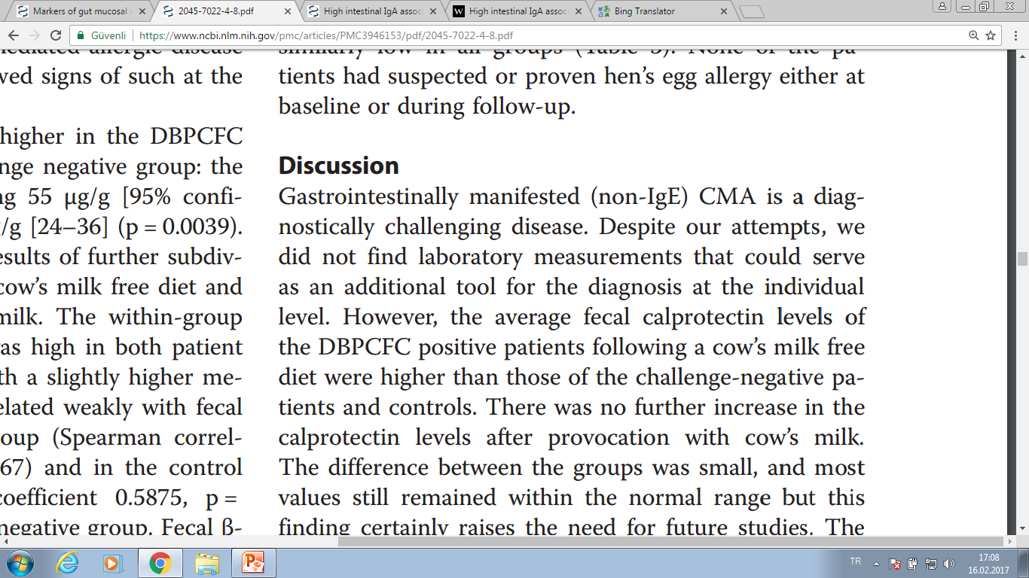
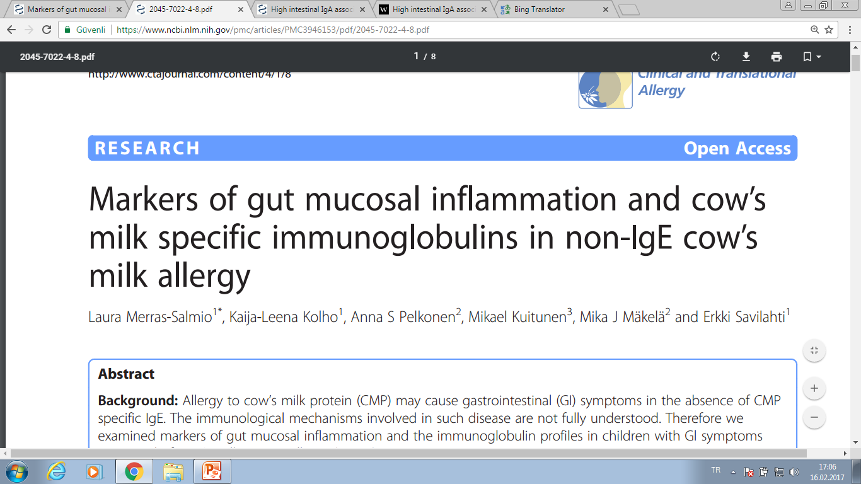
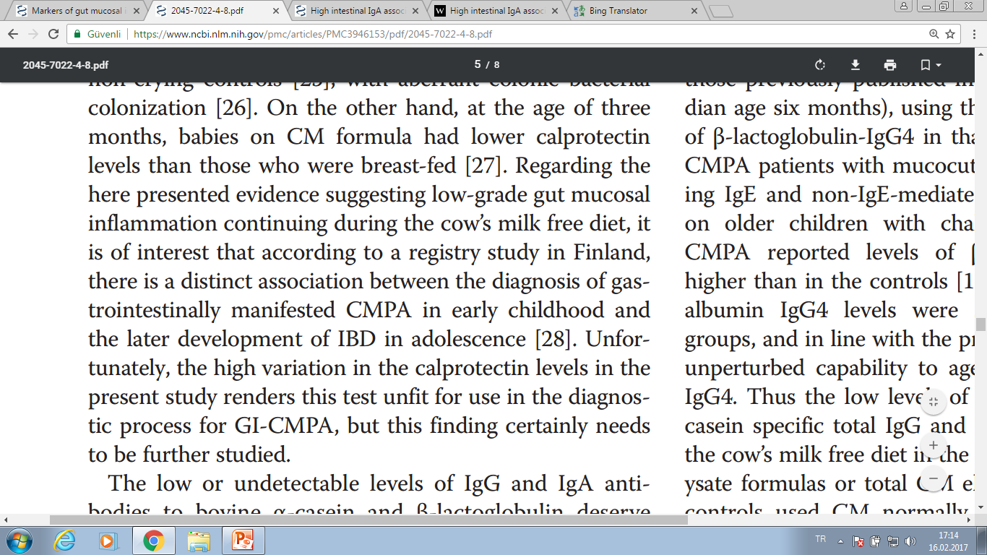

Slide 10

HAYIR Yani Ne olmuş kardeşim AHMET’ İ YEDİYSEM

Slide 11
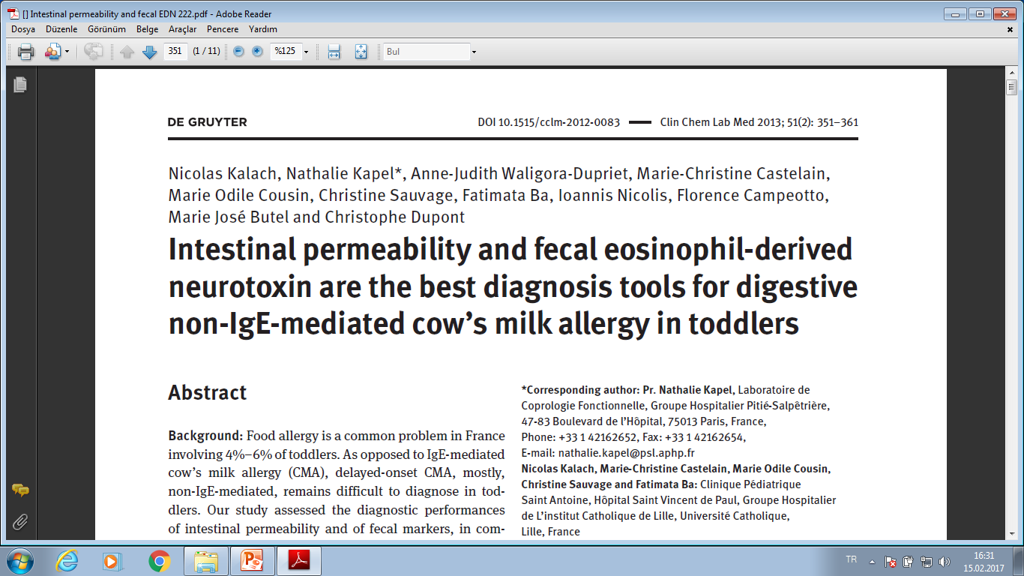
Clin Chem Lab Med 2013; 51(2):
yaş ortalaması 6 ay olan 11 Non_IgE aracılı inek sütü alerjisi çocukta;
Yaş ortalaması 7 ay olan 14 kontrol çocukta;
Prospektif olarak 1 yıl boyunca;
Yama testleri, fekal calprotectin, fekal EDN, fekal s- IgA, intestinal permabilite testi, Alfa-1 antiripsin, TNF-α, β-defensin,
Notes:
Neden kalprotektin tercih ediliyor ??? Merak ediyorum , çok kolay mışşş, ve çok pahalıymışşşşş?????
hepsinde oral yükleme ile inek sütü alerjisi TANISI ALMIŞ work-up (specific cow’s protein IgE and Ig G, skin prick test, atopy patch test and oral open cow’s milk challenge) and digestive work-up including fecal microbiota analysis, intestinal permeability determination (urinary lactitol/mannitol ratio) and fecal markers measurement, i.e., α1-antitrypsin, tumor necrosis factor-α, calprotectin, β-defensin2, secretory IgA and eosinophil-derived neurotoxin (EDN). Receiver operating characteristic (ROC) curves were calculated for all markers in order to define cut-off levels
FRANSADAN YAPILMIŞ BİR ÇALIŞMA Intestinal permeability (IP), which compares the urinary excretion of two orally absorbed non-metabolizable
sugars, lactitol (L), a marker of larger molecule absorption and mannitol (M), a marker of small molecule absorption, is altered during small intestinal suffering [9–11]. IP has been shown to be modified in adults and in children with food allergy: the offending food decreasing M urinary excretion and increasing both L excretion and L/M ratio, a phenomenon that occurs during both digestive and cutaneous manifestations [12, 13].
Fecal markers evaluate non-invasively the

Slide 12
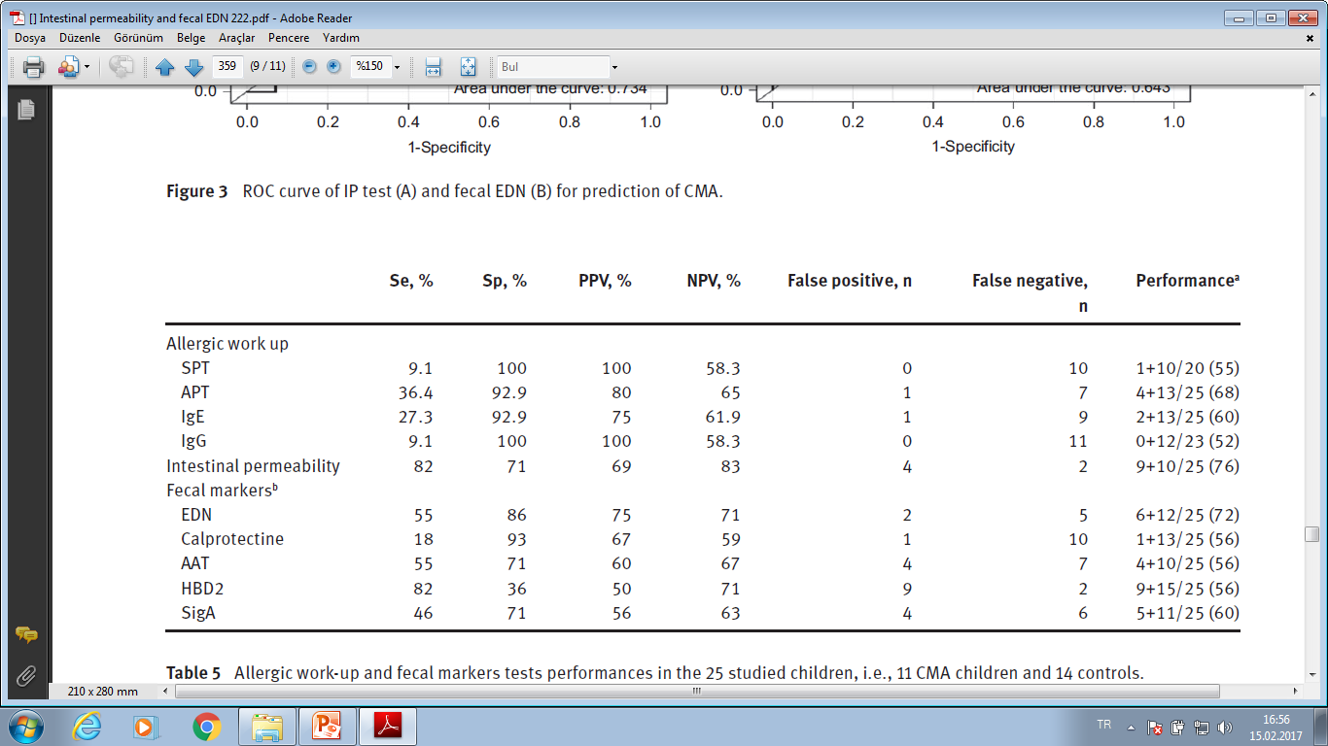
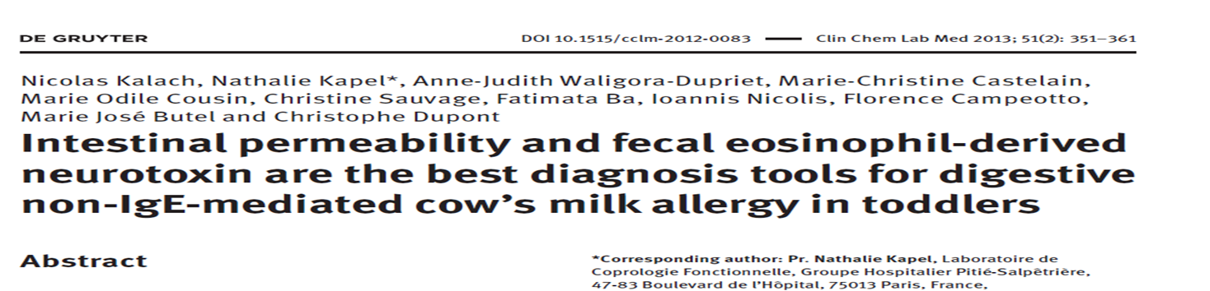
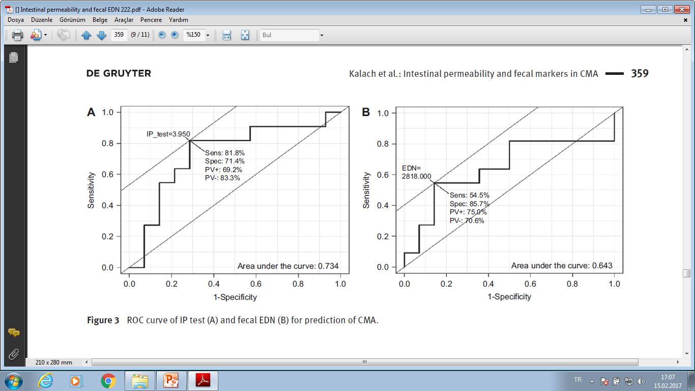
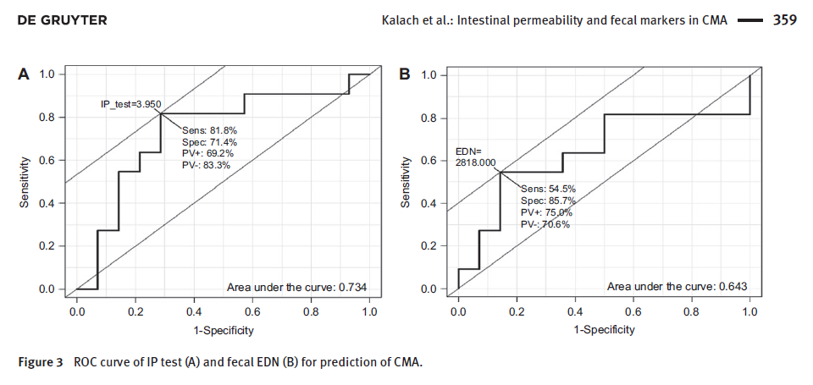




Notes:
Her iki parametreyi birlikte kullandığınızda %85 oranında tanı koyma imkanınız vardır IP ve EDN yi eele alırsanız

Slide 13
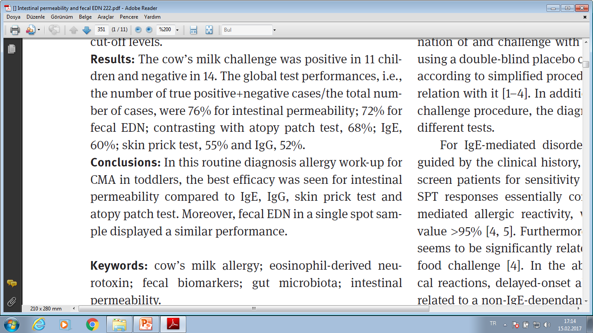

Notes:
Tüm bu markırlar yerine spot gaita analizinde EDN daha hassas bulunmuştur. Fekal kalprotektinden bahsedilmemmiş bileeeeeeee

Slide 14
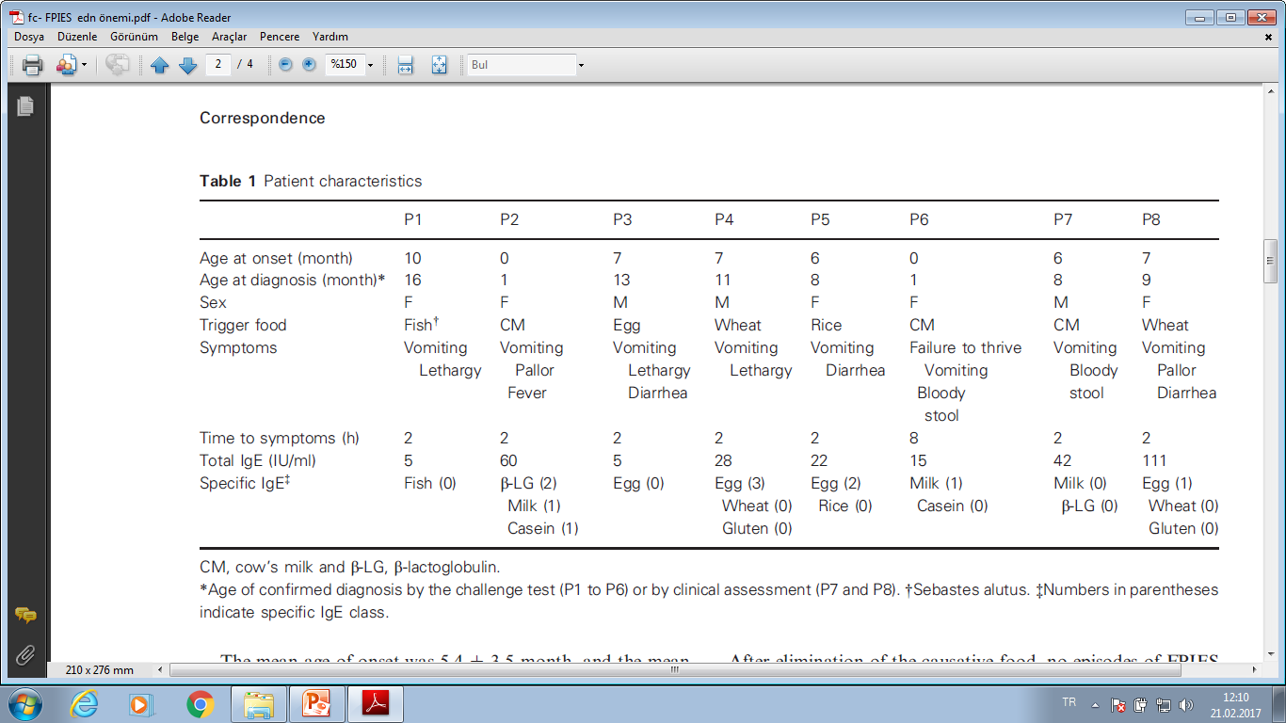
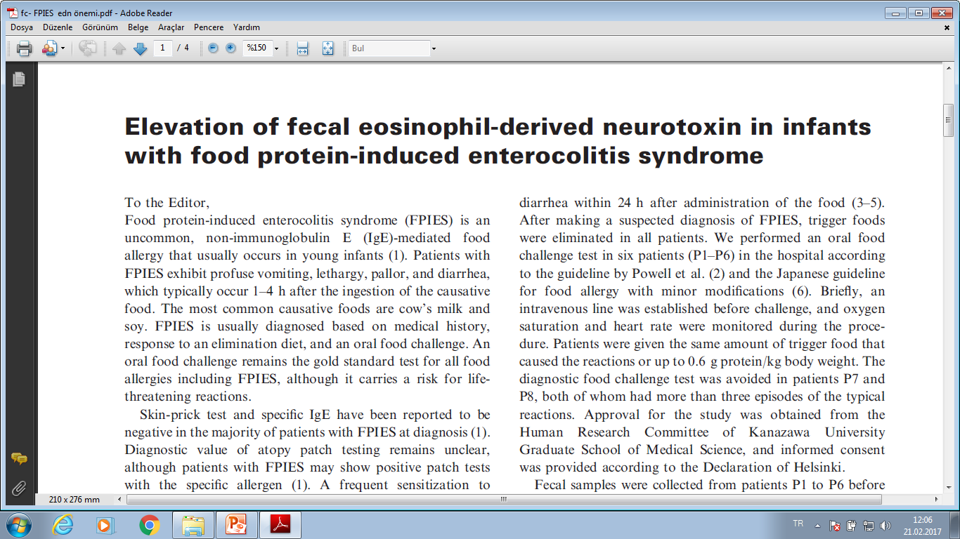
Pediatric Allergy and Immunology 25 ;2014
Notes:
Konu besin alerjisi olduğundan almayı uygun buldum. Bir diğer non-Ige ARACILI besin alerji hastalığı olan FPIES içinde pratik tanı metodlarından olduğu için önemli.
We studied eight Japanese patients affected with FPIES (Table 1). The diagnosis of FPIES was based on the previously established criteria: (i) repeated exposure to the incriminated food elicits repetitive vomiting and/or diarrhea within 24 h, without any other cause for the symptoms; (ii) symptoms are
limited to the gastrointestinal tract; and (iii) removal of the offending protein from the diet results in resolution of symptoms and/or a food challenge elicits vomiting and/or diarrhea within 24 h after administration of the food (3–5).

Slide 15
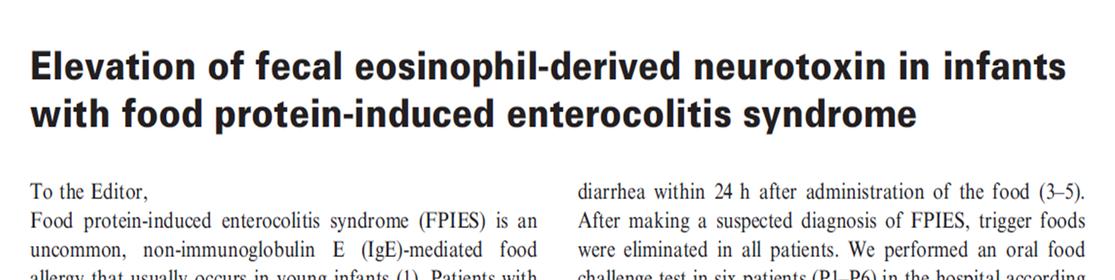
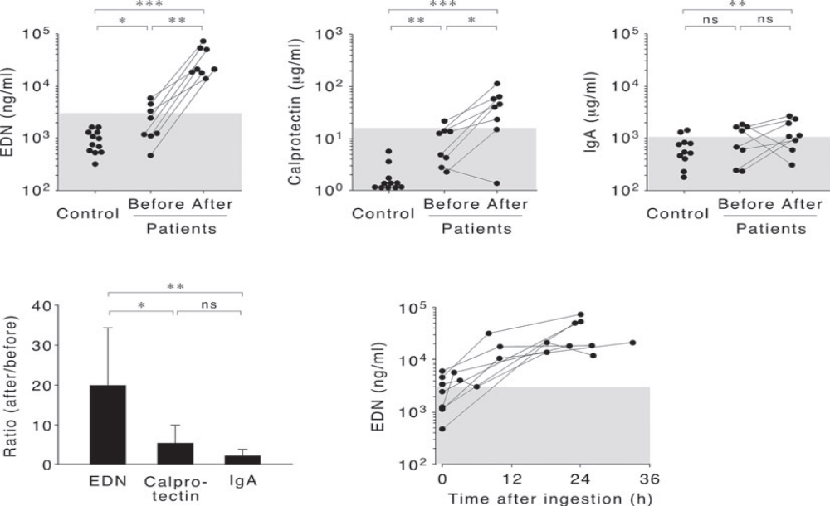
Pediatric Allergy and Immunology 25 ;2014
Notes:
The mean age of onset was 5.4 3.5 month, and the mean time to diagnosis was 3.0 2.1 month. The common symptoms were vomiting (8/8), diarrhea (3/8), and lethargy (3/8). Most patients (7/8) developed symptoms 2 h after the ingestion. All six of the patients who underwent the food challenge
test exhibited typical reactions of FPIES, which did not differ from their medical history derived from the accidental ingestion of the causative food.

Slide 16
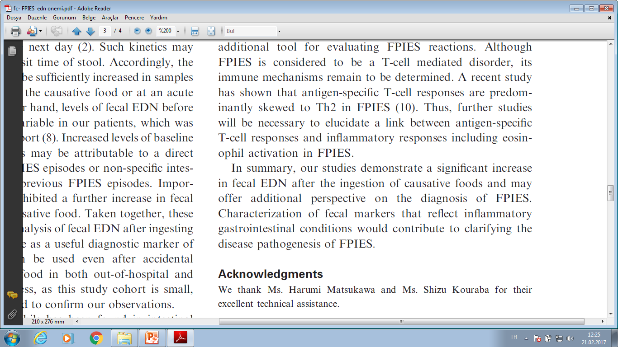
Pediatric Allergy and Immunology 25 ;2014

Slide 17

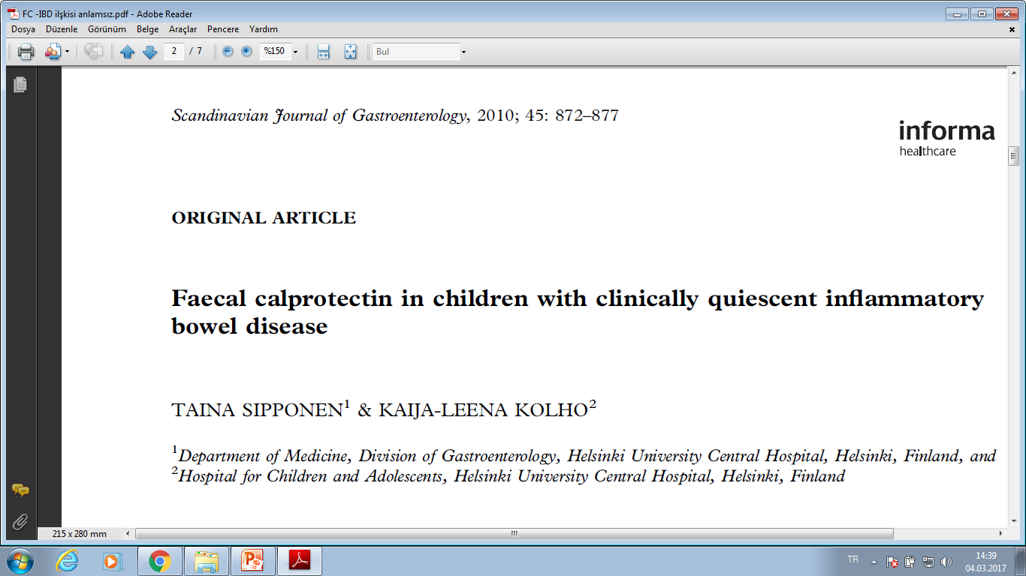
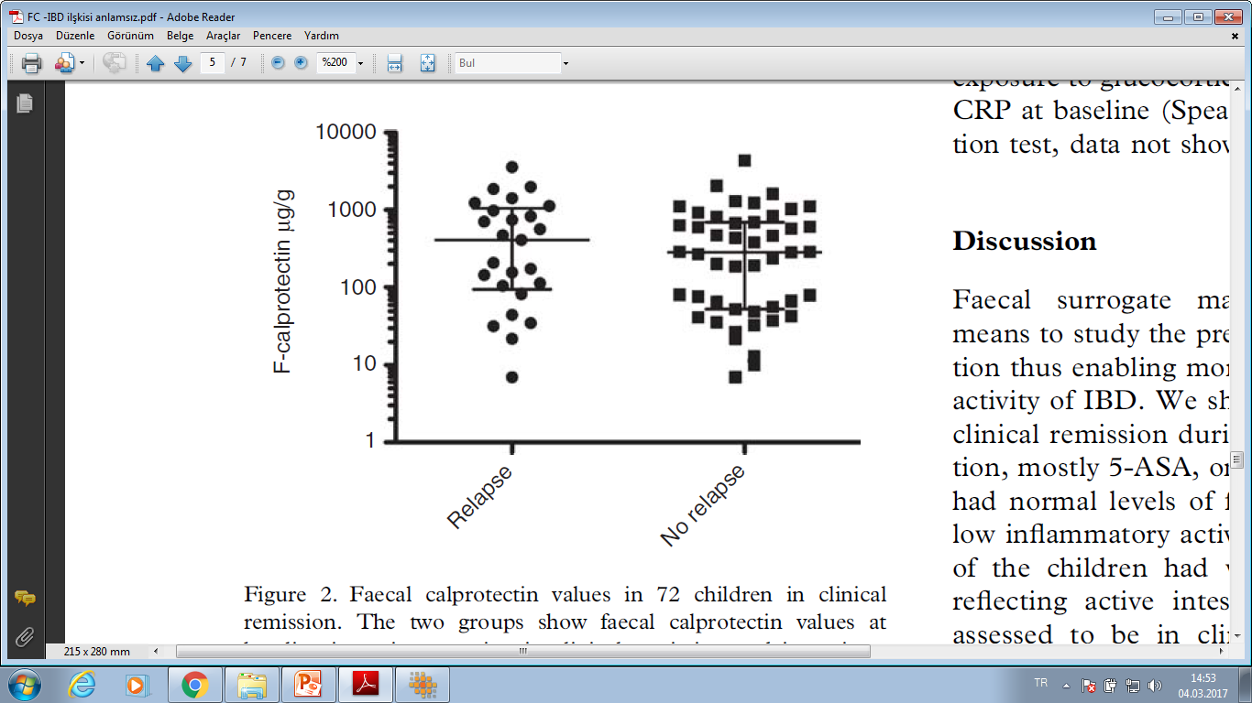
Conclusions:. In paediatric IBD, subjective symptoms and clinical assessment associate poorly with the levels of faecal calprotectin.
Scandinavian Journal of Gastroenterology, 2010; 45:
Notes:
Faecal calprotectin level was measured in 72 children with paediatric IBD in clinical remission (median age 13 years). Of these, 37 children had been in clinical remission for more than a year, 20 for 6–12 months and 15 for 3 to <6 months. The clinical outcome of the patients was followed up to the first relapse or up to 12 months. Results:::When in clinical remission, 35% (25/72) of the children had normal faecal calprotectin (<100 mg/g) and 13% (9/72) a very high level (>1000 mg/g) while not reporting symptoms. A clinical relapse occurred in 35% (25/72) during the subsequent 12 months. When in clinical remission, the predictive value of faecal calprotectin for an overt relapse was low ranging from 0.396 to 0.429 for faecal calprotectin values >100 mg/g or >1000 mg/g, respectively.

Slide 18


Duydum ki kakam ile çok ilgileniyormuşsun AHMET

Slide 19
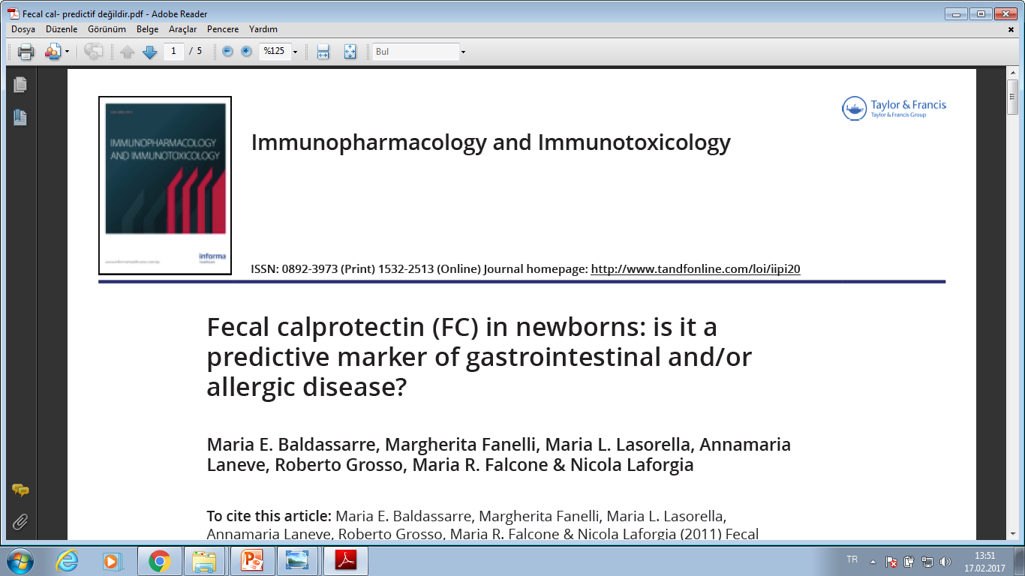
Immunopharmacol and Immunotoxi 2011; 33(1):
Sağlıklı 109 yeni doğan
İlk 1 ay içinde 1 hafta ara ile 4 kez fekal kalprotektin ölçümü
2 yıl izlem ve 2 yıl sonunda alerjik hastalık gelişimi karşılaştırlıyor
Notes:
Tahmin ediyorum bu işin 2.adımı bu testi yaptırarak ileriye yönelik alerji tahminlerinde bulunmak olacaktır ?????
Ancak araştırmalar bu gibi tahminlerin önünü daha önceden kesmiş ama bizim haberimiz olmayabilir Haberiniz olsun diye şimdiden söylüyoruzzzzzzzzzzzzzz?????

Slide 20
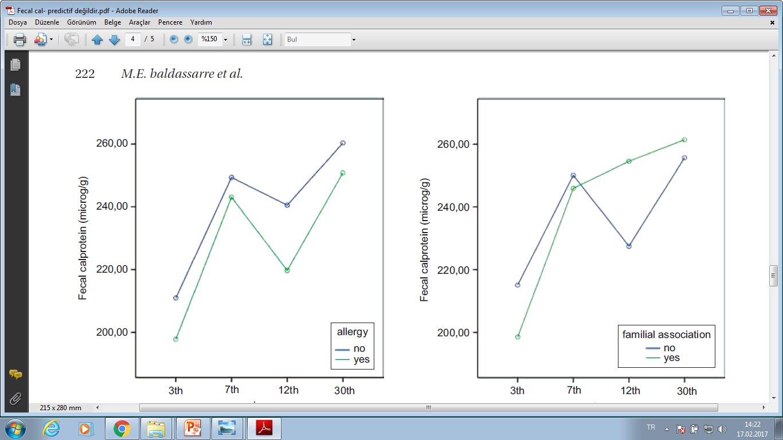
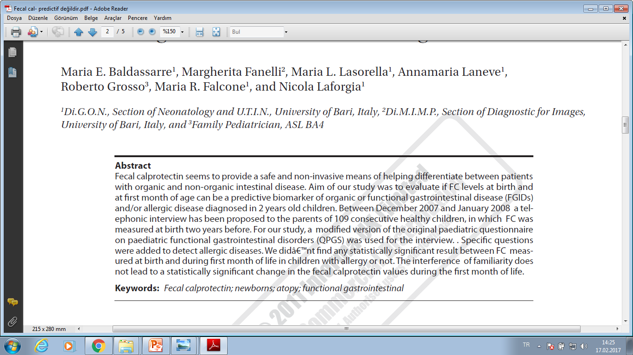
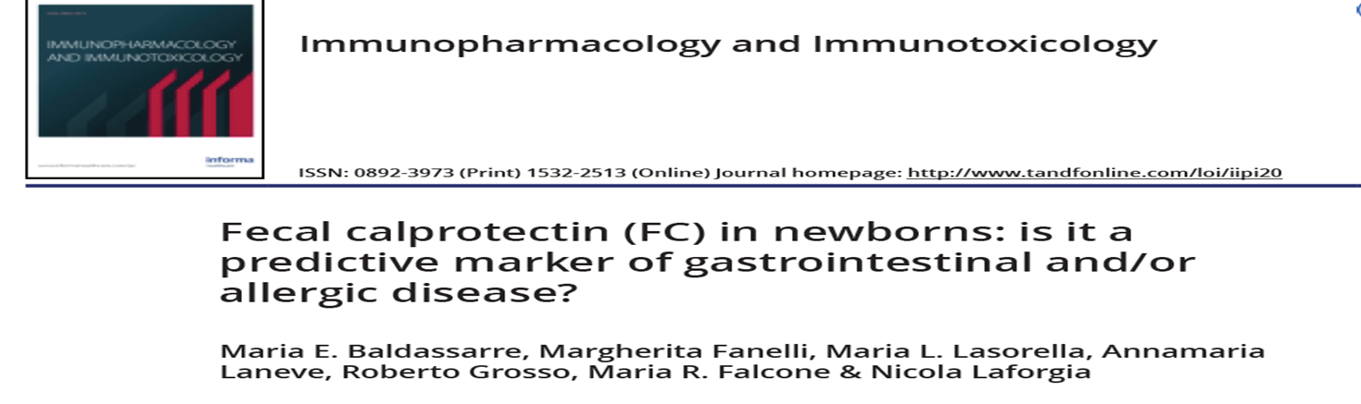
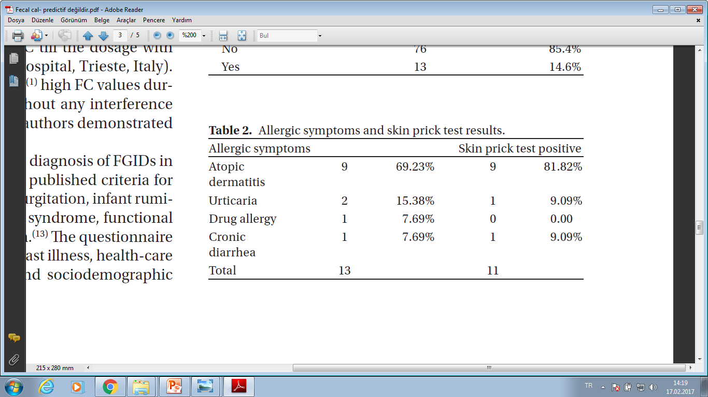
Notes:
Our study aimed to test the predictive value of calprotectin measured at birth as a possible marker of allergic predisposition in the first 2 years of age. The comparison of calprotectine concentration at birth did not lead to any statistically significant result in allergic vs. non-allergic children at 2 years of age. The levels of FC in the first month of life are not influenced

Slide 21
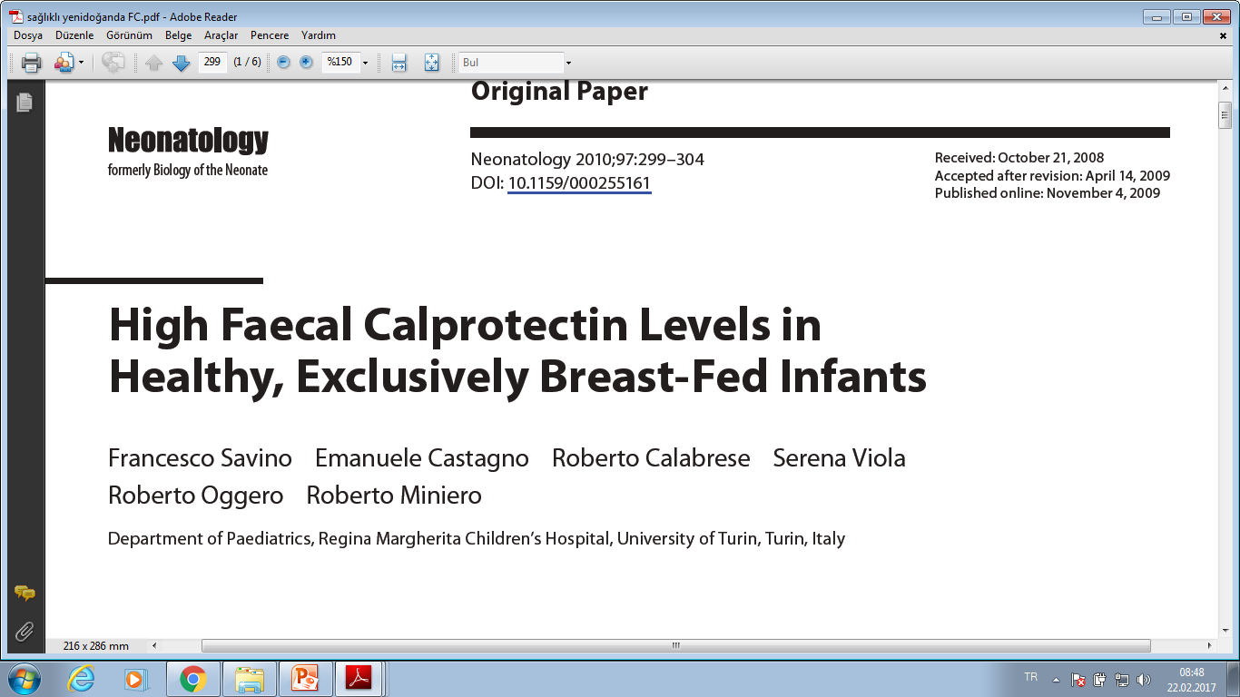
Neonatology 2010;97:299
Sağlılklı 74 yenidoğan, ortalama yaş 50 gün ( 13-90 gün )
Sadece anne sütü alan 39 olgu
Sadece mama ile beslenen 35 olgu
Notes:
Salona sormak lazım ??? Sizce alerjiyi veya inflamasyonu tetiklemesi açısından hangi grup ta daha yüksek olması gerekir??????
Stool samples were obtained from 74 healthy infants (39 exclusively BF and 35 exclusively FF) with a median age of 51 days (range 13–90). Exclusion
criteria were acute infections and treatment with anti-inflammatory drugs. Stool samples were stored at –20 ° C until they were analysed, and the faecal calprotectin concentration was detected using a commercial quantitative enzymelinked immunoassay (Calprest; Eurospital SpA, Trieste, Italy).

Slide 22

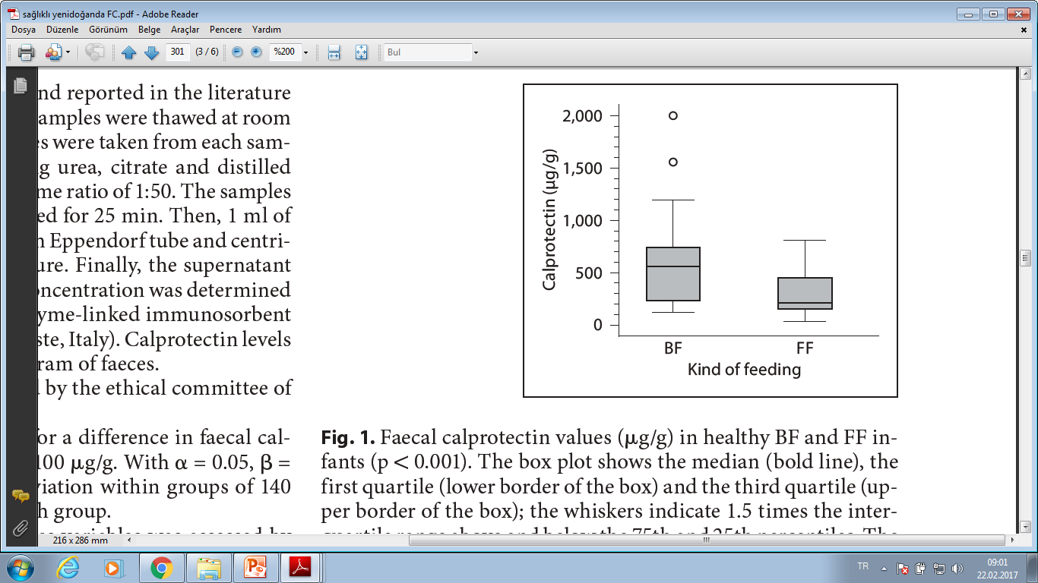
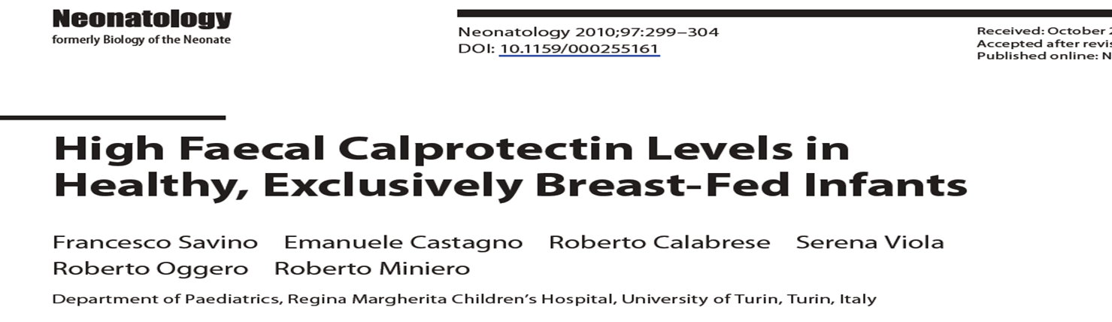
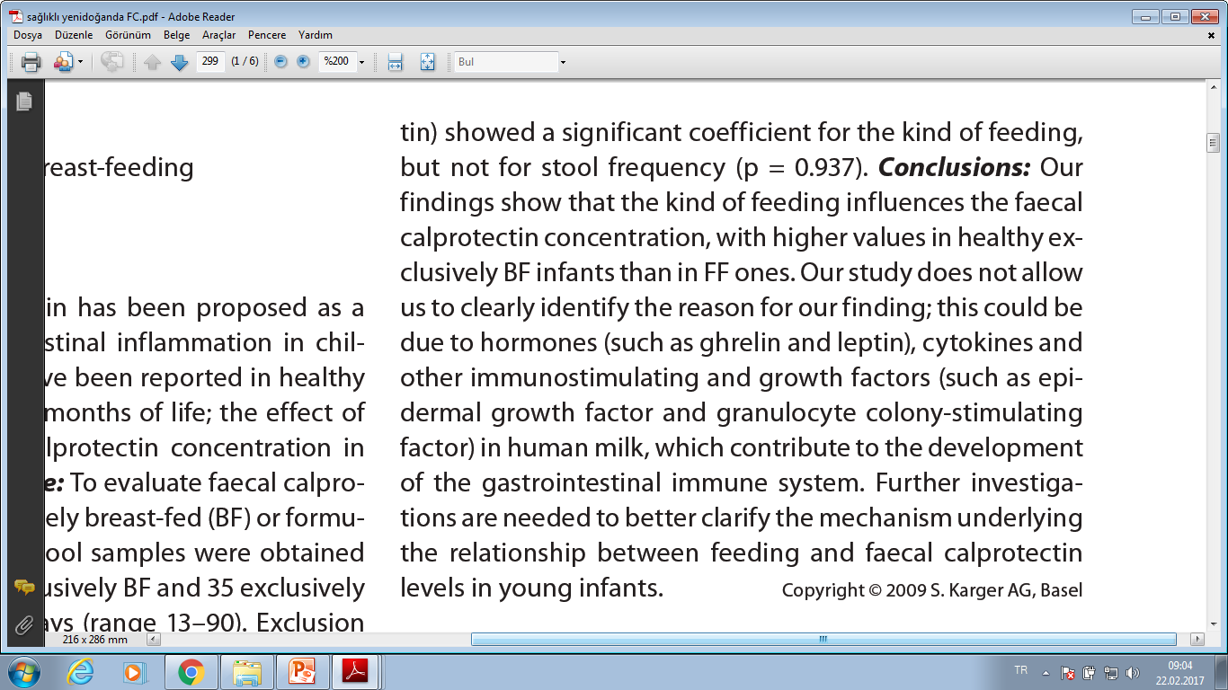
Notes:
Exclusion criteria were: any intake of steroidal or non-steroidal anti-inflammatory drugs, antibiotics or any other drug during the 2 weeks before recruitment; mixed breast-feeding and formula-feeding; intake of any kind of formula other than standard starting formula, such as those with added probiotics, prebiotics, long-chain polyunsaturated fatty acids, thickening agents and/or hydrolysed proteins, and any sign or symptom of infection or gastrointestinal
disease (diarrhoea, vomiting, fever, failure to thrive). Infantile colic (defined as excessive crying in an otherwise healthy, thriving infant with normal weight gain) was not considered among the exclusion criteria, as no difference has been observed between colicky infants and healthy ones with regard to faecal calprotectin

Slide 23




Burnuma kalprotektin
kokusu geliyor
Bırak Aaamet Hocam ya,
Ne kapproteşşini yaa,
Bildiğin kaka kaka

Slide 24
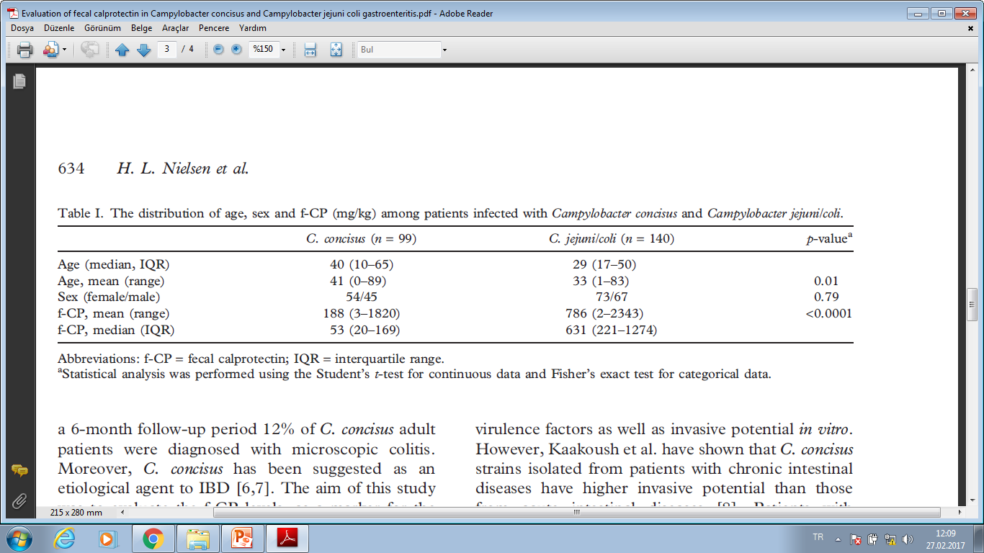
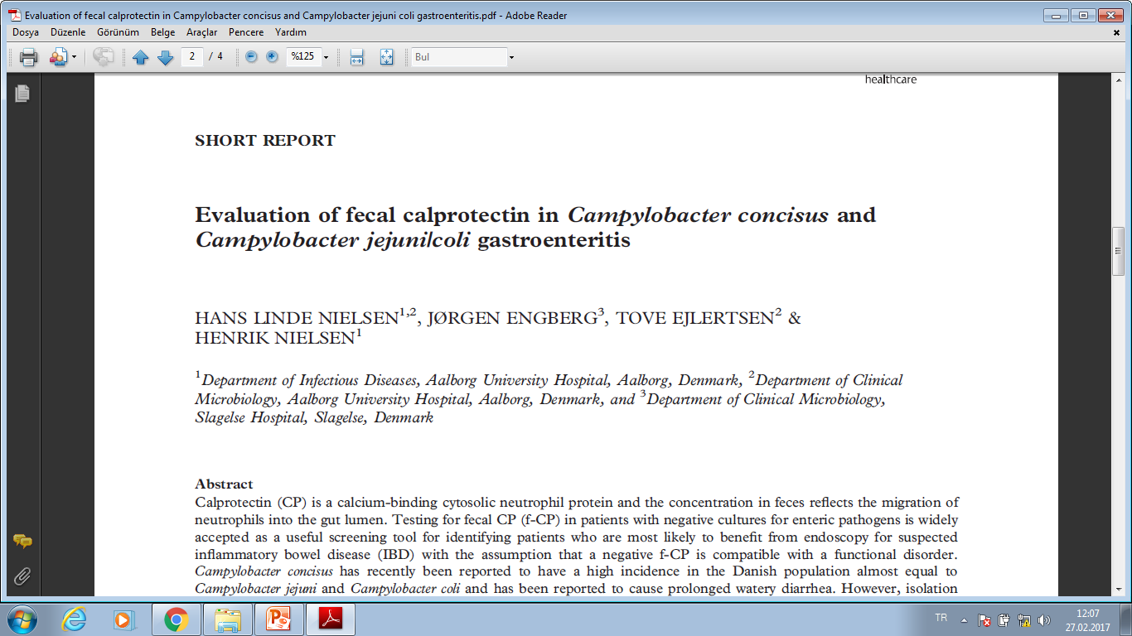
Fekal kalprotektinin ANORMAL olduğu HASTALIKLAR
Notes:
The aim of this study was to evaluate the f-CP levels, as a marker for the intestinal inflammation in C. jejuni/coli- and C. concisus-infected patients. The authors found a high concentration of f-CP (median 631: IQR 221–1274) among 140 patients with C. jejuni/coli infection, whereas the f- CP level among 99 C. concisus-infected patients was significantly lower (median 53: IQR 20–169). The data correlate to the severe inflammatory gastroenteritis seen in patients infected with C. jejuni/coli, whereas C. concisus-infected patients have a much lower intestinal inflammation which could be compared with viral gastroenteritis. Nevertheless, clinicians should be

Slide 25
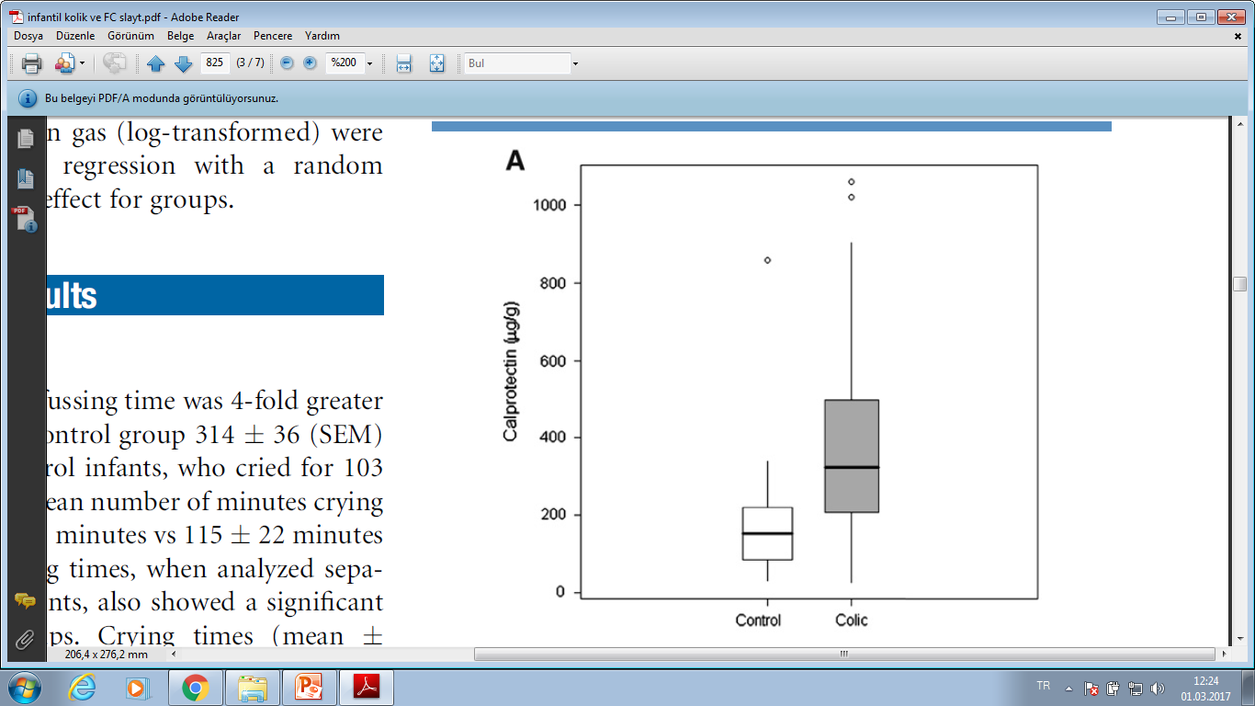
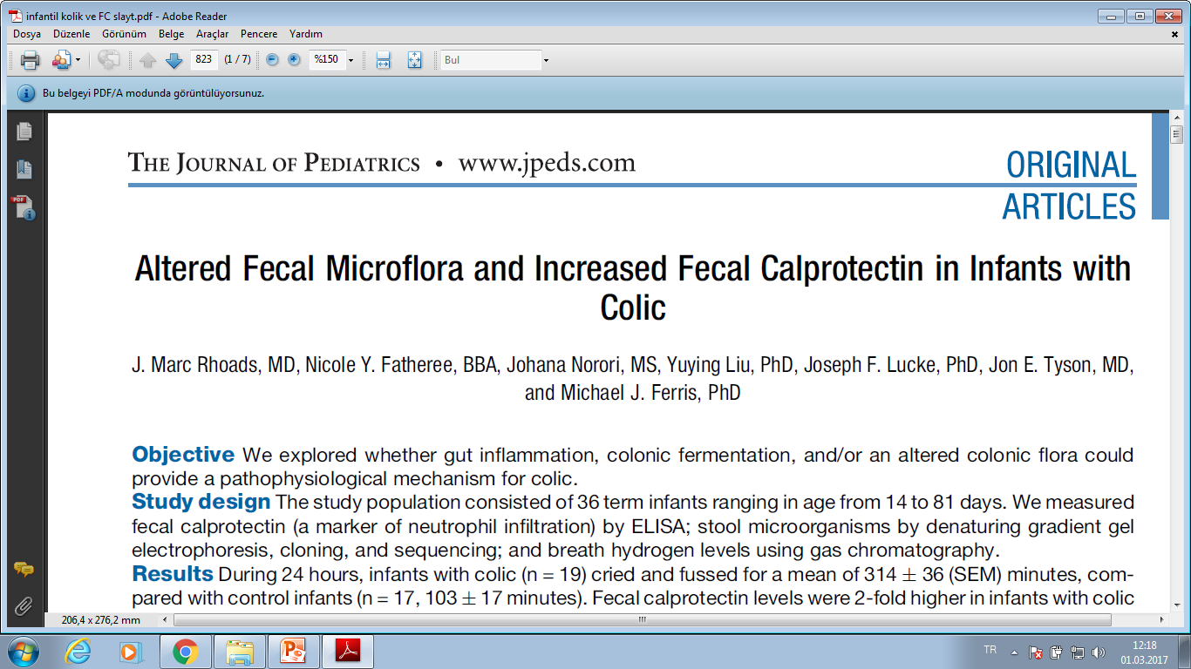
J Pediatr 2009;155:823-8).
Notes:
The study population consisted of 36 term infants ranging in age from 14 to 81 days. We measured fecal calprotectin (a marker of neutrophil infiltration) by ELISA; stool microorganisms by denaturing gradient gel electrophoresis, cloning, and sequencing; and breath hydrogen levels using gas chromatography.
Results During 24 hours, infants with colic (n = 19) cried and fussed for a mean of 314 36 (SEM) minutes, compared with control infants (n = 17, 103 17 minutes). Fecal calprotectin levels were 2-fold higher in infants with colic than in control infants (413 71 vs 197 46 mg/g, P = .042). Stools of infants with colic had fewer identifiable bands on denaturing gradient gel electrophoresis. Klebsiella species were detected in more colic patients than in control
patients (8 vs 1, P = .02), whereas Enterobacter/Pantoea species were detected only in the control patients. These differences could not be attributed to differences in formula versus breast milk feeding, consumption of elemental formula, or exposure to antibiotics. Conclusions Infants with colic, a condition previously believed to be nonorganic in nature, have evidence

Slide 26
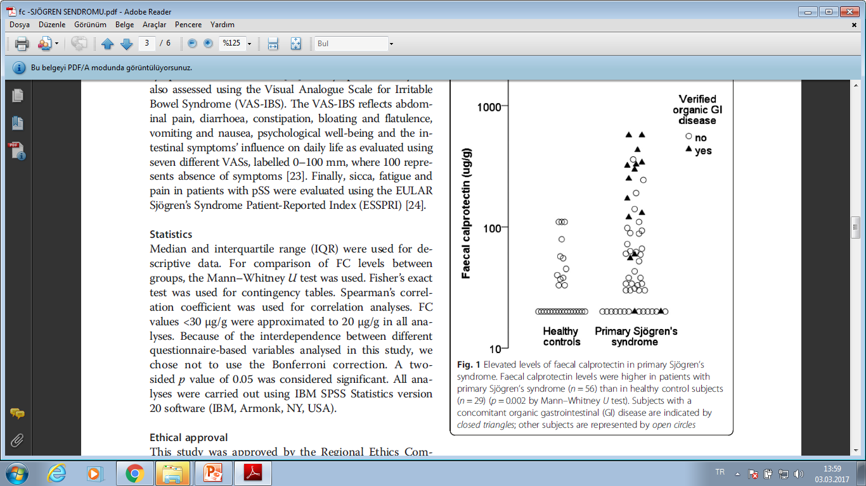
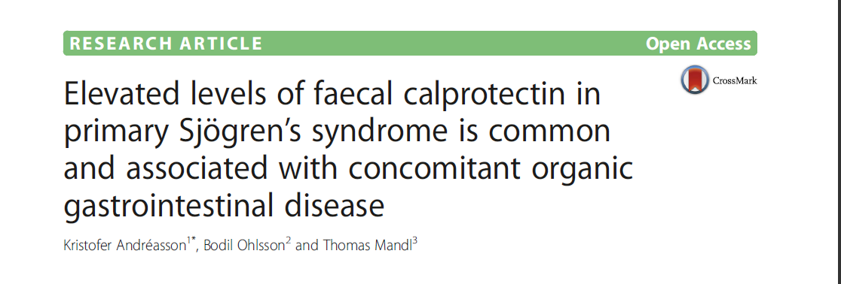
Notes:
In total, 56 consecutive patients with pSS and 29 healthy control subjects were included in this cross-sectional study. FC was measured with a commercially available enzyme-linked immunosorbent assay kit. GI symptoms were evaluated with the Rome III questionnaire and the Visual Analogue Scale for Irritable Bowel Syndrome. In patients with pSS, disease activity was estimated using the European League Against Rheumatism (EULAR) Sjögren’s Syndrome Disease
Activity Index (ESSDAI), and patient-reported outcomes were evaluated with the EULAR Sjögren’s Syndrome Patient

Slide 27
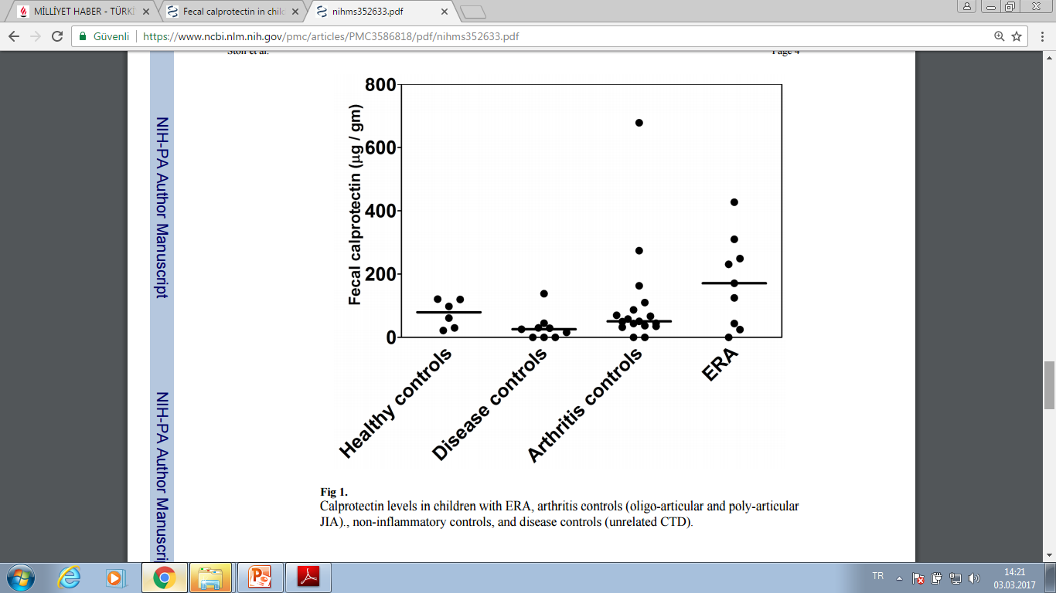
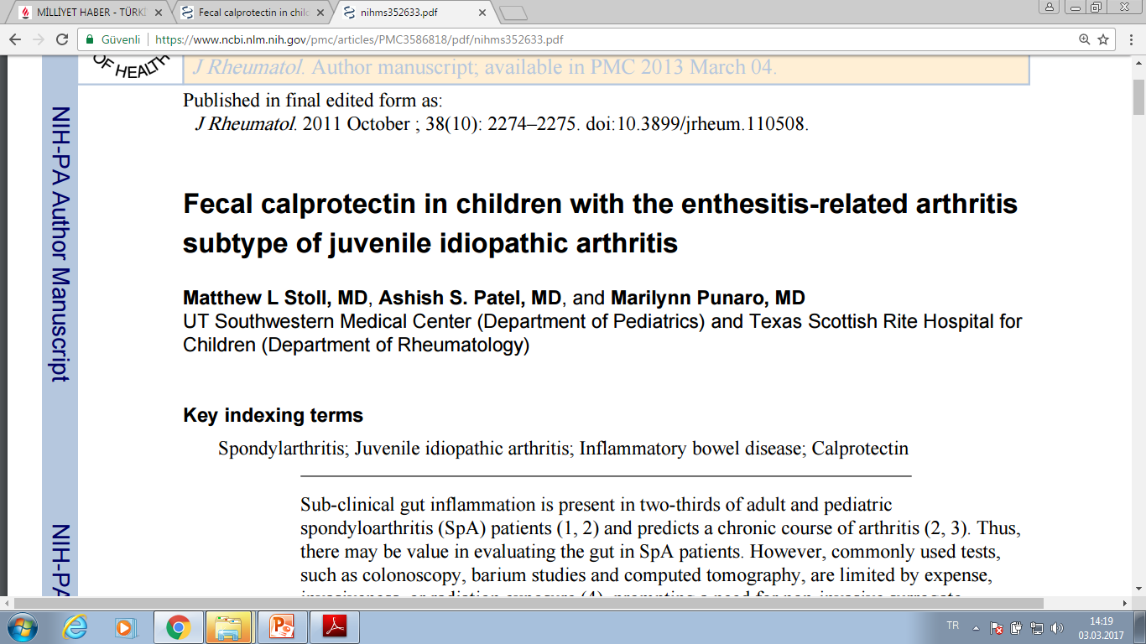
Notes:
The primary implication of this study is that a safe and non-invasive test can be used to evaluate for sub-clinical gut inflammation in arthritis patients. In addition, we confirm prior studies showing evidence of gut inflammation in children with SpA (2). This study has several limitations. Our sample size is relatively small, and reflected pati

Slide 28
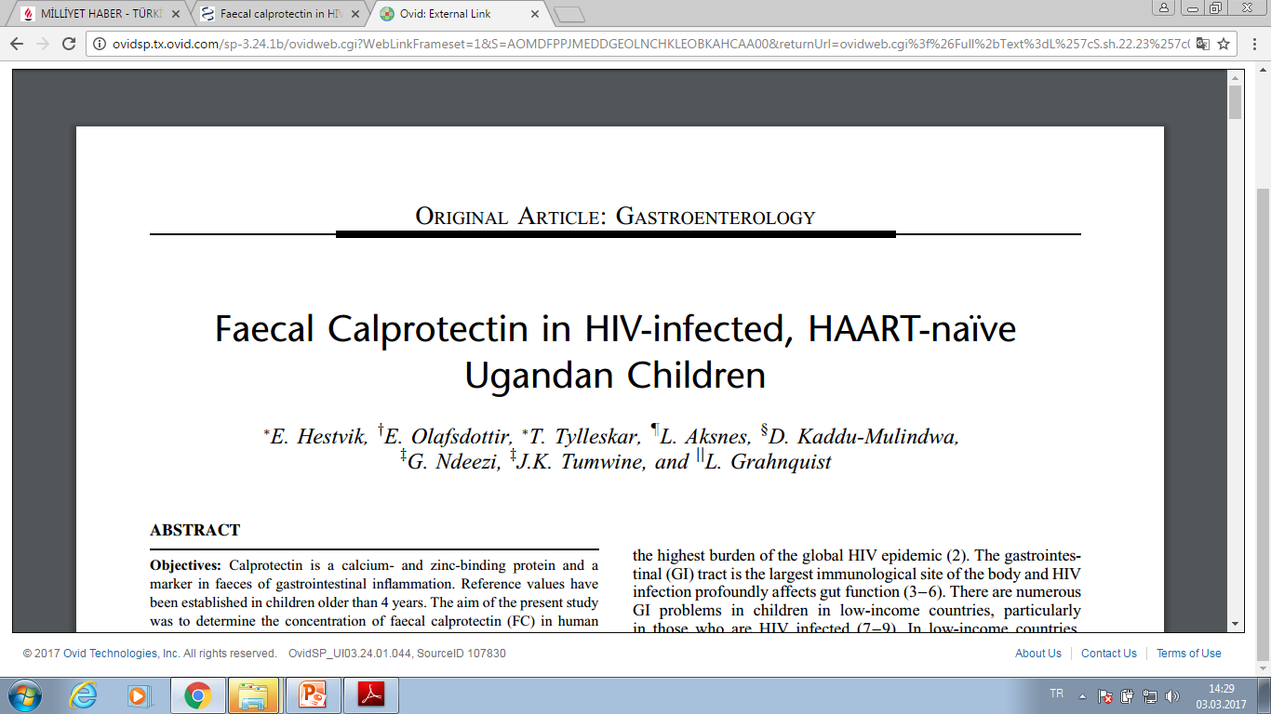
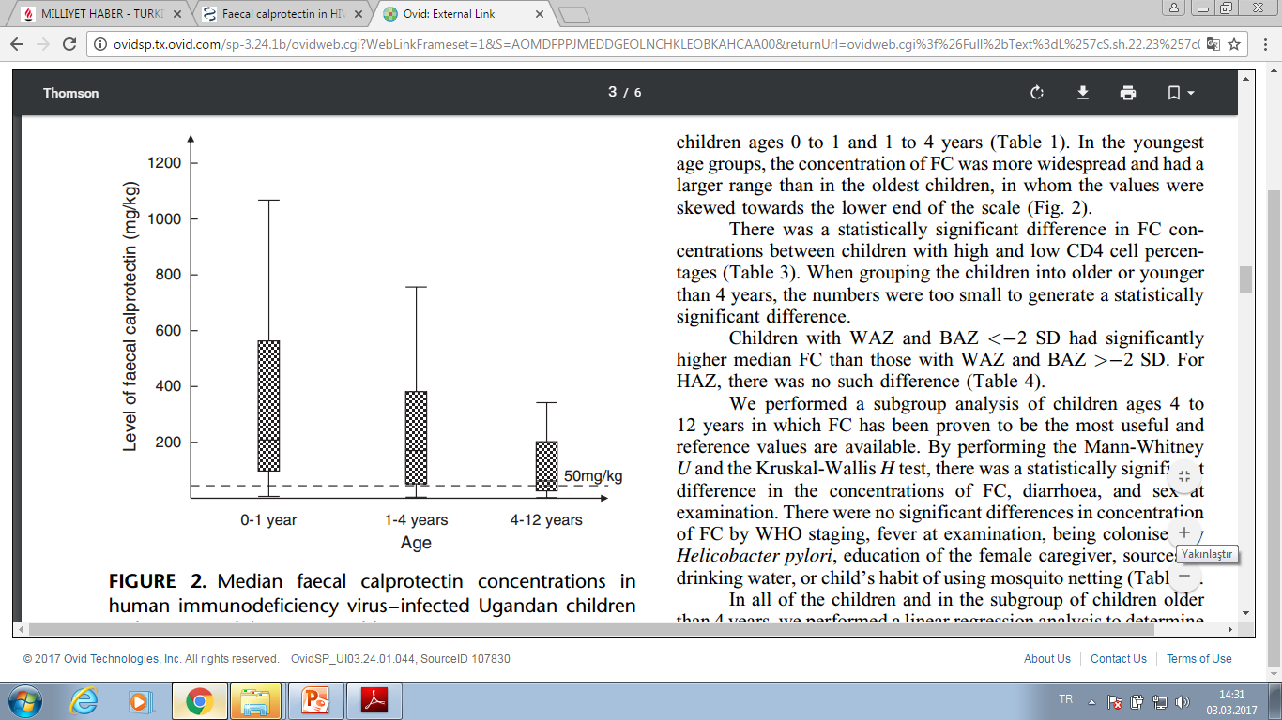
Notes:
Methods: We tested 193 HIV-infected children ages 0 to 12 yearsin a hospital-based survey for FC. A standardised interview with sociodemographic information and medical history was used to assess risk factors. A cluster of differentiation 4 (CD4) cell percentage was prevalent in all of the children.
conclusion: HIV-infected children older than 4 years had a median FC concentration above the reference value, and gut inflammation in the children with elevated values is likely. Children with more advanced disease had increased FC concentrations regardless of age.

Slide 29
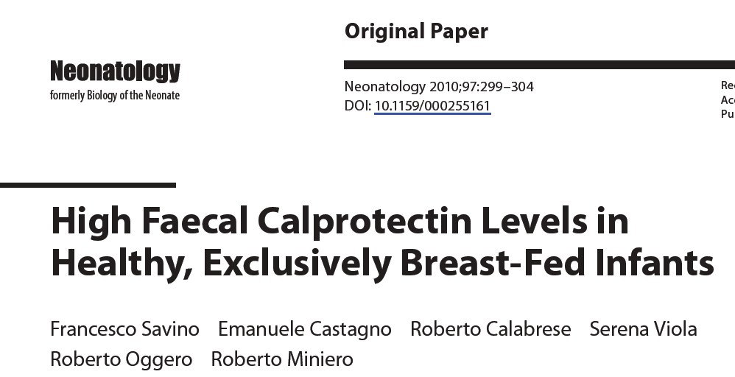
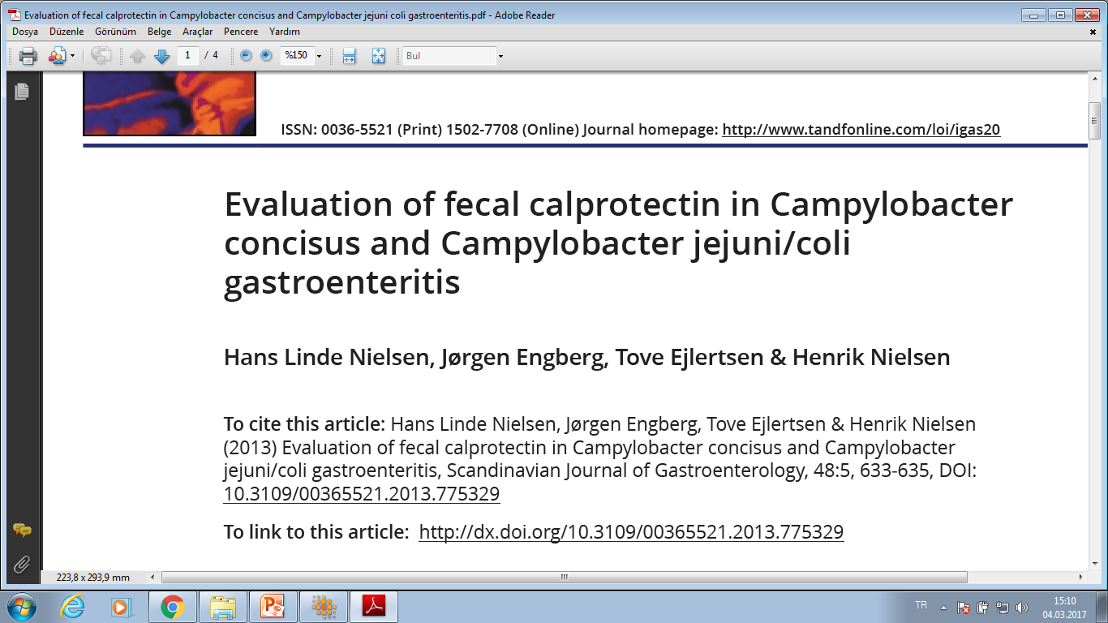



Notes:
Hem sağlıklı bebeklerde hemde anormal olduğu bir sürü hastalık grubu varkan FC naso

Slide 30

Kuş uçtu uçacak Ahhhmett

Slide 31


NATURE REVIEWS | GASTROENTEROLOGY & HEPATOLOGY : 2016: 187 . December

Slide 32


Fekal kalprotectin den hiç bahsedilmemişş!!!!!!!!!!!!

Slide 33

25 Nisan 2017 , saat 09: 00, Ahmet ve KUŞ-ADASI

Slide 34

TÜM BU BİLGİ , BELGE VE DELİLLLERDEN DOLAYI
FEKAL KALPROTEKTİN ?????,
BESİN ALERJİLERİNİN TANISINDA TEK BAŞINA ASLA BİR
TANI KRİTERİ OLARAK
KUL LA NI LA MAZ

