Slide 1


Sublingual İmmünoterapi
Prof. Dr. C. Dost Zeyrek
İstanbul Yeni Yüzyıl Üniversitesi
Çocuk Allerji ve İmmünoloji B.D.

Slide 2

Sunum Planı
Neden IT/Neden SLIT
AR ve astım tedavisinde farmakoterapinin etkinliği
İmmünoterapi / SLIT endikasyonları
İmmünolojik mekanizmalar
Klinik etkinlik
SLIT/SCIT karşılaştırması
Yaş
Süre
Güvenlik
Uzun dönem etkinlik
Uyum
Yeni kullanım alanları

Slide 3

Allerjik Rinitte Farmakoterapi
Tedaviye yetersiz yanıt;
Çocuklarda %29
Yetişkinlerde %69
Farmakoterapi altta yatan allerjik hastalık süreçlerini etkilemez
Meltzer EO, et al. J Allergy Clin Immunol 2009;124(suppl):S43-70.
White P, et al. Clin Exp Allergy 1998;28:266-70.
Notes:
In a survey, 29% of children obtained only partial relief with the use of a prescription nasal corticosteroid.5. Although poor technique and inconsistent medication adherence may contribute to a lack of
complete symptom improvement, it is appreciated that medical
therapy does not affect the underlying allergic disease processes.
In contrast, allergen immunotherapy may not only improve
symptom control but also modify the course of the disease, an
important consideration for parents whose children’s AR symptoms
are not controlled despite a well-supervised trial of medical
treatment.

Slide 4
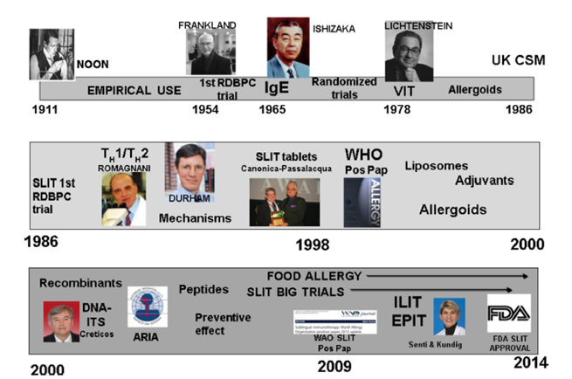
İmmünoterapi
Scadding GK, Brostoff J. Low dose sublingual therapy in patients with allergic rhinitis due to house dust mite. Clin Allergy 1986; 6:483–491.
Johansson SGO. Curr Allergy Asthma Rep 2011;11:173-7.
Notes:
Background — Oral immunotherapy was first proposed as a method of treatment for allergic disease in the early
1900s. In the 1980s, properly designed clinical trials first demonstrated a dose dependent
therapeutic response with specific and well characterized aeroallergens. In 1998, the World Health Organization (WHO) recognized that SLIT was a promising alternate mode of immunotherapy and encouraged continued clinical investigation into this form of
treatment [1]. In 2009, the World Allergy Organization (WAO) published their opinion that the cumulative evidence
showed SLIT represented a viable alternative to SCIT and encouraged continued clinical investigation to
characterize optimal techniques [2,3].
Giriş cümlesi olacak
Sublingual immunotherapy (SLIT) is a type of specific immunotherapy utilized to treat allergic rhinitis or allergic rhinoconjunctivitis (ARC) [1]. SLIT is ideally suited for use in children because it is needleless and convenient (given at home). Over 75 clinical research studies have been performed to prove the clinical efficacy of SLIT with at least 20 of those trials including only children [1,2]. SLIT has become recognized as a low-risk, high-benefit option for adults and children suffering from allergic rhinitis or ARC, and more recently, clinical trials have begun to demonstrate efficacy in diseases such as asthma, atopic dermatitis, and food allergies [3]. The most-studied SLIT allergens for pediatrics are dust mite and grass. Currently, three nature-based tablets have gained approval by the US Food and Drug Administration (FDA), two grass (Oralair and Grastek) and one ragweed (Ragwitek) [4&].
The overall data from these trials, consistently showing the efficacy of the treatment, resulted in the first consensus document [2]. Sublingual immunotherapy (SLIT) was firstly proposed in the 1980s [3], but its application in clinical practice started in the 1990s [1].

Slide 5

Niçin SLIT
SCIT;
Hastane/doktor ofisine sık ziyaret gerektiren uzun seyir
Enjeksiyon gerektirmesi
Enjeksiyonlara lokal ve sistemik reaksiyonlar
Fiyat (daha pahalı)
Notes:
SLIT can be self administered by patients or caregivers, does not require injections, and carries a much lower risk of anaphylaxis compared with SCIT.

Slide 6
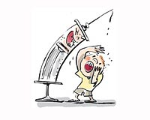
SLIT Endikasyonları
Optimal farmakoterapi ile hastanın bulgularının kontrol altına alınamaması
Zorunlu ön koşul değil
Erken bir tedavi olarak düşünülebilir
Farmakoterapi ile istenmeyen yan etkilerin ortaya çıkması
Hastanın uzun süreli farmakoterapi istememesi
Hastanın enjeksiyonları reddetmesi
Hastanın enjeksiyonları reddetmesi
Canonica GW, et al. Sublingual immunotherapy: World
Allergy Organization position paper 2013 update. World Allergy Organization J 2014; 7:6.
Notes:
SLIT may be particularly indicated in the following
patients:
○ Patients whose allergy is uncontrolled with
optimal pharmacotherapy (that is, those with
severe chronic upper airway disease).
○ Patients in whom pharmacotherapy induces
undesirable side effects.
○ Patients who refuse injections.
○ Patients who do not want to be on constant or
long-term pharmacotherapy.

Slide 7

SLIT’mı/SCIT’mı ?
Hangisi daha etkili?
Uzun süreli klinik etkileri benzer mi ?
Hangisi daha güvenli?
Bu iki tedavi arasındaki seçimde göz önüne alınması gereken pratik konular nelerdir?
Notes:
To make a decision, several issues should be addressed. These include
1) whether it is better to use mono- versus polyallergen
immunotherapy in polysensitized patients; 2) are there
similar long-term clinical effects of SLIT versus SCIT; 3)
which is more effective, SLIT or SCIT; 4) which is safer,
SLIT or SCIT; and 5) what are the likely practical points
to consider in choosing between these two treatment
Tabatabaian F, et al. All Asthma Proc 2015;36:100-104

Slide 8
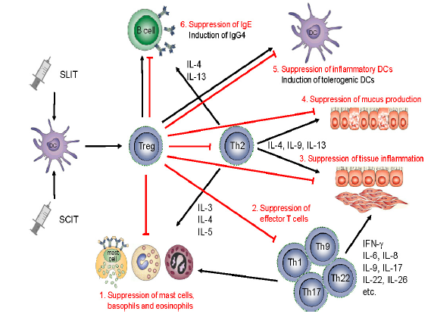
SLIT İmmunoloji
Notes:
SCIT ana mekanizmalar;
(a) the immune deviation towards a Th1-oriented response (and a reduction of the Th2 response);
(b) the production of allergen-specific IgG4, which inhibit the IgE-facilitated antigen presentation; and
(c) the emergence of T regulatory cells, which secrete cytokines like IL-10 able to downregulate the allergen-mediated response
Although routes and doses of allergen administration in SLIT and SCIT regimens differ, mechanisms of action of both routes show similarities on an immunologic basis in many aspects.
The immunologic mechanisms of the action of sublingual route (SLIT) do not substantially differ from those of SCIT. The mechanistic aspect of SLIT includes a relevant role for dendritic cells that are particularly abundant in the mouth and that, through specific cytokine and signaling networks, perform an efficient antigen presentation [4, 5]. Indeed, the purported rationale of a rapid mucosal absorption with SLIT was incorrect [6], but the role of local antigen presentation in the oral mucosa was soon recognized as a main mechanism o action [7].
FIGURE 3. Immune changes induced during SLIT. Immune changes include (1) the polarization of allergen-specific CD4ş T-cell responses,
with a switch from TH2 to TH1 and Treg-cell profiles, (2) a progressive decrease in specific IgEs and rapid and sustained induction of IgG4s
and IgAs, including potential blocking (ie, anti-inflammatory) antibodies, and (3) molecular alterations at the level of innate cells, including
basophils and monocytes/monocyte-derived DCs. Immune mechanisms associated with SLIT and SCIT are thought to be similar, with
a critical role of the induction of TH1 (immunodeviation) and Treg-cell responses (immunosuppression).
3. Mechanism of action
The immunologic changes associated with SLIT are complex and not clearly established. However, they occur at 3 levels: changes in cellular immunity, changes in humoral immunity, and changes in the release of mediators by proinflammatory cells.
Scadding et al. [28] observed a statistically significant increase in positive Foxp3 cell levels in the mucosa of patients treated with SLIT compared with a placebo group. Similarly, immunofluorescence microscopy revealed greater expression of the Tr CD4+DC25+Foxp3+ phenotype in the nasal mucosa of patients who successfull completed SLIT.
Immune changes associated with SLIT efficacy
In murine allergy models, the reduction in airway hyperresponsiveness induced during SLIT is linked with a decrease in both eosinophil infiltrates and allergen-specific TH2 CD4ş T-cell responses in target organs, in parallel with the induction of systemic TH1 and Treg-cell responses. In such preclinical models, SLIT efficacy has also been associated with a progressive decrease in allergen-specific IgEs in serum or mucosae together with the induction of allergen-specific IgAs and IgG2s.16-20 Similar immunological changes have been recorded in human studies during successful SLIT.4,14,21-24 For example, SLIT with birch, grass, ragweed, or house dustmite (HDM)extracts promotes changes in the polarization of allergen-specific CD4+ T-cell responses in the blood of allergic patients from a TH2 to a TH1/Treg-cell pattern.21-24 Both Tr1 (CD4+ Treg cells secreting both IFN-g and IL-10) and CD4+CD25highFoxp3+ Treg cells are elicited in the patients’ blood and mucosae in the course of SLIT.21,23,25 A decrease in allergen-specific IgEs is also detected in sera from patients after 6 months of SLIT, concomitantly with the induction of allergen-specific IgG1s, IgG4s, and IgAs.25-27 Some of those antibodies with high affinity for the allergen can mediate an IgE-blocking capacity thought to contribute to clinical efficacy.25,27
*********************************
THE IMMUNOLOGIC RESPONSE
Studies with SCIT and SLIT have also demonstrated a suppressive effect of AIT on Th17 cells and their cytokines. After 2 years of SCIT with HDM extract in adults, Th2 and Th17 cells were reduced, Th1 and Tregs were increased, and, strikingly, the decrease in plasma interleukin-17 levels correlated highly with the decrease in symptoms of perennial rhinitis.25 Sublingual administration of Dermatophagoides farinae extract for 48 weeks to children with allergic asthma also decreased symptoms, increased Tregs, and decreased Th17 cells in the peripheral blood.26
IT mekanizmalarından bahsedilecek, SLIT farklı değil denilip lokal mekanizmalardan bahsedilecek

Slide 9
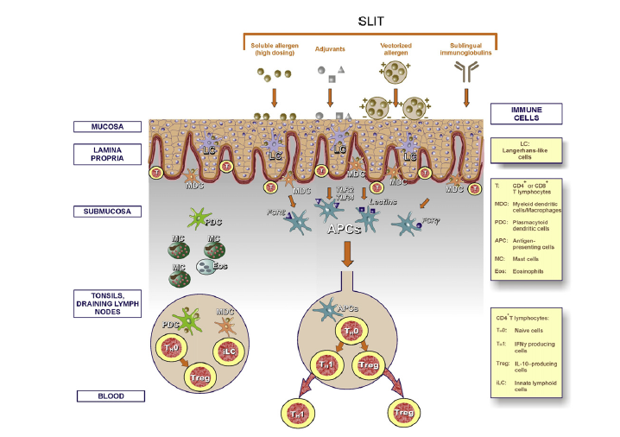
Sublingual Yol ile Tolerans İndüksiyonu
Moingeon P. J Allergy Clin Immunol Pract 2013;1(3):228-41.
Notes:
SLIT induces modest systemic changes consistent with SCIT, but additional local mechanisms in the oral mucosa and/or regional lymph nodes are likely important.
FIGURE 1. Allergen-specific tolerance induction via the sublingual route. The allergen(s) is (are) captured and processed by oral APCs
(LCs, MDCs; macrophages) within 15 to 30 minutes. Those APCs loaded with allergen-derived peptides reach cervical lymph nodes
within 12 to 24 hours, where they interact with naive CD4ş Tcells to induce TH1 and Treg cells with suppressive activity within 2 to 5 days.
These CD4ş Tcells subsequently migrate into the blood and to tissues, resulting in long-term allergen-specific tolerance.
Thanks to the potent tolerogenic mechanisms of the oral mucosa, inflammatory reactions are rare. Various mechanisms of local tolerance have been described within the oral mucosa: the absence of MALT (mucosa-associated lymphoid tissue) and a small number of cells participating in inflammatory reaction (eosinophils, mast cells), the presence of lamina propria, which ensures limited absorption of antigen macromolecules and contact with inflammatory cells situated in the submucosal layer [35], the phenomenon of immune exclusion via secretory IgA, which restricts antigen penetration [36], the presence of IFN-g-producing Th1 lymphocytes [37] and regulatory T lymphocytes, which affect immunosupression via intercellular mechanisms through cytokine release (IL-10), and the induction of anergy or depletion of T lymphocytes [38, 39, 40].
Sublingual immunotherapy is associated with
○ retention of allergen in sublingual mucosa for several hours.
○ early increases in antigen-specific IgE and blunting of seasonal IgE.
○ persistent increases in antigen-specific IgG4 and IgE blocking activity that parallel long-term clinical benefits of both SCIT and SLIT.
○ inhibition of eosinophils and reduction of adhesion molecules in target organs.
○ an early (at 4-12 weeks) increase in peripheral phenotypic Tregs and delayed (at 12 months) immune deviation in favor of Th1 responses.
○ detection of CD25 + FOXP + phenotypic Treg cells in the sublingual mucosa.
○ alterations in dendritic cell markers (e.g., increases in expression of complement component C1Q) that correlate with clinical response to treatment and merit further study.
SLIT induces modest systemic changes consistent with SCIT, but additional local mechanisms in the oral mucosa and/or regional lymph nodes are likely important.
Cevdet
The oral mucosal area is an important entry site for commensal microbes and numerous daily dietary antigens, where peripheral tolerance is induced in a quick manner to maintain immune homeostasis. The sublingual area stands as a quick tolerance induction area by inducing Th1/Treg cells in the absence of danger signals.75 The oral cavity hosts several subsets of tolerogenic DCs, which induce Treg cell responses. Subsets of DCs include CD11b1CD11c- and CD11b1CD11c1 myeloid DCs at the mucosal/submucosal interface, plasmacytoid DCs found in submucosal tissues, and a minor subset of CD2071 Langerhans cells located in the mucosa itself. Both myeloid and plasmacytoid oral DCs have been shown to capture and process the antigen
*****************************
For all the DCs subpopulations, in healthy individuals as well as in patients undergoing SLIT, there have been documented numerous tolerogenic (through the release of IL-10 and IL-12) and regulatory functions (through induction of differentiation of naive or Th0 lymphocytes into the population with the phenotype Th1/Treg [43, 44]. Of critical importance in activating the tolerogenic function of DCs and thus SLIT efficacy are:
1) the duration of allergen contact with antigen-presenting cells in the oral mucosa;
2) the dose and frequency of allergen contact (application);
3) oral mucosa micro-environment;
4) the effects of adjuvant factors that increase tolerogenic abilities and induce a Th1-type response (e.g. MPL – a TLR-4 agonist) [31, 45].
*************************
The oropharyngeal mucosa as a tolerogenic organ
The oral cavity is a naturally tolerogenic environment,
remaining noninflamed despite being exposed continuously
to multiple foreign proteins. The presence of Langerhans
cells and monocytes capable of producing IL-10
and TGF-β are major contributors to the maintenance of
tolerance (see Chapter 3 of the 2009 WAO position paper
[9]). A recent study [10] has shown that T cells isolated
from the human buccal mucosa, in contrast to those isolated
from skin, express TGF-β1, IL-10, interferon-γ and
IL-17, particularly in the vestibular region, and markedly
express toll-like receptor (TLR) 2 and TLR4.
Palomares et al. [13] recently highlighted that the tonsils and surrounding lymphoid tissue are located in the gateway of both the alimentary and respiratory tracts and may be important for local induction of tolerance to both food and inhalant allergens. Abundant FOXP3+ Treg cells were detected in lingual and palatine tonsils. Tonsil-derived plasmacytoid dendritic cells (DCs) were shown to have the ability to generate functional CD4+ CD25+ CD127– FOXP3+ Treg cells. ……………………………………………….
In a double-blind 18-month controlled trial of highdose grass pollen SLIT (20 mcg Phl p 5 daily), biopsies of the sublingual mucosa demonstrated more CD3+ FOXP3+ and CD25+ FOXP3+ T cells in SLIT-treated patients than in placebo-treated patients, and some CD3+ FOXP3+ cells were shown with triple immunofluorescence to express IL-10, a direct illustration of the induction of local phenotypic Treg cells following successful treatment [15].

Slide 10
SLIT İmmün Değişiklikler
Serum IgG ve IgG4 düzeylerinde artış
Artış SCIT kadar olmayabilir
Allerjen sIgE düzeyinde erken geçici artış. Daha sonra mevsimsel artışta körelme
Sublingual FOXP3+ Treg hücrelerindeki lokal artışla birlikte B hücresine allerjen-IgE kompleksinin bağlanmasına karşı serum inhibitör aktivitesinde artış (IgE-FAB)
Periferal Treg hücrelerde artış (4-12 hafta)
Th1 immün deviasyon (12 ay)
Scadding GW, et al. Clin Exp Allergy 2010;40:598–606
Durham SR, et al. J Allergy ClinImmunol 2012;129:717–725.
Piconi S, et al. J Immunol 2010;185:7723–7730.
Canonica GW, et alWorld Allergy Organ J 2014;7:6.
Notes:
Specific antibody levels
Studies of sublingual grass pollen immunotherapy in general show an increase in serum allergen-specific IgG4 and IgG, although the increase is not as great as that seen with SCIT [16,17]. Transient early increases in allergen-specific IgE have also been observed and are associated with blunting of seasonal increases in IgE [4]. However, some SLIT studies have not shown increases in IgG levels, particularly following house dust mite immunotherapy [18].
In a study of high-dose grass pollen SLIT, increases in grass pollen–specific IgA2 as well as IgG and IgG4 occurred in parallel with local increases in sublingual FOXP3+ Tregs [15]. These increases were accompanied by increases in serum inhibitory activity for binding of allergen-IgE complexes to B cells (IgE-FAB), a validated surrogate of IgE-facilitated antigen presentation to T cells. Furthermore, the long-term clinical benefit observed for 2 years following a 3-year course of grass pollen SLIT was associated with persistent elevations in serum levels of both allergen-specific IgG4 [3,4] and functional IgGassociated inhibitory activity for IgE-FAB when compared to the levels in placebo-treated patients [4]

Slide 11

SLIT İmmün Değişiklikler
Daha az yan etki
SLIT allerjenleri mast hücrelerine ulaşmadan önce tolerojenik DH tarafından yakalanmakta
Oral kavitede submukozal bölgede daha az mast hücresi ve eozinofil
Mascarell L, et al. Clin Exp Allergy 2009;39:1910-9.
Calderon MA, et al. Allergy 2012;67:302-11.
Notes:
Specificities of the oral immune system
Following administration under the tongue, allergens diffuse
and are in contact with immune cells throughout the oral cavity.
Oral tissues contain few pro-inflammatory cells such as mast cells
and eosinophils, located in submucosal tissues, thereby explaining
the excellent safety profile of SLIT with mostly local but only
rare systemic effects.11,15 Importantly, antigen-presenting cells
(APCs) involved in the capture and processing of allergens and
the subsequent presentation of derived peptides to naive T cells
in draining cervical lymph nodes have been identified (Figure 1).
These APCs are located in the upper layers of oral tissues, and
include CD207ş Langerhans cells (LCs) present in the mucosa
itself, as well as CD11bş CD68ş CD206ş macrophages located
along the lamina propria.7-13 Oral APCs can capture allergens

Slide 12
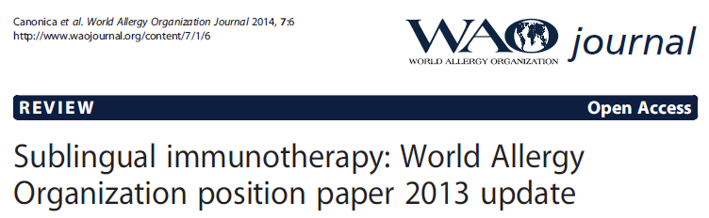

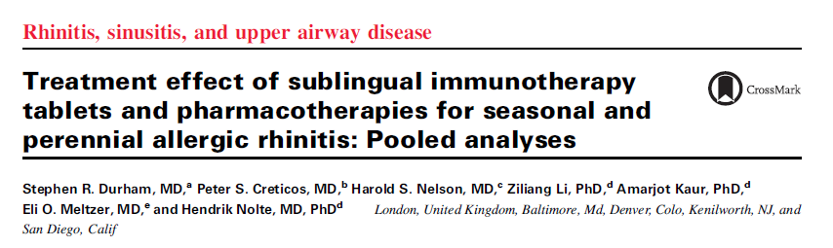
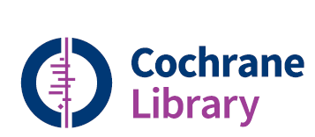

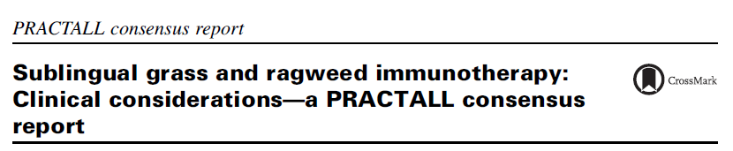
Klinik Etki

Slide 13
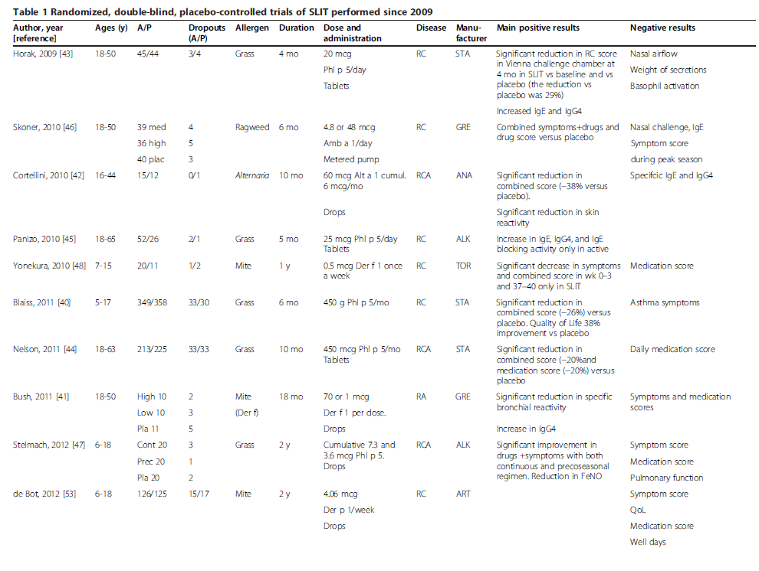
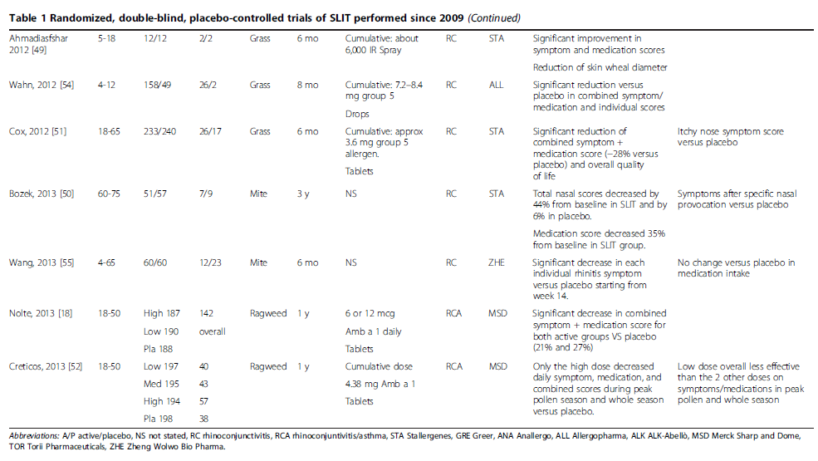
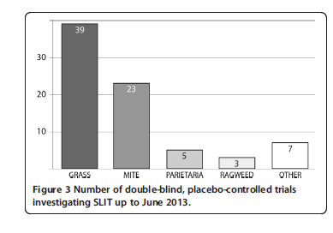
Notes:
As of June 2013, there were 77 randomized double–blind, placebo-controlled (RDBPC) trials of
SLIT, of which 62 were conducted with grass or house dust mite (HDM) extracts. The majority of
these studies were heterogeneous for allergen dose, duration, and patient selection. All statements on
efficacy of SLIT do refer to products which have demonstrated efficacy in appropriate studies.
▪ Seventeen trials, of which one was totally negative, were published after the previous WAO position paper.
▪ The literature suggests that, overall, SLIT is clinically effective in rhinoconjunctivitis and asthma

Slide 14
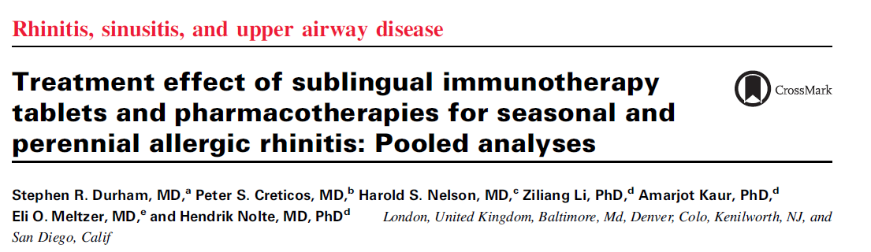
J Allergy Clin Immunol 2016;138:1081-8
23 SAR, 11 PAR çalışması
n:18914
Yaş: 5-85
Kuzey Amerika, Avrupa ve Latin Amerika (2 çalışma)
Notes:
Background: Data comparing the treatment effect of allergy
immunotherapy and pharmacotherapy are lacking.
Objective: We sought to indirectly compare the treatment effect
of sublingual immunotherapy (SLIT)-tablets with
pharmacotherapy for seasonal allergic rhinitis (SAR) and
perennial allergic rhinitis (PAR).
Methods: Pooled data from randomized, double-blind, placebocontrolled
trials for the clinical development programs of
selected allergic rhinitis treatments were evaluated. Total nasal
symptom scores (TNSSs) relative to placebo were compared.
Subjects scored symptoms daily during entire pollen seasons in
6 timothy grass SLIT-tablet trials (n 5 3094) and 2 ragweed
SLIT-tablet trials (n 5 658) and during the last 8 weeks of
treatment in 2 house dust mite (HDM) SLIT-tablet trials
(n 5 1768). Subjects scored symptoms daily in 7 montelukast
(10 mg, n 5 6799), 9 desloratadine (5 mg, n 5 4455), and 8
mometasone furoate nasal spray (MFNS; 200 mg daily,
n 5 2140) SAR or PAR trials. SLIT-tablet trials allowed rescue medication use, whereas most pharmacotherapy trials did not.
A fixed-effect meta-analysis method estimated differences in ontreatment
average TNSSs.
Results: In grass and ragweed SLIT-tablet trials, overall
improvement in TNSSs relative to placebo was 16.3% and
17.1%, respectively. In HDM SLIT-tablet trials, TNSS overall
improvement relative to placebo was 16.1%. In the montelukast,
desloratadine, and MFNS trials, TNSS overall improvement
relative to placebo was 5.4%, 8.5%, and 22.2%, respectively, for
SAR trials, and 3.7%, 4.8%, and 11.2%, respectively, for PAR
trials.
Conclusions: Although comparisons were limited by study
design heterogeneity and use of rescue medications in SLITtablet
trials, effects on nasal symptoms with timothy grass and
ragweed SLIT-tablets were nearly as great as with MFNS and
numerically greater than with montelukast and desloratadine
for SAR. HDM SLIT-tablet effects were numerically greater
than all pharmacotherapies for PAR. SLIT-tablets offer the
additional benefit of long-term efficacy.

Slide 15
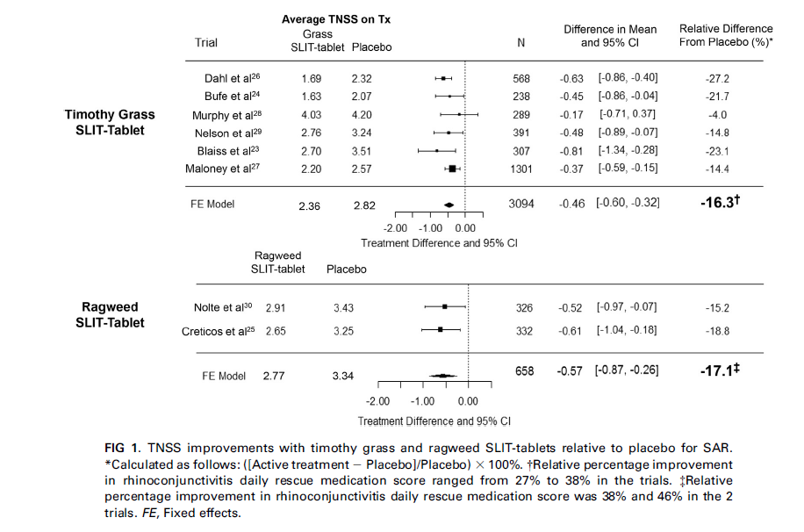
Notes:
Treatment effect for SAR The treatment effects in the timothy grass and ragweed SLITtablets were similar. In the 6 timothy grass SLIT-tablet trials, TNSS improvement relative to placebo ranged from 4.0% to 27.2%, with an overall improvement of 16.3% (Fig 1).23,24,26-29 In the 2 ragweed SLIT-tablet trials, TNSS improvement relative to placebo was 15.2% and 18.8%; overall improvement was 17.1% (Fig 1).25,30

Slide 16
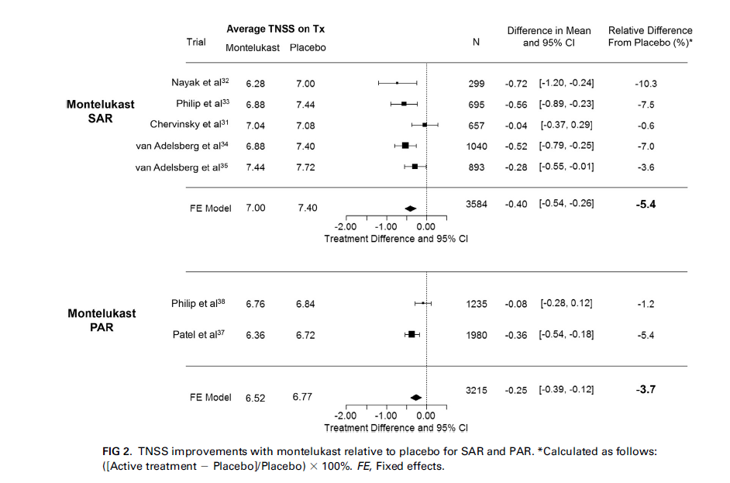

Slide 17
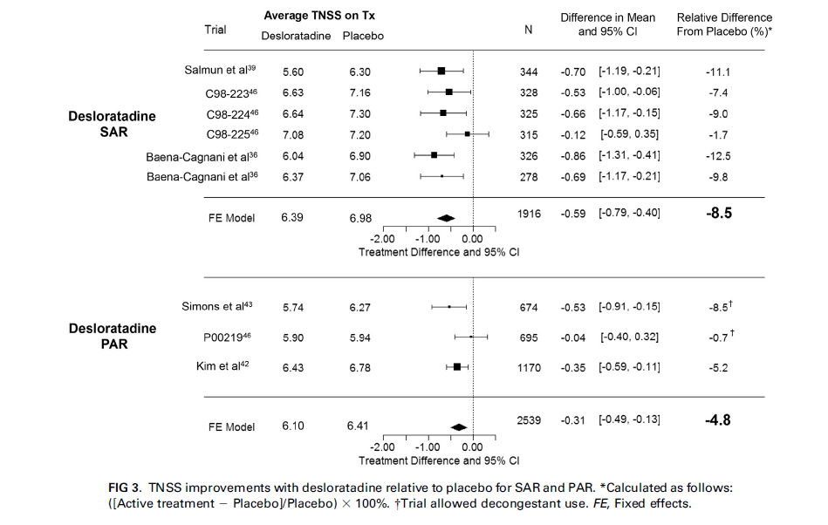

Slide 18
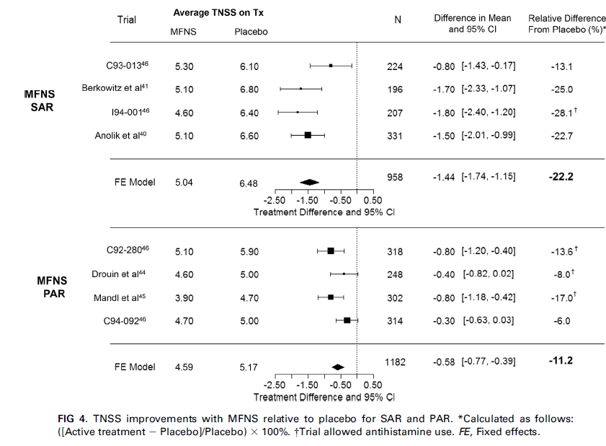

Slide 19
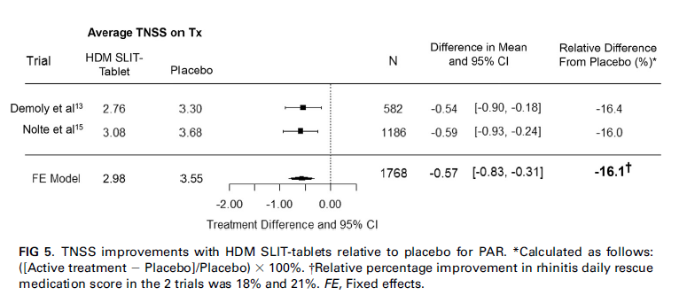
Notes:
In the 2 HDM SLIT-tablet trials, improvement in the weighted
daily medication score for rhinitis was 18% and 21% with active
treatment relative to placebo.

Slide 20
J Allergy Clin Immunol 2016;138:1081-8
Sonuçlar;
SAR’lı hastalarda semptomların düzelmesi
SLIT = İntranazal steroid
SLIT > Montelukast ve antihistaminik
PAR’lı hastalarda semptomların düzelmesi
SLIT (HDM için) > Bütün farmakoterapi
SLIT etkisi
SAR=PAR
Notes:
DISCUSSION
The results of these meta-analyses indicate that nasal symptom improvement relative to placebo with SLIT-tablets was nearly as great as with MFNS and numerically greater than montelukast and desloratadine for patients with SAR
The effects of HDM SLIT-tablets were numerically greater than all the pharmacotherapies in PAR trials.
The effect sizes with SLIT-tablets were nearly identical for SAR and PAR, whereas the effect sizes of pharmacotherapies for PAR were approximately 1.5- t 2-fold less than those observed for SAR.
In conclusion, although comparisons were limited by study design heterogeneity, timothy grass and short ragweed SLIT tablets had nearly as great an effect on nasal symptoms compared with an INCS (MFNS) and had a numerically greater effect compared with a leukotriene antagonist (montelukast) and an antihistamine (desloratadine) in SAR trials. The HDM SLIT tablet had a numerically greater effect compared with a leukotriene antagonist, an antihistamine, and an INCS in PAR trials

Slide 21
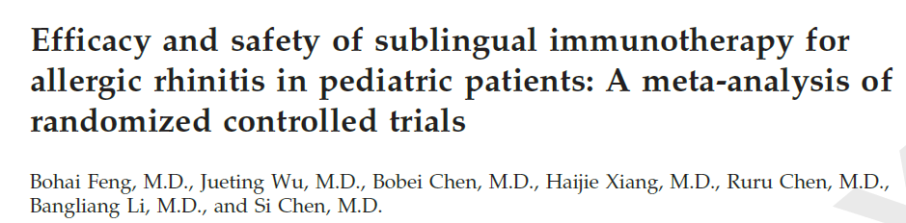
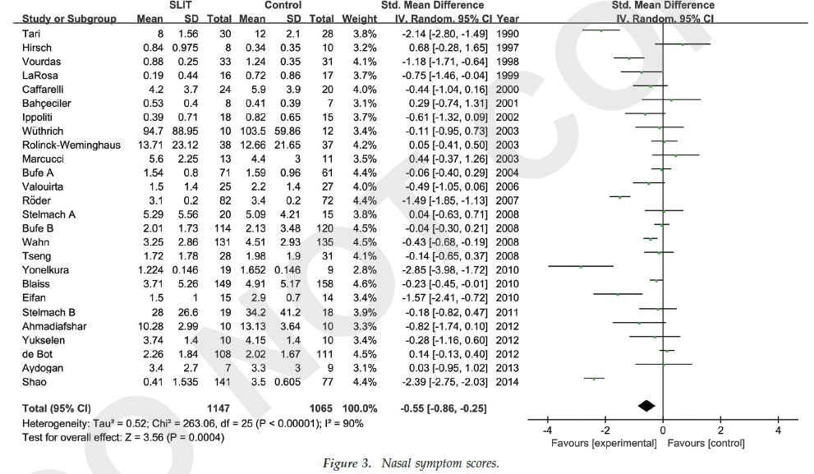
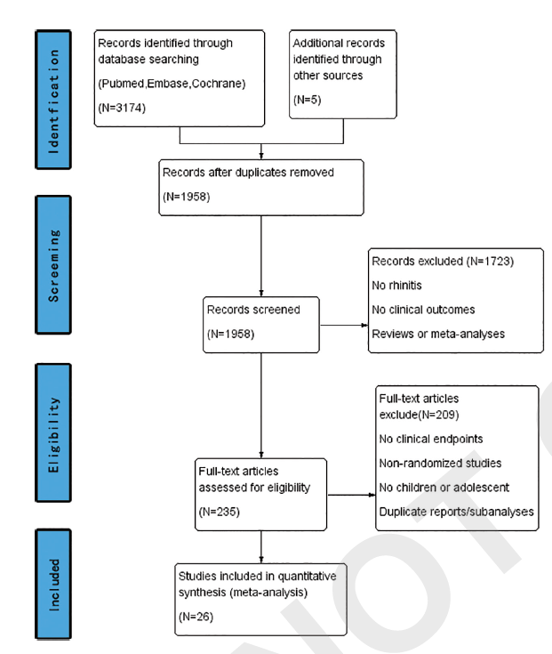
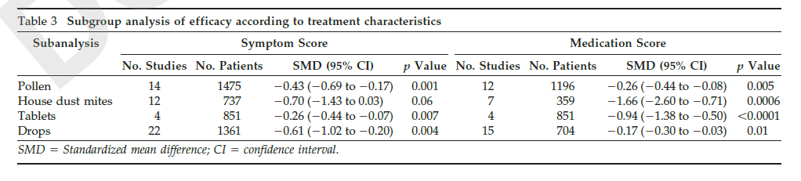
Notes:
In 2013, the European Academy of Allergy and Clinical
Immunology (EAACI) edited an important position paper
on pediatric rhinitis, providing several evidence-based
insights on diagnostic and therapeutic aspects. In this
document, SLIT is confirmed as an effective treatment
for grass pollens and house dust mite allergic rhinitis and
this concept is labeled through a force of this statement
of grade A, according to the system for grading clinical
recommendation in evidence-based guidelines[1,8].
************************************************
ABSTRACT
Background: Allergic rhinitis (AR) has become a global health problem that constantly affects a large part of the general population, especially children.
Objective: Sublingual allergen immunotherapy (SLIT) has been used extensively for pediatric AR, although its efficacy and safety are often questioned. In
this meta-analysis of randomized controlled trials (RCT), we evaluated the use of SLIT for pediatric AR.
Methods: A number of medical literature data bases were searched through January 2016 to identify RCTs that examined the use of SLIT for pediatric AR and
that assessed clinical outcomes related to efficacy. Descriptive and quantitative information was abstracted. Standardized mean differences (SMD) were calculated by
using fixed- and random-effects models. Subgroup analyses were performed. Heterogeneity was assessed by using the I2 metric. A network meta-analysis was used
to estimate SMDs between two SLIT protocols for pediatric seasonal AR. All data were extracted from publications or received from the authors.
Results: Twenty-six studies were eligible for inclusion in the meta-analysis of rhinitis or rhinoconjunctivitis symptom scores, and 19 studies were eligible
for the meta-analysis of medication scores. Descriptive and quantitative data were extracted. SLIT differed significantly from placebo in terms of symptom
scores (SMD 0.55 [95% confidence interval {CI}, 0.86 to 0.25]; p 0.0003, I2 90%) and medication scores (SMD 0.67 [95% CI, 0.96 to 0.38];
p 0.00001, I2 83%). Oral pruritus was the adverse effect, which occurred most commonly in children who were receiving SLIT. Network meta-analysis
revealed no significant difference between the pre-coseasonal and continuous SLIT protocols for seasonal AR in symptom scores (SMD 6.55 [95% CI, 25.38
to 12.29]; p 0.496) and medication scores (SMD 8.83 [95% CI, 22.10 to 4.43]; p 0.192).
Conclusions: Our meta-analysis results indicated that SLIT provided significant symptom relief and reduced the need for medication in pediatric patients.
Moreover, the safety of SLIT needs to be confirmed in RCTs with larger samp

Slide 22
SLIT ve Astım
n: 50 olgu
Yaş: 6-17
Duyarlanma: Grass polen
Astım semptomlarında %41 azalma (p<0,001)
Stelmach I, et al. Clin Exp Allergy 2009;39:401–408
n: 604 olgu
Yaş: ≥14 yaş
Duyarlanma: Ev tozu akarı
İKS dozunda %42 azalma (p<0,004)
Klinik parametrelerde fark yok
Mosbech H, et al. J Allergy Clin Immunol 2014;134(3):568–75
Notes:
Summary
Background Although sublingual immunotherapy (SLIT) has been used with increasing
frequency, the data on the efficacy of SLIT in pediatric asthma are limited.
Aim The aim of our study was to evaluate the efficacy and the safety of high-dose SLIT given
pre-seasonally and co-seasonally in an ultra-rush scheme in children with bronchial asthma
allergic to grass pollen.
Methods Fifty children with asthma, aged 6–17, sensitive to grass pollen, participated in the
2-year prospective, randomized, double-blind, placebo-controlled trial, to investigate the
efficacy and safety of SLIT (Staloral 300 IR, Stallergenes SA, 25 mg major allergens) as a
standardized extract of five grass pollen with ultra-rush induction.
Results SLIT significantly improved asthma symptom scores (41% vs. placebo group), reduced
nasal symptoms (25% vs. placebo group) and the use of rescue medications (10% vs. placebo
group), improved forced expiratory volume in 1 s, but had no effect on ocular symptoms,
nasal hyper-reactivity, peak expiratory flow and forced expiratory volume between 25% and
75% of vital capacity. Serum levels of immunoglobulin E and IgG4 did not change after SLIT.
After the second season of SLIT, an improvement in bronchial hyperresponsiveness was
observed; however, compared with placebo, this effect was not significant. Among all subjects
in SLIT group, predominantly local reactions have been recorded in 59% of subjects in the
first year of treatment and in 35% in the second.
Conclusions Our study indicated that high-dose ultra-rush, co-seasonal SLIT given for 2 years,
was safe and reduced a multiple symptom–medication score.
******************************************
Background: Investigations meeting current standards are
limited for the effect of house dust mite (HDM) allergy
immunotherapy in asthmatic patients.
Objective: This trial investigated the efficacy and safety of a
standardized quality (SQ; allergen standardization method
proprietary to the trial sponsor) HDM SLIT-tablet (ALK,
Hørsholm, Denmark) in adults and adolescents with HDM
respiratory allergic disease. This publication reports the results
of the endpoints related to asthma.
Methods: Six hundred four subjects 14 years or older with
HDM allergic rhinitis and mild-to-moderate asthma were
randomized 1:1:1:1 to double-blind daily treatment with one of
3 active doses (1, 3, or 6 SQ-HDM) or placebo. Their use of
inhaled corticosteroid (ICS) was standardized and adjusted at
baseline and the end of treatment to the lowest dose providing
asthma control. The primary end point was a reduction in ICS
dose from the individual subject’s baseline dose after 1 year of
treatment.
Results: The primary analysis revealed a mean difference
between 6 SQ-HDM and placebo in the reduction in daily ICS dose of 81 mg (P 5.004). Relative mean and median reductions
were 42% and 50% for 6 SQ-HDM and 15% and 25% for
placebo, respectively. No statistically significant differences were
observed for the other assessed asthma parameters, reflecting
the intended controlled status of the trial subjects. The most
common adverse events were local reactions in the mouth.
The rate and severity of adverse events were higher for 3 and
6 SQ-HDM than for 1 SQ-HDM and placebo.
Conclusion: Efficacy in mild-to-moderate asthma of 6 SQ-HDM
relative to placebo was demonstrated by a moderate statistically
significant reduction in the ICS dose required to maintain
asthma control. All active doses were well tolerated.

Slide 23
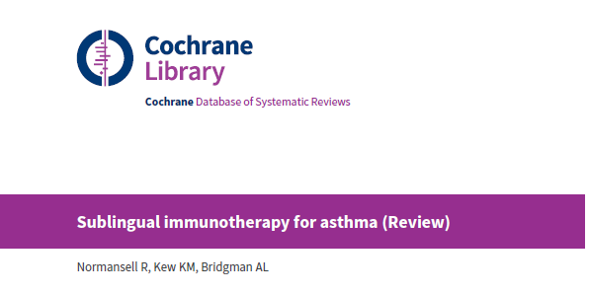
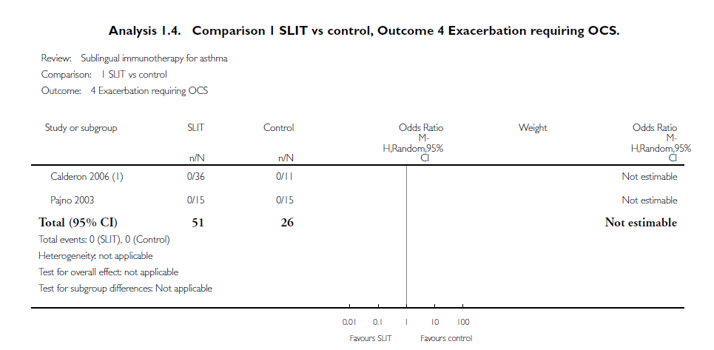
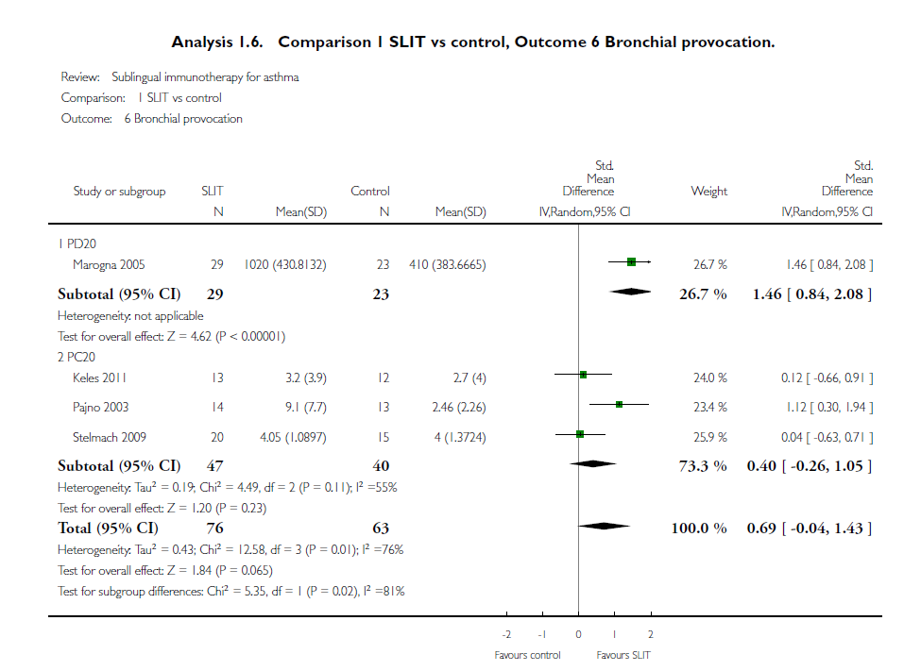
Notes:
About the efficacy in asthma, a metaanalysis was published in the Cochrane Database
Systematic Reviews on August 2015, including 52 studies, but the results were inconclusive [9].
A B S T R A C T
Background
Asthma is a common long-term respiratory disease affecting approximately 300 million people worldwide. Approximately half of
people with asthma have an important allergic component to their disease, which may provide an opportunity for targeted treatment.
Sublingual immunotherapy (SLIT) aims to reduce asthma symptoms by delivering increasing doses of an allergen (e.g. house dust mite,
pollen extract) under the tongue to induce immune tolerance. However, it is not clear whether the sublingual delivery route is safe and
effective in asthma.
Objectives
To assess the efficacy and safety of sublingual immunotherapy compared with placebo or standard care for adults and children with
asthma.
Search methods
We identified trials from the Cochrane Airways Group Specialised Register (CAGR), ClinicalTrials.gov (www.ClinicalTrials.gov), the
World Health Organization (WHO) trials portal (www.who.int/ictrp/en/) and reference lists of all primary studies and review articles.
The search is up to date as of 25 March 2015.
Selection criteria
We included parallel randomised controlled trials (RCTs), irrespective of blinding or duration, that evaluated sublingual immunotherapy
versus placebo or as an add-on to standard asthma management. We included both adults and children with asthma of any severity
and with any allergen-sensitisation pattern. We included studies that recruited participants with asthma, rhinitis, or both, providing at
least 80% of trial participants had a diagnosis of asthma.
Data collection and analysis
Two review authors independently screened the search results for included trials, extracted numerical data and assessed risk of bias, all
of which were cross-checked for accuracy. We resolved disagreements by discussion.
We analysed dichotomous data as odds ratios (ORs) or risk differences (RDs) using study participants as the unit of analysis; we
analysed continuous data as mean differences (MDs) or standardised mean differences (SMDs) using random-effects models.We rated
all outcomes using GRADE (Grades of Recommendation, Assessment, Development and Evaluation) and presented results in the
’Summary of findings’ table.
Sublingual immunotherapy for asthma (Review) 1
Copyright © 2015 The Cochrane Collaboration. Published by JohnWiley & Sons, Ltd.
Main results
Fifty-two studies met our inclusion criteria, randomly assigning 5077 participants to comparisons of interest.Most studies were doubleblind
and placebo-controlled, but studies varied in duration from one day to three years. Most participants had mild or intermittent
asthma, often with co-morbid allergic rhinitis. Eighteen studies recruited only adults, 25 recruited only children and several recruited
both or did not specify (n = 9).
With the exception of adverse events, reporting of outcomes of interest to this review was infrequent, and selective reporting may have
had a serious effect on the completeness of the evidence. Allocation procedures generally were not well described, about a quarter of
the studies were at high risk of bias for performance or detection bias or both and participant attrition was high or unknown in around
half of the studies.
One short study reported exacerbations requiring a hospital visit and observed no adverse events. Five studies reported quality of life,
but the data were not suitable for meta-analysis. Serious adverse events were infrequent, and analysis using risk differences suggests
that no more than 1 in 100 are likely to suffer a serious adverse event as a result of treatment with SLIT (RD 0.0012, 95% confidence
interval (CI) -0.0077 to 0.0102; participants = 2560; studies = 22; moderate-quality evidence).
Within secondary outcomes, wide but varied reporting of largely unvalidated asthma symptom and medication scores precluded
meaningful meta-analysis; a general trend suggested SLIT benefit over placebo, but variation in scales meant that results were difficult
to interpret.
Changes in inhaled corticosteroid use in micrograms per day (MD 35.10 mcg/d, 95% CI -50.21 to 120.42; low-quality evidence),
exacerbations requiring oral steroids (studies = 2; no events) and bronchial provocation (SMD 0.69, 95% CI -0.04 to 1.43; very lowquality
evidence) were not often reported. This led to many imprecise estimates with wide confidence intervals that included the
possibility of both benefit and harm from SLIT.
More people taking SLIT had adverse events of any kind compared with control (OR 1.70, 95%CI 1.21 to 2.38; low-quality evidence;
participants = 1755; studies = 19), but events were usually reported to be transient and mild.
Lack of data prevented most of the planned subgroup and sensitivity analyses.
Authors’ conclusions
Lack of data for important outcomes such as exacerbations and quality of life and use of different unvalidated symptom and medication
scores have limited our ability to draw a clinically useful conclusion. Further research using validated scales and important outcomes for
patients and decision makers is needed so that SLIT can be properly assessed as clinical treatment for asthma. Very few serious adverse
events have been reported, but most studies have included patients with intermittent or mild asthma, so we cannot comment on the
safety of SLIT for those with moderate or severe asthma. SLIT is associated with increased risk of all adverse events.

Slide 24
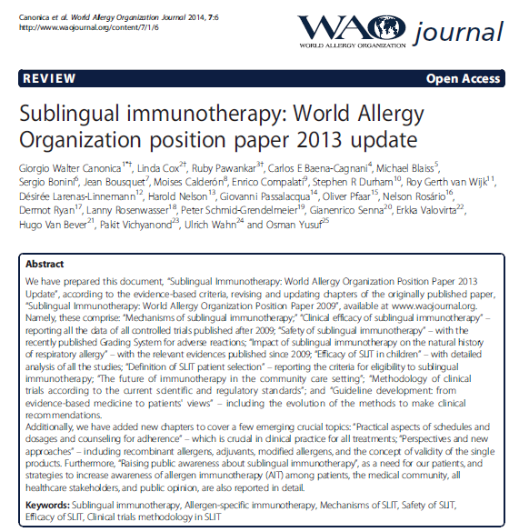
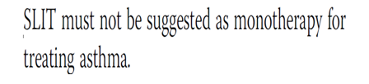
SLIT ve Astım

Slide 25
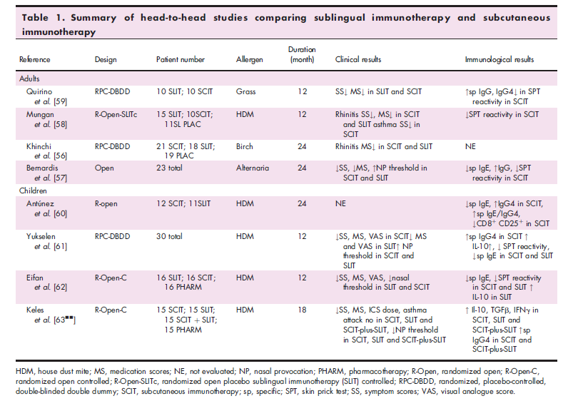
SCIT/SLIT Direkt Karşılaştırma
Notes:
HEAD-TO-HEAD STUDIES
Head-to-head studies comparing efficacy and
immunological response of SCIT and SLIT are very
small in number [56–62,63&&] (Table 1). Although there is quite satisfactory evidence on efficacy of both routes of immunothreapy, comparative data on long-lasting preventive effects, immunological responses and onset of efficacy are scarce.

Slide 26
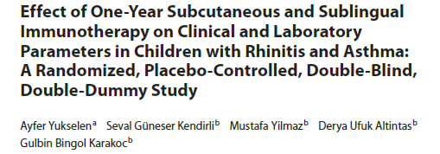
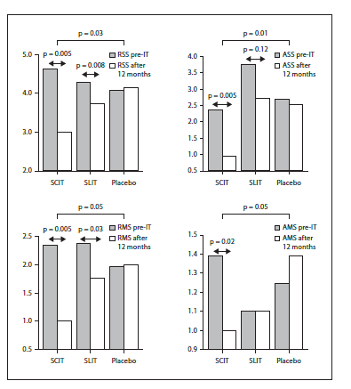
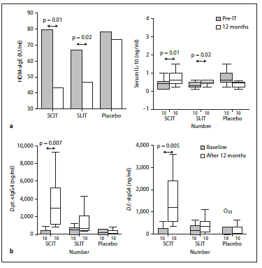
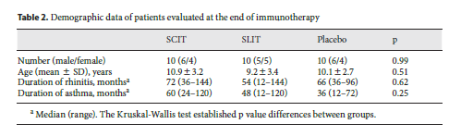


Notes:
Yukselen et al. [62] conducted an RDBPC comparison between HDM SCIT and SLIT with a double-blind
double-dummy design and concluded that both active treatments are effective, SCIT more so than SLIT. Although
the study was - underpowered, with 10 patients in each of the 4 groups, the tendency was clear: both
treatments improved rhinitis and asthma symptoms and medication scores, but the changes only reached statistical
significance in comparison to placebo in the SCIT group. Also, the response to nasal challenge with HDM
improved in both groups, but the bronchial HDM challenge dose improved only in the SCIT group, accompanied
by a reduction in the post-challenge eosinophil count in broncho-alveolar lavage. Similar immunologic changes
(HDM-IgE reduction, IL-10 rise) were seen after both SCIT and SLIT, with the exception of HDM-IgG4, which
only rose in the SCIT group, reaching a statistically significant difference with the SLIT group [62].
Abstract
Background: It has been reported that both sublingual
(SLIT) and subcutaneous (SCIT) allergen-specific immunotherapy
have clinical efficacy, yet there are rather few comparative
placebo studies of children. We aimed to investigate
the clinical and immunological efficacy of mite-specific SLIT
and SCIT versus a placebo in rhinitis and asthma in children.
Methods: The outcomes of this 1-year, randomized, placebo-
controlled, double-blind, double-dummy study were
symptom and medication scores, visual analog scores (VAS),
titrated skin prick tests, nasal and bronchial allergen provocation
doses, serum house dust mite-specific immunglobulin
E (HDM-sIgE), sIgG4, IL-10 and IFN- levels.
Results: Clinical
and laboratory parameters were evaluated in 30 patients.
SCIT significantly diminished symptom and medication
scores for rhinitis and asthma (p = 0.03 and p = 0.05 for rhinitis;
p = 0.01 and p = 0.05 for asthma) and VAS. SLIT also reduced
VAS, symptoms associated with rhinitis and asthma as
well as medication usage for rhinitis, but this reduction was not significant when compared with the placebo. Skin reactivitiy
to HDM and HDM-sIgE levels was reduced significantly
in both immunotherapy groups. Serum IL-10 levels and nasal
provocative doses increased significantly with both SCIT
and SLIT. Nasal eosinophil increments after nasal challenge
decreased with two treatment modes, but bronchial provocative
doses and sputum eosinophil increments after bronchial
challenge were reduced only with SCIT. In both treatment
arms, there was no change in IFN- levels. Serum sIgG4
levels increased significantly only in the SCIT group.
Conclusion:
Based on the limited number of patients at the end of
the 1-year immunotherapy, the clinical efficacy of SCIT on
rhinitis and asthma symptoms was more evident when compared
with the placebo.
Yukselen et al. [15&&] conducted a 3-year study involving a 1-year run-in, 1-year randomized placebo-controlled, double-blind, double-dummy, treatment, and 1-year follow-up with an open-phase arm with active treatment for all patients. During the study, patients were randomized to receive either active SCIT or SLIT for 2 years or a 1-year period. All pediatric patients were diagnosed with persistent allergic rhinitis to HDM and mild persistent asthma. These investigators also found thatSLIT and SCIT are both significantly effective treatments for allergic rhinitis and asthma after 2 years. However, SCIT was found to significantly decrease symptom scores, medication-use scores, HDMspecific bronchial provocation, and sputum eosinophils after 1 year when SLIT was found to decrease these measures significantly after 2 years but not after 1 year. In regard to significantly reducing the allergic rhinitis symptoms of the children, SCIT and SLIT were comparable and not significantly different [15&&].
SCIT versus SLIT for respiratory allergy
Yukselen et al. [62] conducted an RDBPC comparison between HDM SCIT and SLIT with a double-blinddouble-dummy design and concluded that both active treatments are effective, SCIT more so than SLIT. Although the study was - underpowered, with 10 patientsin each of the 4 groups, the tendency was clear: both treatments improved rhinitis and asthma symptoms and medication scores, but the changes only reached statistical significance in comparison to placebo in the SCIT group. Also, the response to nasal challenge with HDM improved in both groups, but the bronchial HDM challenge dose improved only in the SCIT group, accompanied by a reduction in the post-challenge eosinophil count in broncho-alveolar lavage. Similar immunologic changes (HDM-IgE reduction, IL-10 rise) were seen after both SCIT and SLIT, with the exception of HDM-IgG4, which only rose in the SCIT group, reaching a statistically significant difference with the SLIT group [62].

Slide 27
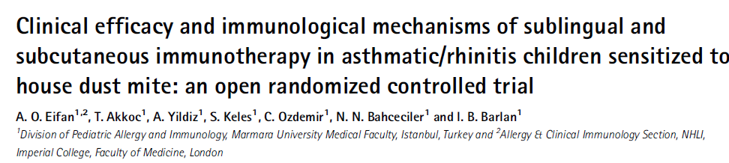
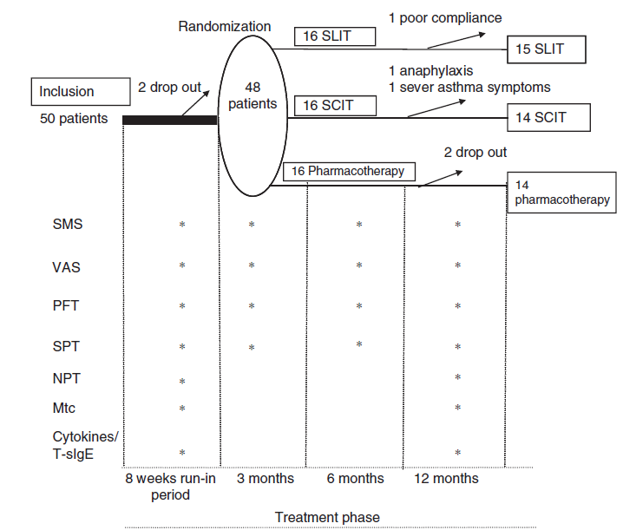
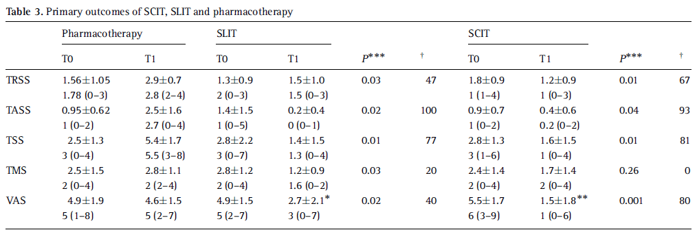
Clin Exp Allergy 2010;40:922-32
Notes:
A similar study was conducted by Eifan et al. [27]. In a randomized trial, they studied SLIT versus SCIT versus pharmacotherapy alone. Although the study groups were somewhat larger, the study was still underpowered, and no difference between SCIT and SLIT was shown in any of the many parameters examined.
Summary
Background In children, the clinical efficacy and immunological mechanisms of sublingual
immunotherapy (SLIT) compared with subcutaneous immunotherapy (SCIT) is still to be
elucidated.
Objectives To compare SLIT, SCIT and pharmacotherapy in relation to clinical efficacy and
immunological mechanisms that govern its effect in asthmatic/rhinitis children who were
sensitized to house dust mite (HDM).
Methods In this single centre, prospective, randomized, controlled, open labelled, three
parallel group trial, 48 patients mono-sensitized to HDM were randomized to receive either
SLIT (n = 16), SCIT (n = 16) or pharmacotherapy alone (n = 16). Symptom, medication and
visual analogue score (VAS) were collected and bronchial-nasal hyper-reactivity, skin prick
tests, total-specific IgE were performed at baseline and 12 months after treatment. In addition,
peripheral blood mononuclear cells were cultured with recombinant Der p 1 and Bet v 1
extracts and allergen-specific IL-4, IL-5, IL-13, IFN-g, IL-10, and TGF-b secretions were
measured.
Results SLIT and SCIT demonstrated a significant reduction of total rhinitis and asthma
symptom score, total medication score, VAS and skin reactivity to HDM (Po0.05) when
compared with pharmacotherapy. A significant reduction of serum-specific HDM-IgE in SCIT
and SLIT were observed. Moreover, titrated nasal provocative dose significantly increased in
both immunotherapy groups when compared with the pharmacotherapy group. No adverse
effects were reported in SLIT, while two patients demonstrated serious adverse events in SCIT.
After 1 year of treatment, Der p 1-driven IL-10 significantly increased in SLIT compared with
pharmacotherapy, whereas Bet v 1-driven TGF-b (negative control) increased significantly in
SLIT only. No changes were observed for Th1–Th2 cytokines.
Conclusion Both SLIT and SCIT demonstrated clinical improvement compared with
pharmacotherapy in asthma/rhinitis children sensitized to HDM.
Keywords asthma, cytokines, nasal provocation, rhinitis, sublingual–subcutaneous
immunotherapy

Slide 28
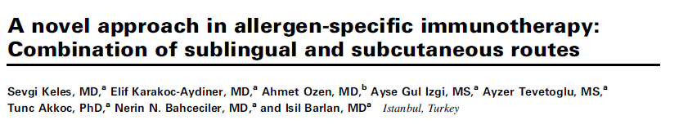
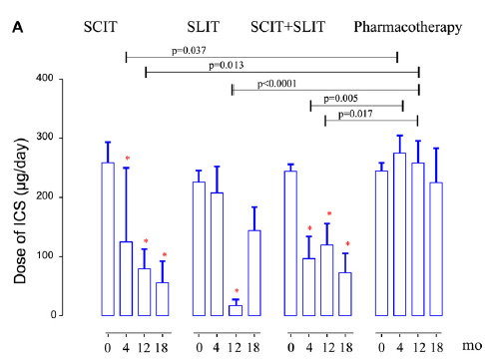
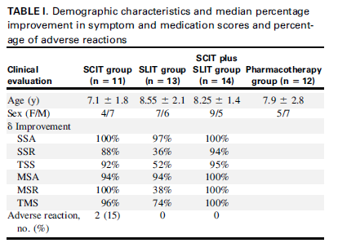
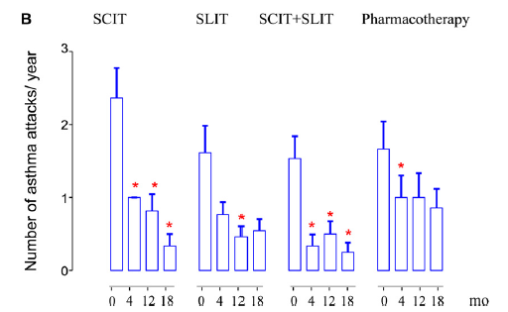
Notes:
Background: Subcutaneous allergen-specific immunotherapy
(SIT) has an early onset of action, whereas repeated injections
and safety concerns have limited its use in the pediatric age
group. Meanwhile, the improved safety profile of the sublingual
route has been accepted as an alternative despite its relatively
late onset of action.
Objective: We sought to improve the efficacy and safety of SIT
with a combination of the subcutaneous route in the build-up
phase and sublingual maintenance in comparison with the
sublingual or subcutaneous routes alone.
Methods: Fifty-one house dust mite–sensitized children with
mild-to-moderate asthma were randomized into one of
4 groups to receive either (1) subcutaneous immunotherapy
(SCIT), (2) sublingual immunotherapy (SLIT), (3) SCIT plus
SLIT, or (4) pharmacotherapy. Clinical parameters were
evaluated at baseline and months 1, 4, 12, and 18. Allergenspecific
immunoglobulin levels and allergen-induced IL-5,
IL-10, IL-13, IL-17, TGF-b, and IFN-g levels were evaluated
as well.
Results: In the SCITand SCIT plus SLIT groups, the number of
asthma attacks and inhaled corticosteroid dosage decreased
compared with baseline values at the months 4, 12, and 18 but only
at month 12 in the SLIT group. The improvement in visual analog
scores for rhinitis was significant only in the SCIT plus SLIT
group. Increases in the levels of regulatory andTH1 cytokines were
observed both in the SCITand SLIT groups,with some differences
in dynamics. Antigen-specific IgG4 levels increased in the SCIT
and SCIT plus SLIT groups but not in the SLIT group. Clinical
symptom scores were correlated positively with IL-5 levels and
negatively with antigen-specific IgG4, IFN-g, and TGF-b levels.
Conclusion: Our novel regimen of immunotherapy, SCIT plus
SLIT, appeared promising in that it successfully combined the
advantages of the 2 alternatives: rapid onset and potency in
SCIT and safety and avoidance of injections in SLIT. (J Allergy
Clin Immunol 2011;128:808-15.)

Slide 29
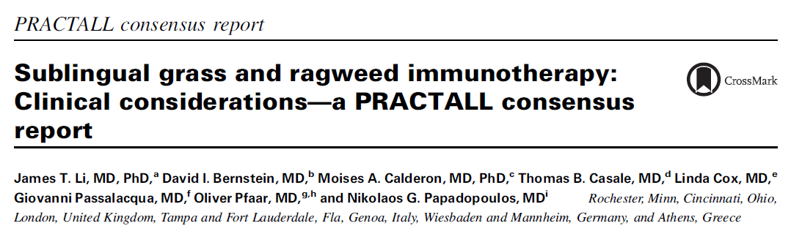
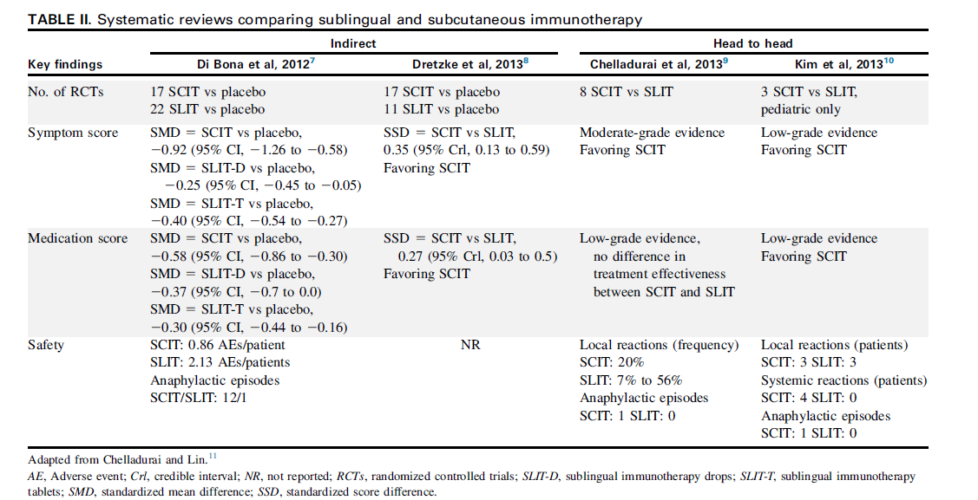
J Allergy Clin Immunol 2016;137:369-76.
Notes:
HOW DOES SLIT’S EFFECTIVENESS COMPARE WITH THAT OF SCIT?
In the United States SCIT is administered through the subcutaneous
route, and extracts are often mixed in a physician’s office,
whereas SLIT is administered through the sublingual route, with
tablets produced by manufacturers. Other countries might have
different SCIT and SLIT products available. There is insufficient
evidence to do a meaningful comparison of efficacy between
SCIT and SLIT; however, existing evidence suggests both routes
are effective in reducing symptom scores and medication use in
patients with allergic rhinitis and asthma compared with placebo.
Several systematic reviews and meta-analyses of randomized
controlled trials of SCIT, SLIT, or both versus placebo (indirect
and indirect comparison) suggest that SCIT might provide greater
clinical and immunologic efficacy (Table II).6-11

Slide 30

SLIT Uygulama Yaşı
Yaş sınırı yok
3 yaş
Canonica GW, et al. Sublingual immunotherapy: World Allergy Organization position paper 2013 update. World Allergy Organ J 2014;7:6.
Notes:
SLIT in young children
Immunotherapy guidelines do not specify a particular lower age limit for initiating AIT. the third update of Allergen Immunotherapy: A Practice Parameter [102] states that: Immunotherapy can be initiated in young children less than 5 years of age if indicated. Indications should be based on the severity of the disease, risk/benefit ratios, and the ability of the physician to correlate the clinical presentation with appropriate and obtainable allergy testing. One further study with dust mite SLIT in 138 children aged 2–5 years with asthma or rhinitis showed only mild to moderate local AEs [107].
SLIT is not subject to age limits (minimum or maximum)
and is safe and efficacious in all age groups if an allergic
mechanism is involved in pathogenesis, although evidence on
efficacy in children aged less than 5 years is lacking. One metaanalysis showed SLIT to be efficacious in children aged 3-18
years with allergic rhinitis (1a, A) [76]. Another study showed
that SLIT is poorly or moderately efficacious in children aged
less than 4 years who are monosensitized to house dust mites
and present symptoms of mild to moderate asthma [77]. SLIT
is safe in children aged more than 3 years [78].
Consequently, the preventive benefit of AIT is expected to be greater if initiated early in the course of the allergic disease, when the disease progression may be more easily influenced (see Preventive efficacy).[1
Yaş için alt yaş yok. Hatta erken dönemde başlanması daha iyi olur
With the use of SLIT, an appropriate lower age limit must be attained. Two clinical studies determined the lower age limit for HDM specifically. Shao et al. [17&&] discovered that SLIT for a dust mite allergy was effective in children 3–13 years old. Chen et al. [18] found that after comparing preschool- aged children, 3–6 years old, and schoolaged children, 7–14 years old, no difference was found in the effectiveness of SLIT. In both of these studies, no significant difference was found between the two age groups designated regarding safety or efficacy. The World Allergy Organization SLIT position paper also supported the same age range as noted by those studies [34].
Yaş alt sınırı 3 olarak veriyor

Slide 31
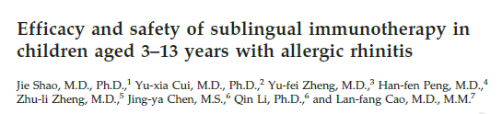
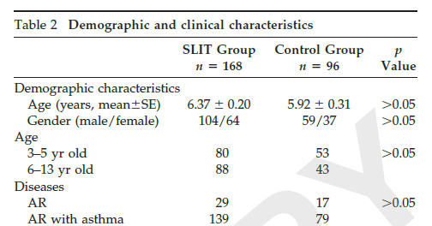
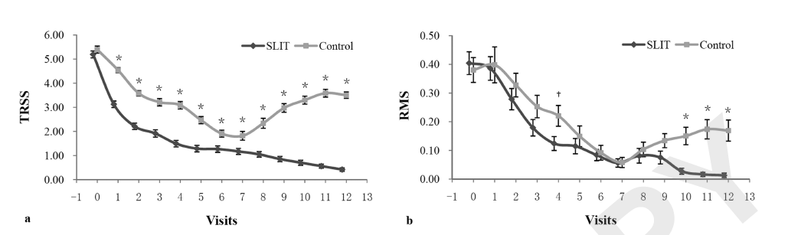
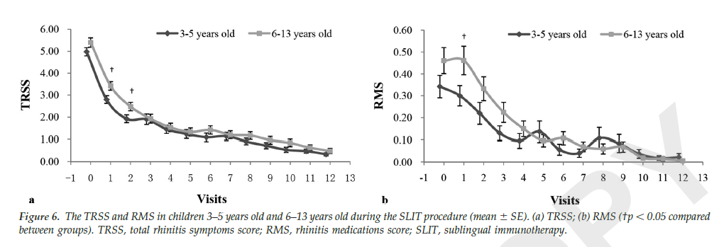
Am J Rhinol Allergy 2014;28:131-139
Notes:
ABSTRACT
Background: Sublingual immunotherapy (SLIT) is recommended for allergic diseases. However, clinical studies containing evidence-based data of this treatment in young children, which is rarely reported in the literature, are needed. This study was designed to assess the efficacy and safety of SLIT in children, including very young children.
Methods: Two hundred sixty-four children aged 3–13 years old (133 children, 3–5 years old) with Dermatophagoides farinae–induced allergic rhinitis
with or without asthma treated by standard pharmacotherapy had randomly received either SLIT (SLIT group) or no SLIT (control group) for 12 months.
Symptoms, medications, visual analog scale (VAS) and presence of adverse events (AEs) were assessed at monthly visits. Skin-prick test and Dermatophagoides farinae-specific IgE and IgG4 were measured before and after treatment.
Results: Both treatments were effective in the global clinical scores during the first seven visits when compared with baseline (all, p 0.01), and SLIT showed lower symptoms scores and VAS scores throughout this period (all, p 0.01). These improvements continued until the later visits only in the SLIT group. Also, the asthma medication consumption was decreased by SLIT treatment only at the end of study (p 0.01). The specific IgG4 was significantly increased after SLIT treatment when compared with the control group, but no significant change of specific IgE was observed in either groups. In the SLIT group, there was no significant difference between children less than or more than 5 years old in terms of clinical efficacy, onset of action, immunologic parameters, and safety. No severe systemic AEs were reported.
Conclusion: SLIT is effective and well-tolerated in children with allergic rhinitis 3-13 years old
One of the first large trials showing SL-AIT efficacy in a large group of small children.
As for age-groups, Shao et al. [36&] published the results for HDM liquid SLIT in one of the largest groups of preschool children studied so far: in a randomized-controlled trial of 264 children, of which 133 were between 3 and 5 years of age, who received HDM liquid SLIT from a Chinese manufacturer during 12 months. During the second part of the first year, ARC symptom-score and medication score improved more in the active versus the control group. Also, over 80% of the children had allergic asthma: in SLIT versus controls, in the second part of the first year, less asthma medication was taken (P<0.01).
Sublingual immunotherapy in the very young or elderly patients Although SLIT efficacy has been shown for children from 5 years onward, a discussion still remained concerning its efficacy in children below this age limit. Shao et al. [26] conducted a randomized controlled study of SLIT with Dermatophagoides farinaein 264 children (3–13 years) with allergic rhinitis with or without asthma. Among these individuals, 133 were between 3 and 5 years of age. SLIT showed a significant improvement in symptoms and medication after a year of treatment, as well as a rise in specific IgG4. Moreover, the investigators comment that there was no significant difference between children less than or more than 5 years old in terms of clinical efficacy, onset of action, immunologic parameters, and safety.

Slide 32
Efficacy of sublingual immunotherapy with Dermatophagoides farinae drops in preschool and school-age children with allergic asthma and allergic rhinitis
Chen S¹, Wang L², Liao F², Zeng X², Xing QB², Chen B², Lin XZ²
Zhonghua Er Ke Za hi. 2013;51(11):831-5.
n:122
Yaş: 3-14 (≤6 yaş, n: 59, >6 yaş, n:63)
Allerjik rinit ve astım tanılı
Ev tozu akarı duyarlı
SLIT en az iki yıl
Tedavi etkinliği ve yan etkiler açısından iki grup arasında fark yok
Notes:
OBJECTIVE:
To evaluate the efficacy of specific sublingual immunotherapy (SLIT) with Dermatophagoides farinae drops on children with allergic asthma and allergic rhinitis of the preschool and school-age groups of children and adolescents.
METHOD:
This study analyzed the efficacy of SLIT in 122 children (aged 3-14 yr) with house dust mites-induced allergic asthma and allergic rhinitis. According to the age, patients were defined as the preschool group ( ≤ 6 years old, n = 59) and school-age group (> 6 years old, n = 63). All children were treated with Dermatophagoides farinae drops for at least 2 years. Clinical observation and follow-up study were conducted during the treatment. Before and after SLIT for half a year, 1 year and 2 years, asthma symptom scores (day and night), rhinitis symptom scores and medication scores were evaluated. The adverse events were assessed during the study.
RESULT:
After SLIT for half a year, 1 year and 2 years, there were no significant differences between the preschool group (0.3 ± 0.5,0.0 ± 0.1,0.0 ± 0.0) and school-age group (0.3 ± 0.4,0.0 ± 0.1,0.0 ± 0.0) in day scores of asthma (Z value was -1.687, -0.613,0.000, all P > 0.05). There were no significant differences between the preschool group (0.2 ± 0.5,0.1 ± 0.3,0.0 ± 0.0) and school-age group (0.2 ± 0.4,0.1 ± 0.3, 0.0 ± 0.0) in night scores of asthma (Z value was -0.496, -0.486,0.000, all P > 0.05). There was no significant differences between the preschool group (1.4 ± 0.9,0.4 ± 0.5,0.1 ± 0.3) and school-age group (1.3 ± 0.9,0.5 ± 0.6,0.2 ± 0.4) in symptom scores of allergic rhinitis (Z value was -0.394, -1.166, -1.075, all P > 0.05). There were no significant differences between the preschool group (1.6 ± 0.8,0.0 ± 0.0,0.0 ± 0.0) and school-age group (1.7 ± 0.7,0.0 ± 0.0,0.0 ± 0.0) in medication scores of allergic rhinitis (Z value was -0.655,0.000,0.000, all P > 0.05). After SLIT for 2 years, most children in the preschool and school-age groups were no longer using asthma controlling medication, with no significant difference between the two groups (Z value was 0.000, P > 0.05). The overall incidence of adverse reactions was only 7%, and there was no significant difference in the incidence of adverse reactions between the two groups (χ(2) = 0.000, P > 0.05). The local adverse events were mild gastrointestinal discomfort and rash, a majority of local adverse events in the preschool group were diarrhea. No severe adverse events happened in the treatment.
CONCLUSION:
SLIT with Dermatophagoides farinae drops is safe and effective in children with allergic asthma and allergic rhinitis of the preschool and school-age groups of children and adolescents, which provides evidences for early SLIT intervention of the disease.

Slide 33

SLIT Optimal Süre
Tartışmalı

Slide 34
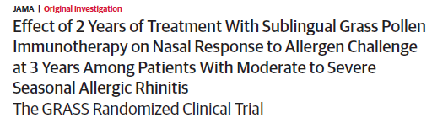
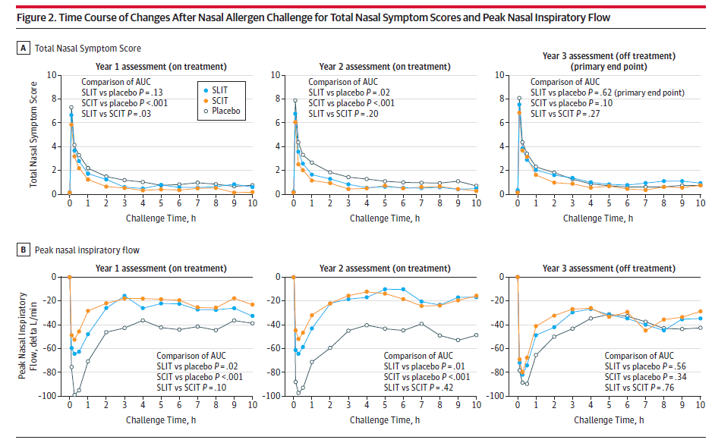
Scadding GW, et al. JAMA. 2017;317(6):615-625.
Notes:
IMPORTANCE Sublingual immunotherapy and subcutaneous immunotherapy are effective in
seasonal allergic rhinitis. Three years of continuous treatment with subcutaneous
immunotherapy and sublingual immunotherapy has been shown to improve symptoms for at
least 2 years following discontinuation of treatment.
OBJECTIVE To assess whether 2 years of treatment with grass pollen sublingual immunotherapy,
comparedwithplacebo,providesimprovednasalresponsetoallergenchallengeat3-yearfollow-up.
DESIGN, SETTING, AND PARTICIPANTS A randomized double-blind, placebo-controlled,
3–parallel-group study performed in a single academic center, Imperial College London, of
adult patients with moderate to severe seasonal allergic rhinitis (interfering with usual daily
activities or sleep). First enrollment was March 2011, last follow-up was February 2015.
INTERVENTIONS Thirty-six participants received 2 years of sublingual immunotherapy (daily
tablets containing 15 μg of major allergen Phleump 5 and monthly placebo injections), 36
received subcutaneous immunotherapy (monthly injections containing 20 μg of Phleum p 5
and daily placebo tablets) and 34 received matched double-placebo. Nasal allergen challenge
was performed before treatment, at 1 and 2 years of treatment, and at 3 years (1 year after
treatment discontinuation).
MAIN OUTCOMES AND MEASURES Total nasal symptom scores (TNSS; range; 0 [best] to 12
[worst]) were recorded between 0 and 10 hours after challenge. The minimum clinically
important difference for change in TNSS within an individual is 1.08. The primary outcome
was TNSS comparing sublingual immunotherapy vs placebo at year 3. Subcutaneous
immunotherapy was included as a positive control. The study was not powered to compare
sublingual immunotherapy with subcutaneous immunotherapy.
RESULTS Among 106 randomized participants (mean age, 33.5 years; 34 women [32.1%]), 92
completed the study at 3 years. In the intent-to-treat population, mean TNSS score for the
sublingual immunotherapy group was 6.36 (95%CI, 5.76 to 6.96) at pretreatment and 4.73
(95%CI, 3.97 to 5.48) at 3 years, and for the placebo group, the score was 6.06 (95%CI, 5.23
to 6.88) at pretreatment and 4.81 (95%CI, 3.97 to 5.65) at 3 years. The between-group
difference (adjusted for baseline) was −0.18 (95%CI, −1.25 to 0.90; [P = .75]).
CONCLUSIONS AND RELEVANCE Among patients with moderate to severe seasonal allergic
rhinitis, 2 years of sublingual grass pollen immunotherapy was not significantly different from
placebo in improving the nasal response to allergen challenge at 3-year follow-up.

Slide 35
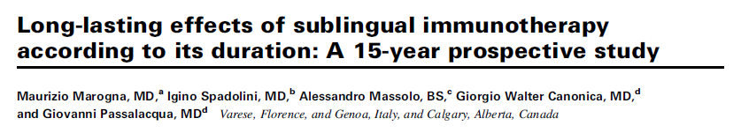
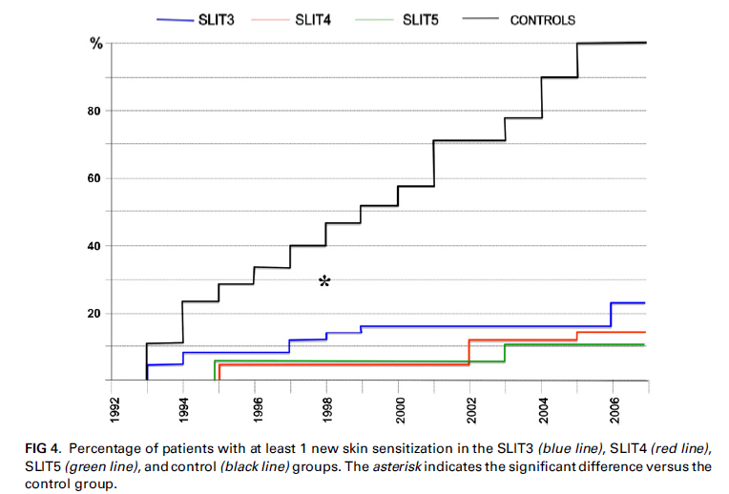
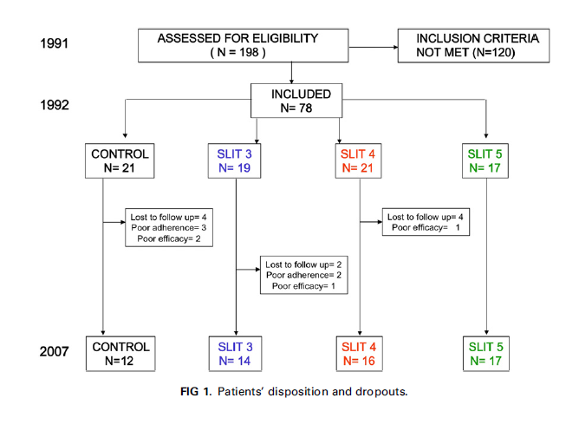
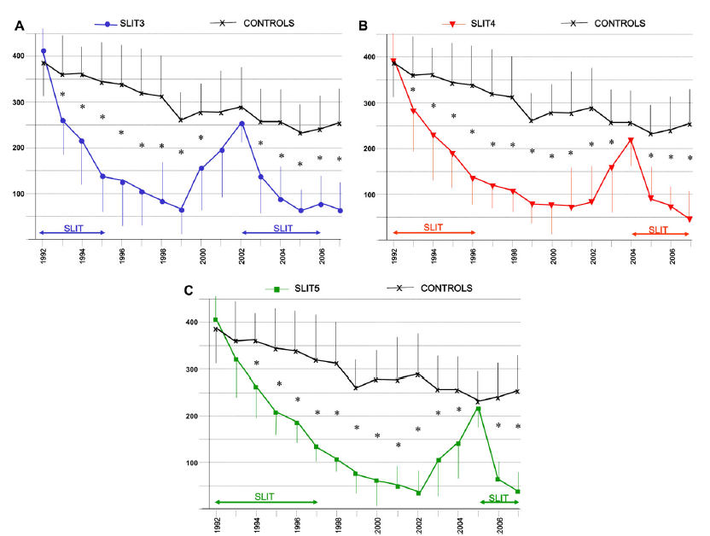
Notes:
6.4. Optimal duration of SLIT
The duration of SLIT that is necessary to induce long-term improvement is at least 3 years; no significant improvements have been observed in cycles lasting more than 5 years (1a, B). The authors of an open-label, placebo-controlled prospective study [232] evaluated patients with respiratory allergy and bronchial hyperreactivity who were monosensitized to mites. SLIT was administered for 3, 4, and 5 years, and efficacy was evaluated in the long term. In the case of the patients who received SLIT for 3 years, the benefits persisted for 7 years, whereas in those treated for 4 or 5 years the improvement persisted 8 years later. New sensitizations were detected in all the patients in the control group; among patients receiving the active treatment, less than 25% experienced new sensitizations (21%, 12%, and 11%, respectively).
232. Marogna M, Spadolini I, Massolo A, Canonica GW, Passalacqua G. Long-lasting effects of sublingual immunotherapy according to its duration: a 15-year prospective study. J Allergy Clin Immunol. 2010:126;969-975.
**************************
Duration of treatment
A clinical improvement can be reasonably expected already in the first year of therapy.[3] Several causes should be considered when the treatment fails: wrong in diagnosis; too short duration of therapy; inadequate dosage; inadequate adherence. [49] Therefore, patients treated with SLIT, who assume the doses at home, should be evaluated every 3–6 months, in order to: verify the clinical benefit of SLIT; check the appearance of any side effects; ensure adherence to treatment; examine the need of modify the dose, consistent with the package insert; consider, if indicated, to terminate treatment. The severity of the disease, the clinical benefit and the adherence to the treatment are relevant to decide to continue or suspend the treatment. Once a clinical benefit is ascertained, SLIT should be continued for a period of at least three years.[3] One controlled non-randomized study conducted on 78 adults with allergic rhinitis with or without asthma treated with dust mite SLIT for 3, 4 or 5 years showed that patients experienced persistent reduction in symptoms lasting 7, 8 and 8 years, respectively.[50] On these results, the authors suggested that 4 years of therapy was a reasonable duration, but this needs confirmation.[51] It is reasonable that the duration of SLIT (3–5 years) must be established on an individual basis.
Background: Data on the long-term effects of sublingual
immunotherapy (SLIT) are sparse, and the optimal duration of
treatment is a matter of debate.
Objective: We sought to prospectively evaluate the long-term
effect of SLIT given for 3, 4, or 5 years and to compare the effect
of those different durations.
Methods: In this prospective open controlled study we
followed up patients with respiratory allergy who were
monosensitized to mites for 15 years. The subjects were
divided in 4 groups receiving drug therapy alone or SLIT for
3, 4, or 5 years. Clinical scores, skin sensitizations,
methacholine reactivity, and nasal eosinophil counts were
evaluated every year during the winter months. The clinical
effect was considered to persist until clinical scores remained
at less than 50% of the baseline value, and then patients
underwent another course of SLIT.
Results: Seventy-eight patients were enrolled, and 59 completed
the study. In the 12 control subjects no relevant change in
clinical scores was seen throughout the study. In the patients
receiving SLIT for 3 years, the clinical benefit persisted for 7
years. In those receiving immunotherapy for 4 or 5 years, the
clinical benefit persisted for 8 years. New sensitizations occurred
in all the control subjects over 15 years and in less than a
quarter of the patients receiving SLIT (21%, 12%, and 11%,
respectively). The second course of vaccination induced a benefit
more rapidly than the first course. The behavior of bronchial
hyperreactivity and nasal eosinophils paralleled the clinical
score.
Conclusion: Under the present conditions, it can be suggested
that a 4-year duration of SLIT is the optimal choice because it
induces a long-lasting clinical improvement similar to that seen
with a 5-year course and greater than that of a 3-year
vaccination. (J Allergy Clin Immunol 2010;126:969-75.)

Slide 36
SLIT İstenmeyen Reaksiyonlar
Lokal reaksiyonlar
%40-75
Sistemik reaksiyonlar
Doz sayısı %0,056
Kişi olarak %0,38
Maloney J, et al. Allergy 2015;70:302-9.
Passalacqua G, et al. J Allergy Clin Immunol Pract 2017;5:13-21.

Slide 37
SLIT İstenmeyen Reaksiyonlar
Lokal reaksiyonlar
Ağızda ve dudaklarda kaşıntı, şişme
Kulakta kaşıntı
Bulantı, kusma, ishal
Karın ağrısı
Tad algısında değişme
Dilde ağrı
Ağız ve dilde ülserasyonlar
Boğaz irritasyonu
Sık
Nadir
Passalacqua G, et al. J Allergy Clin Immunol Pract 2017;5:13-21.
Notes:
Most LARs are mild, self-limited, resolve quickly, and have little impact on adherence.9,32 Nevertheless, local symptoms in the oral cavity may spread, on rare occasions, to the larynx, causing life threatening laryngeal edema.
Oromucosal reactions,
considered a SLIT local reaction, were relatively
common, affecting up to 75% of patients, and were seen
most frequently in the build-up phase
WHAT ADVERSE EVENTS CAN OCCUR WITH SLIT?
Adverse reactions associated with SLIT can be local or systemic. Local reactions, such as oral or mild gastrointestinal symptoms, are fairly common, affecting up to 75% of SLIT-treated patients.41 Itching or irritation affecting the lips, tongue, ears, or throat are the most common reported symptoms. Isolated gastrointestinal symptoms associated with SLIT, such as abdominal pain or nausea, can be considered local reactions caused by swallowing the tablet contents. If gastrointestinal symptoms occur in conjunction with other systemic symptoms, they would be considered systemic reactions

Slide 38
SLIT İstenmeyen Reaksiyonlar
Sistemik reaksiyonlar
Astım
Allerjik rinit
Anafilaksi
Ürtiker, anjioödem
GIS semptomları (Sistemik semptomlarla birlikte)
Uvula ödemi
Wheezing, dispne
Hipotansiyon
Maloney J, et al. Allergy 2015;70:302-9.
Notes:
Specifically, children did not have any more adverse events than adults in any SLIT studies [3]. The use, benefit, and safety of SLIT in children and recent, relevant clinical trials, which are presented in Table 1 [6,7–10,11,12–14,15,16,17, 18–20], will be discussed.
SLIT adverse reactions accounted for treatment withdrawal
in 3% of the SLIT patients, compared with 1.4%
of the placebo-treated patients

Slide 39


112,330 olgu
12 olgu
Notes:
It is, therefore,
noteworthy that looking at the reports published up
to 30 June 2013, merely 12 cases of anaphylaxis due (112,330 olgu)
to SLIT have been observed [33,35–41] (Table 2).
In fact, an over-dosage of
allergen, the use of non standardized extracts such
as latex or multiple allergen extracts could partially account for these reactions.
Moreover, it is also
interesting that SLIT tablet-induced anaphylaxis
was reported in patients with previous systemic
reactions to SCIT. Therefore, on clinical grounds,
switching from SCIT to SLIT in patients with
systemic reactions to SCIT is not advisable. Furthermore,
the use of only standardized extracts is recommended
in daily practice.

Slide 40

SLIT İstenmeyen Reaksiyonlar
Görülme zamanı;
Tedaviye başladıktan kısa süre sonra
2 hafta içinde düzelir
Lokal reaksiyonların süresi 10 günü geçmez
Cox L, et al. J Allergy Clin Immunol 2010;125:569-74

Slide 41
Risk Etkenleri
Daha önce SCIT ilişkili sistemik reaksiyon
Daha önce sistemik reaksiyon öyküsü
Astım-Kontrolsüz astım
Mevsimsel etki
Oral lezyon veya enfeksiyonlar
Nonstandardize ekstraklar
Çoklu allerjen karışımı
Doz (Yüksek doz-İlk doz)
Hızlandırılmış program
Hasta ilişkili
İlaç ilişkili
de Groot H, et al. Allergy 2009;64:963–964
Blazowski L. Allergy 2008;63:374
Nakayama T, et al. Int Arch Allergy Immunol 2010;153:378–387
Notes:
Risk factors for SLIT adverse events
No clear predictors for SLIT AEs have been identified, although some of the factors in the SLIT anaphylaxis case reports are recognized as risk factors for SCIT: height of season [81], history of previous systemic reactions [79], dose [80], and accelerated schedules [83].
In addition, most of the patients with SLIT-related SAEs or anaphylaxis had asthma; symptomatic asthma has been identified as a risk factor for AEs with SCIT [70,87].
In general, patients receiving SLIT are not prescribed
injectable epinephrine in the event of a rare systemic reaction.
However, in the study of 43 patients that identified
prior SCIT systemic reaction as a possible predictor
for SLIT systemic reaction, injectable epinephrine was
prescribed as an ethics committee requirement, and 2
patients used it [86].
************************
height of season [81],
history of previous systemic reactions [79],
dose [80],
accelerated schedules
most of the patients with SLIT-related SAEs or anaphylaxis had asthma (70, 87)
No patient-related risk factors for systemic reactions have been clearly defined, even if uncontrolled asthma, oral lesions or infections and previous severe SCIT-related adverse events can be considered specific risk factors [23&,24].
Suboptimal administration procedures (use of nonstandardized extracts, mixtures of many allergens, over-dosing) may also increase the risk of local adverse events [23&,28].
Risk factors identified in these reports included overdose, newly started SLIT (first dose), multiallergen SLIT, and previous SARs to SCIT or asthma exacerbations with SCIT.

Slide 42

SLIT İstenmeyen Reaksiyonlar
%3-6
Lokal reaksiyonlar nedeniyle SLIT’ın bırakılması
Maloney J, et al. Ann Allergy Asthma Immunol 2014; 112:146-155
Notes:
Despite the lessened risk of systemic reaction, 3% of patients discontinue therapy due to local reactions, though one placebo-controlled trial reported a 6% discontinuation rate

Slide 43

Adrenalin Kullanımı
1795
72
Senna G, et al. Curr Opin Allergy Clin Immunol 2013;13:656-662
Notes:
THE REAL-LIFE SETTING
The safety and tolerability of SLIT in daily practice
was evaluated in several postmarketing surveys published
up to 30 June 2013 [18–22,29–34] (Table 1).
Overall, a population of 1795 patients, mostly
children, was assessed. In fact 7 out of the 11 surveys
considered only a pediatric population [18,20,21,
29–31,34], and in two surveys children below5 years
were included [29,30]. A total of 72 systemic reactions
and 291 local reactions were registered. However,
if we focus only on the use of epinephrine as a
marker of life-threatening reactions, this was utilized
only in two cases (0.1%). Most of the systemic
reactions reported were mild and resolved spontaneously
without treatment.

Slide 44


J Allergy Clin Immunol Pract 2017;5:84-9
Notes:
In a recent summary of 29 SLIT-tablet trials, epinephrine was
administered in 35 subjects; 25 were receiving active treatment
with SLIT, and 16 administrations were for SLIT treatmentrelated
events.39 The authors calculated that 0.2% of subjects
(16/8152) received epinephrine for SLIT-related events, and that
none of the events were considered serious or resulted in airway compromise.
BACKGROUND: Allergy immunotherapy can result in systemic
allergic reactions and even life-threatening anaphylaxis requiring
epinephrine administration.
OBJECTIVE: The objective of this study was to describe
epinephrine use in the clinical trial development programs of 3
rapidly dissolving sublingual immunotherapy tablets (SLITtablets;
Merck & Co., Inc., Kenilworth, NJ/ALK, Hørsholm,
Denmark/Torii Pharmaceutical Co., Ltd., Tokyo, Japan).
METHODS: Data on epinephrine use were collected from 13
timothy grass SLIT-tablet trials (MK-7243; £2800 bioequivalent allergen units/75,000 SQ-T dose, n [ 2497; placebo, n [
2139), 5 short ragweed SLIT-tablet trials (MK-3641; £12 Amb a
1-U, n [ 1725; placebo, n [ 770), and 11 house dust mite
(HDM) SLIT-tablet trials (MK-8237; £12 SQ-HDM; n[3930;
placebo, n [ 2246).
RESULTS: In grass SLIT-tablet trials, epinephrine was used 13
times (grass SLIT-tablet, n [ 10; placebo, n [ 3). Eight
administrations were for grass SLIT-tablet-related adverse events
(AEs): 4 for systemic allergic reactions and 4 for local mouth
and/or throat swelling. In ragweed SLIT-tablet trials, epinephrine
was used 9 times in 8 subjects (ragweed SLIT-tablet, n [ 7;
placebo, n [ 1 [2 administrations for protracted anaphylaxis]).
Four administrations were for ragweed SLIT-tablet-related AEs:
1 for systemic allergic reaction and 3 for local mouth and/or
pharynx/throat swelling. In HDM SLIT-tablet trials, epinephrine
was administered 13 times (HDM SLIT-tablet, n [ 8;
placebo, n [ 5). Four administrations were for HDM SLITtablet-
related AEs: 1 for systemic allergic reaction and 3 for local
events. Of the 16 epinephrine administrations for events related
to SLIT-tablet treatment, 11 occurred within the first week of
treatment (7 administrations on day 1) and 5 were subject selfadministered.
CONCLUSIONS: Epinephrine administrations in response to
SLIT-tablet-related reactions in clinical trials are uncommon,
typically occur within the first week of treatment, and are rarely
self-administered. All SLIT-tablet-related events treated with
epinephrine were nonserious. 2016 American Academy of
Allergy, Asthma & Immunology (J Allergy Clin Immunol Pract
2017;5:84-9)

Slide 45

Adrenalin kullanımı
Avrupada 1 milyardan fazla doz SLIT
USA’da 900,000 hasta
Şiddetli anafilaksi nadir
SLIT ilişkili ölüm yok
Adrenalin, USA’da (FDA tarafından) SLIT için önerilmekte
1,8/100 000 tablet
Diğer ülkelerde önerilmemekte
Nolte H, et al. J Allergy Clin Immunol Pract 2017;5:84-9
Notes:
A cost-benefit analysis of injectable epinephrine for stinging insect
allergy concluded that EAIs are cost-effective when the fatality
rate exceeded 2 per 100,000 persons at risk.9
*******************************************
Epinephrine was administered for SLIT-tablet-related events
at a rate of 1.80 administrations per 100,000 SLIT-tablets [69].

Slide 46
SLIT Güvenliği
SLIT, SCIT’dan daha iyi tolere edilmektedir
SLIT istenmeyen reaksiyonlarının çoğunluğu lokal reaksiyonlardır. Tedavinin başlangıcında görülmekte ve herhangi bir tıbbi müdahale olmadan birkaç gün-hafta içinde düzelmektedir
Anafilaksi nadir, ölüm yok.
Şiddetli reaksiyonlar için risk faktörleri henüz tanımlanmamıştır. Fakat daha önce SCIT’a sistemik reaksiyon görülmesi risk faktörü olabilir
SLIT allerji uzmanı ve eğitimi olan doktorlar tarafından reçete edilmelidir
Canonica GW, et al. Sublingual immunotherapy: World Allergy Organization position paper 2013 update. World Allergy Organ J 2014;7:6.
Notes:
Chapter 5: Safety of sublingual immunotherapy
Sublingual immunotherapy (SLIT) appears to be better tolerated than subcutaneous immunotherapy (SCIT). SLIT should only be prescribed by physicians with appropriate allergy training and expertise.
Specific instructions should be provided to patients regarding the management of adverse reactions, unplanned interruptions in treatment, and situations when SLIT should be withheld.
The majority of SLIT adverse events are local reactions (e.g., oromucosal pruritus) that occur during the beginning of treatment and resolve within a few days or weeks without any medical intervention (e.g., dose adjustment, medication).
A few cases of SLIT-related anaphylaxis have been reported but there have been no fatalities.
Risk factors for the occurrence of SLIT severe adverse events (SAEs) have not yet been established, although there is some suggestion that patients who have had prior systemic reactions to SCIT may be at increased risk.

Slide 47
Kontrendikasyonlar
Kesin:
1. Şiddetli immün sistem bozuklukları, şiddetli dolaşım sistemi bozuklukları, malign hastalıklar, kronik inflamasyonlar.
2. Şiddetli, stabil olmayan, kontrolsüz astım – FEV1< %70
3. β–bloker tedavisi
4. Uyumun iyi olmaması ve şiddetli mental bozukluklar
Rölatif:
1. Gebelik (Önce başlanmışsa devam edilebilir)
2. GIS mukozasını tutan geçici inflamatuar durumlar, akut enfeksiyonlar, diş çekimi veya kaybı, ağızda cerrahi müdahale
Canonica GW, et al. Sublingual immunotherapy: World Allergy Organization position paper 2013 update. World Allergy Organ J 2014;7:6.
Notes:
Contraindications to SLIT [1, 46]. There are no studies focusing on the safety of SLIT when SIT is contraindicated. According to expert opinion, it seems reasonable to maintain the same contraindications.
7.3.2 Infection
In general, SLIT should not be administered to patients with infections, especially respiratory or oral infections (oral thrush, oral ulcers, gingivitis, or periodontitis). The doses should be delayed in the same circumstances as in SCIT until the infection has resolved (5, D).
7.3.3 Oral surgery or tooth extraction
In cases of oral surgery or tooth extraction, treatment
should be suspended for 7 days and restarted with the same
dose. In any case, treatment should not be restarted until 24-
48 hours after the patient’s health status returns to normal.
In the case of longer interruptions, treatment should be
restarted at the previous dose and under medical supervision [87] (4, D).
In children, treatment should also be suspended temporarily
after the loss of milk teeth and until the wound has completely healed.
Prescription of immunotherapy to patients with immunological or autoimmune diseases should be on an individual basis, and the risk-benefit ratio should be taken into account in each case, since there are no controlled studies on the effectiveness of or risks associated with immunotherapy in these patients (5, D). The possibility that patients with immunological/autoimmune diseases present a greater risk of unexpected reactions is merely hypothetical.

Slide 48

SLIT’ın Astım Gelişimine Etkisi
Arasi S, et al. Expert Rev Clin Immunol 2016;12(1):49–56
Notes:
Preventive efficacy
An interesting aspect concerns the possible preventive role of
AIT in the progression of allergic diseases. It is known that the
clinical expression of the respiratory allergies tends to change
over time, according to a “natural history,” the so-called “atopic
march.” In the typical sequence, allergic rhinitis often precedes
asthma and, therefore, it can be considered a risk factor for the
development of allergic asthma. Moreover, patients with rhinitis
may have a bronchial hyper-responsiveness, which is a predictor
for the onset of allergic asthma.[25–28] Several studies
suggest that AIT is capable of modifying the natural history of
the allergic respiratory diseases.[3] The few studies on the
preventive effects of SLIT on the development of asthma in
children with allergic rhinitis clearly showed the superiority of
the association of SLIT and drug therapy on drug therapy
alone.[29–34] In addition, a preventive effect on the development
of bronchial hyper-reactivity was documented.[32]

Slide 49
SLIT’ın Astım Gelişimine Etkisi
n: 113 (SLIT: 48, kontrol: 49)
Yaş: 5-14
SLIT 3 yıl
Kontrol grubunda 3,8 kat daha yüksek
Novembre E, et al. J Allergy Clin Immunol 2004;114:851-7.
n: 216 (SLIT: 144, Kontrol:72)
Yaş: 5-17
SLIT 3 yıl
SLIT: %1,5, Kontrol grubu: %28,8
Marogna M, et al. Ann Allergy Asthma Immunol 2008;101:206–211.
Notes:
Background: We wondered whether short-term coseasonal
sublingual immunotherapy (SLIT) can reduce the development
of asthma in children with hay fever in an open randomized
study.
Objective: We sought to determine whether SLIT is as effective
as subcutaneous immunotherapy in reducing hay fever
symptoms and the development of asthma in children with
hay fever.
Methods: One hundred thirteen children aged 5 to 14 years
(mean age, 7.7 years) with hay fever limited to grass pollen and
no other clinically important allergies were randomized in an
open study involving 6 Italian pediatric allergy centers to
receive specific SLIT for 3 years or standard symptomatic
therapy. All of the subjects had hay fever symptoms, but at the
time of study entry, none reported seasonal asthma with more
than 3 episodes per season. Symptomatic treatment was limited
to cetirizine, loratadine, nasal budesonide, and salbutamol on
demand. The hay fever and asthma symptoms were quantified
clinically.
Results: The actively treated children used less medication in
the second and third years of therapy, and their symptom
scores tended to be lower. From the second year of
immunotherapy, subjective evaluation of overall allergy
symptoms was favorable in the actively treated children.
Development of asthma after 3 years was 3.8 times more
frequent (95% confidence limits, 1.5-10.0) in the control
subjects.
Conclusions: Three years of coseasonal SLIT improves seasonal
allergic rhinitis symptoms and reduces the development of
seasonal asthma in children with hay fever. (J Allergy Clin
Immunol 2004;114:851-7.)
************************************
Background: Sublingual immunotherapy (SLIT) has been proved to be effective in allergic rhinitis and asthma, but there are
few data on its preventive effects, especially in children.
Objective: To evaluate the clinical and preventive effects of SLIT in children by assessing onset of persistent asthma and new
sensitizations, clinical symptoms, and bronchial hyperreactivity.
Methods: A total of 216 children with allergic rhinitis, with or without intermittent asthma, were evaluated and then randomized
to receive drugs alone or drugs plus SLIT openly for 3 years. The clinical score was assessed yearly during allergen exposure.
Pulmonary function testing, methacholine challenge, and skin prick testing were performed at the beginning and end of the study.
Results: One hundred forty-four children received SLIT and 72 received drugs only. Dropouts were 9.7% in the SLIT group
and 8.3% in the controls. New sensitizations appeared in 34.8% of controls and in 3.1% of SLIT patients (odds ratio, 16.85; 95%
confidence interval, 5.73– 49.13). Mild persistent asthma was less frequent in SLIT patients (odds ratio, 0.04; 95% confidence
interval, 0.01– 0.17). There was a significant decrease in clinical scores in the SLIT group vs the control group since the first year.
The number of children with a positive methacholine challenge result decreased significantly after 3 years only in the SLIT group.
Adherence was 80% or higher in 73.8% of patients. Only 1 patient reported systemic itching.
Conclusions: In everyday clinical practice, SLIT reduced the onset of new sensitizations and mild persistent asthma and
decreased bronchial hyperreactivity in children with respiratory allergy.

Slide 50
SLIT’ın Astım Gelişimine Etkisi
Grass Asthma Prevention (GAP) çalışması
n: 812 ( SLIT:406, kontrol: 406)
Yaş: 5-12
SLIT :%29, Kontrol grubu: %49
Valovirta E, et al. Clin Ther 2011; 33:1537-1546.
n: 18 (SLIT: 8, Kontrol: 10)
Yaş: 5-10
HDM monosensitize AR
SLIT: 1yıl
Kontrol grubunda BHR’de 3 kat artış
Aydogan M, et al. Respiratory Medicine 2013; 107:1322-1329
Notes:
Aydogan et al. [13] conducted a randomized study involving pediatric patients who were skin-tested positively to house dust mite (HDM) and were not diagnosed with asthma. The purpose of the study focused on the effectiveness of SLIT on HDM-allergic nonasthmatic children. The total symptom scores of both the active and placebo groups improved from the baseline. SLIT was proven successful in decreasing the skin, nasal, and bronchial reactivity to methacholine [13].
ABSTRACT
Background: Allergic rhinoconjunctivitis is a risk
factor for asthma development. Treating the underlying
allergy may represent an attractive method of
asthma prevention. No regulatory guidance exists in
this area, and, to our knowledge, no clinical investigations
meeting modern regulatory standards have been
published.
Objective: The objective of this publication is to
describe the rationale behind the design of and report
on the recruitment for the ongoing pediatric Grazax
Asthma Prevention (GAP) trial.
Methods: The trial was designed for assessment of
the preventive effect of an SQ-standardized grass allergy
immunotherapy tablet (AIT) on asthma development,
both during treatment and after the end of treatment.
(The standardized quality [SQ] procedure is a
standardization procedure comprising 3 components:
total potency, major allergen content, and assessment
of extract complexity.) The trial design was discussed
with several European Competent Authorities.
Results: The GAP trial is a multinational, parallelgroup,
double-blind, placebo-controlled randomized
trial. Main eligibility criteria were age of 5 to 12 years,
grass pollen–induced allergic rhinoconjunctivitis, no
asthma, and no overlapping symptomatic allergies.
The children have been randomized 1:1 to receive the
grass AIT or placebo once daily for 3 years, followed
by a blinded observational period of 2 years. Asthma is
assessed by the investigators according to specific diagnostic
criteria, used at screening visits before randomization
to exclude children with existing asthma, and
evaluated at least half-yearly during the trial. Seven
months of screening resulted in 812 randomized children
at 101 centers in 11 countries.
Conclusions: To our knowledge, the GAP trial represents
the first double-blind, placebo-controlled randomized
trial to assess the preventive effect of allergen-
**************************************
Summary
Background: Although sublingual immunotherapy (SLIT) has been demonstrated to be a safe
and efficient treatment in children with seasonal allergic rhinitis (AR), there is little evidence
on the efficacy of SLIT with house-dust-mite (HDM) extract in children with isolated perennial
AR.
Objectives: We sought to assess the clinical efficacy and safety of HDM-SLIT in children with
isolated allergic rhinitis-conjunctivitis mono-sensitized to HDM without asthma symptoms.
Methods: Twenty-two children (aged 5e10 years) with perennial AR and conjunctivitis symptoms
mono-sensitized to Dermatophagoides pteronyssinus and Dermatophagoides farinae were
enrolled. During a 2 months run-in period, symptom and medication scores, lung functions,
bronchial hyperreactivity, nasal provocation and skin prick tests were evaluated.
Subjects were randomized to active or placebo using a double-blind method. A total of eighteen
subjects were randomised to receive either active SLIT or placebo for 12 months. Daily symptom and medication scores, baseline lung functions, bronchial hyperreactivity, nasal
provocation and skin prick tests were recorded and re-evaluated at the end of treatment.
Results: After one year of treatment, no significant differences were detected in the between
groups and within group comparisons based on total rhinitis symptom/medication scores
(p > 0.05). Skin reactivity to Dermatophagoides pteronyssinus was significantly reduced in
HDM-SLIT compared to placebo group (p Z 0.018). A significant reduction in nasal sensitivity
was observed in SLIT group after one year treatment when compared to baseline
(p Z 0.04). Total conjunctivitis symptoms were reduced significantly in both active and lacebo
group at the end of treatment compared to baseline. The proportion of patients with nonspecific
bronchial hyperreactivity increased to almost 3-fold in placebo group compared to
baseline.
Conclusion: HDM-SLIT was not superior to placebo in reducing isolated rhinoconjunctivitis
symptoms within 12 months of treatment. However, HDM-SLIT has a modulating effect on
allergen-specific nasal and skin reactivity in isolated perennial AR children.

Slide 51
SLIT Yeni duyanma
n: 216 (SLIT: 144, Kontrol:72)
Yaş: 5-17
SLIT: 3 yıl
Yeni duyarlanma;
SLIT: %3,1
Kontrol grubu: %34,8
Marogna M, et al. Ann Allergy Asthma Immunol 2008;101:206–211.
n: 198
Yaş: 14-38
Yeni duyarlanma;
Kontrol grubu: %100
SLIT-3 yıl: %21,4
SLIT-4 yıl: %12,5
SLIT-5 yıl: %11,7
Marogna M, et al. J Allergy Clin Immunol 2010;126:969-75.

Slide 52

SLIT Uyum
Yaşa göre SLIT’ın bırakılması;
Çocuk-Yetişkin %41
<6 yaş %45 (tablet/damla)
<4 yaş %100 (tablet)
Pajno GB, et al. Pediatr Allergy Immunol 2012;23:688-689.
Notes:
Recognizing the importance of treatment adherence for
SLIT efficacy, one study evaluated the adherence to SLIT in 150 children <6 years old over a 2-year period [74]. Overall, 45% of the children discontinued treatment. The percentage of discontinuations was significantly higher in the children <4 years old than in the older children, with all discontinuations in this age group occurring within the first 3 months of treatment. The most common cause for withdrawal in the children <4 years old was “… the subjective discomfort in keeping under the tongue drops/ tablets, or children’s refusal, without apparent side effects.” The parents attributed their children’s refusal to unpleasant taste. There was no difference in adherence between tablets or drops in the older children, but tablets were discontinued in 100% of the children <4 years old.
The authors speculated that the local SLIT side effects are more troublesome in young children and suggested that SLIT would best be started after age 4 because of poor adherence in younger children.
4 yaşından küçük çocuklarda uyum kötü
Adherence
The efficacy of SLIT is strictly dependent on adherence. SLIT is self-administered at home, thus requiring a daily commitment, for a long-term therapy. A US study on children and adults reported a constant dropout rate of 41% over a 4-year period above all for referred efficacy concerns.[52] Several European studies assessed compliance to SLIT in children. Among them, one study conducted on 150 children younger than 6 years old over a 2-year period reported an overall attrition rate of 45%.[53] In particular, children <4 years showed a percentage of discontinuation significantly higher than the older ones, and all discontinuations in the younger group occurred within the first 3 months of treatment. There was no difference in adherence between tablets or drops in the older children, but tablets were discontinued in 100% of the children <4 years old.[53] There was one asthma reaction leading to SLIT withdrawal in the <4-year-old group. The authors suggested that SLIT would best be started after age 4 years because of poor adherence in younger children
Fakat uyum kötü
Recognizing the importance of treatment adherence for SLIT efficacy, one study evaluated the adherence to SLIT in 150 children <6 years old over a 2-year period [74]. Overall, 45% of the children discontinued treatment. The percentage of discontinuations was significantly higher in the children <4 years old than in the older children, with all discontinuations in this age group occurring within the first 3 months of treatment. The most common cause for withdrawal in the children <4 years old was “… the subjective discomfort in keeping under the tongue drops/ tablets, or children’s refusal, without apparent side effects.” The parents attributed their children’s refusal to unpleasant taste. There was no difference in adherence between tablets or drops in the older children, but tablets were discontinued in 100% of the children <4 years old.
The authors speculated that the local SLIT side effects are more troublesome in young children and suggested that SLIT would best be started after age 4 because of poor adherence in younger children.
4 yaşından küçük çocuklarda uyum kötü

Slide 53
SLIT Mono/Polisensitize
Polisensitize hastalarda;
Poliallerjen IT’e karşı monoallerjen IT daha mı iyi?
Polisensitize hasta %51-82
Fark yok
Emminger W,et al. J All Clin Immunol 2009;123: s75
Calderon MA, et al. J Allergy Clin Immunol 2012;129:929–934
Ciprandi G, ,et al. Int J Immunopathol Pharmacol. 2010; 23: 637–40.
Lee JE, et al. Ann Allergy Asthma Immunol. 2011; 107: 79–84.
Marogna M, et al. Allergy. 2004:59;1205-1210.
Nelson H, et al. Allergy 2013;68:252-5.
Monosensitize daha etkili
Amar SM, et al. J Allergy Clin Immunol 2009;124:150–6.
Notes:
IS IT BETTER TO USE MONO-VERSUS POLYALLERGEN IMMUNOTHERAPY IN POLYSENSITIZED PATIENTS?
Epidemiologic data indicate that the prevalence of polysensitization is between 51% and 82% in patients with allergic sensitivity in both Europe and the United
Let us first examine the data exploring single allergen SLIT in mono- versus polysensitized patients. In a review by Caldero´n et al., robust, large-scale clinical trials of grass pollen SLIT showed that polysensitized patients benefited at least as much from allergy immunotherapy as monosensitized patients.1 In a study by Emminger et al., approximately 72% of patients were polysensitized, and only 28% of patients were monosensitized to grass.4 In the patients that were sensitized to grass plus one or more allergens, their response rates to SLIT were as good or slightly better as those that were sensitized to grass alone. This improvement was seen in both better symptoms scores and medications scores.
Therefore, single allergen immunotherapy has proved to be as effective in polysensitized patients as in monosensitized patients. However, the data come mostly from studies with grass pollen.

Slide 54



Notes:
Abstract
Objectives:
To document the effectiveness and safety of sublingual allergen immunotherapy (SLIT) with a five-grass
pollen tablet (Oralair*) and compare different treatment options in a broad, non-selected population of
patients in a real-world clinical setting.
Research design and methods:
This was a 2 year, open, prospective, multicenter, single-arm, non-interventional study. Patients with a
history of clinically relevant allergic symptoms caused by grass pollen, confirmed by skin prick testing,
received treatment with the five-grass pollen tablet. Concomitant treatment with symptomatic medication
and/or additional SLIT or subcutaneous immunotherapy (SCIT) was permitted. Twelve-month data are
presented here. Effectiveness was assessed comparing a combined rhinoconjunctivitis (RC) score
derived from the severity of rhinitis and conjunctivitis symptoms under treatment with retrospective data
of the previous year.
Results:
A total of 1408 patients participated in the study, of whom 434 were children/adolescents and 962
polyallergic. Compared with the grass pollen season preceding five-grass pollen tablet treatment, a
statistically significant reduction of 49.9% was achieved in RC score for the total population (p50.001),
and an improvement in overall health was perceived by 90.9% of patients. The overall population of
polyallergic patients derived similar benefits from treatment with the five-grass pollen tablet as
monoallergic patients. The percentage reduction in RC score was larger in polyallergic patients taking no
additional therapy (60.2%) than in those taking concomitant symptomatic medication (38.1%) or allergen
immunotherapy (AIT) (50.8%). Within the last of these groups, RC score improved by 47.6% among patients
receiving additional SCIT, versus 54.8% with additional SLIT. Adverse drug reactions, reported in 15.3% of
study participants, were mostly local in nature and mild or moderate in intensity.
Conclusions:
After 1 year of treatment, polyallergic patients responded similarly to the five-grass pollen tablet as
monoallergic patients. For polyallergic patients in whom additional treatment was needed, a second SLIT
may be more beneficial than a SCIT or symptomatic co-medication.

Slide 55


J Allergy Clin Immunol Pract 2016;4:301-9
Notes:
N: 102
Yaş: 18-65
grass and ragweed sublingual immunotherapy (SLIT) tablets
İstenmeyen reaksiyon ve tedavi kesilmesi mono ve çoklu kullanımda farklı değil
İyi tolerans
This study suggests that coadministration of both grass and ragweed SLIT tablets is safe, but further clinical long-term trials are needed to determine whether there is any effect on efficacy.23
23. Maloney J, Berman G, Gagnon R, Bernstein DI, Nelson HS, Kleine-Tebbe J, et al. Sequential treatment initiation with timothy grass and ragweed sublingual immunotherapy tablets followed by simultaneous treatment is well tolerated. J Allergy Clin Immunol Pract 2016;4:301-309.e2
Çoklu SLIT yararlı

Slide 56
SLIT Diğer Kullanımlar
All.Rinit
Astım
Atopik dermatit
Besin allerjisi
Notes:
OTHER USES FOR SUBLINGUAL IMMUNOTHERAPY
In addition to allergic rhinitis, ARC, and asthma,
SLIT efficacy has also been assessed in atopic dermatitis
and food allergies. SLIT was proven to reduce
eczema symptoms in atopic dermatitis patients [35].
However, only a few clinical research studies have
been done in this area. Pajno et al. [36] found, in
a double-blind, randomized, placebo-controlled
study in children from age 5 to 16 years who were
diagnosed with atopic dermatitis, SLIT was effective
in reducing atopic dermatitis (SCORing Atopic
Dermatitis) after 9 months of treatment

Slide 57


SLIT Atopik Dermatit
n: 56 (SLIT: 28, kontrol: 28)
Yaş: 5-16
SLIT (HDM)
SCORAD (bazale göre değişiklik) ;
AD % 10.2
Kontrol %4
Pajno GB, et al. J Allergy Clin Immunol. 2007;120:164-70.
n: 35
AD (n:16) …………………………..%68.8 iyileşme…………………..1 hasta astım gelişimi
AD+Astım/AR (n:19) ………….%73,7 iyileşme
Mastrandrea F, et al. Allergol Immunopathol. 2000;28:54-62.
p=0,025
Notes:
ATOPIC DERMATITIS (AD)
The study carried out by Pajno et al. showed an improvement in the SCORAD index solely in individuals allergic to house dust mites who suffered from a mild form of AD [69]. In AD patients with mono-sensitization to house dust mites, SLIT may be considered [70]. The authors of the review emphasize that the efficacy of immunotherapy in patients with atopic eczema has been poorly investigated in the past 5 years, mostly with small, heterogeneous groups, and short duration of study. [53]
Conclusion: Based on the currently available evidence, there is no proof of the efficacy of SLIT in patients with AD [53].
Pajno GB, Caminiti L, Vita D, Barberio G, Salzano G, Lombardo F, et al. Sublingual immunotherapy in mite-sensitized children with atopic dermatitis: A randomized, double-blind, placebo-controlled study. J Allergy Clin Immunol. 2007; 120: 164–70.
53. Compalati E, Rogkakou A, Passalacqua G, Canonica GW. Evidences of efficacy of allergen immunotherapy in atopic dermatitis: an updated review. Curr Opin Allergy Clin Immunol. 2012; 12: 427–33.
70. Mastrandrea F, Mirelli SG, Meinardi A, Starcia G, Corraduzza G, Parciani S. Specific sublingual immunotherapy in atopic dermatitis. Results of a 6-year follow-up for 35 consecutive patients. Allergol Immunopathol. 2000; 28: 54–62.
************************************************
Background: Atopic dermatitis often has an allergic
component, and immunotherapy may therefore prove
beneficial.
Objective: To assess the effect of sublingual immunotherapy
(SLIT) in children with atopic dermatitis.
Methods: Children age 5 to 16 years with atopic dermatitis
(Scoring Atopic Dermatitis [SCORAD] > 7) and sensitization to
dust mites alone, without food allergy or chronic asthma,
were enrolled in a randomized, double-blind, placebocontrolled
study and stratified according to disease severity.
SLIT or placebo was given for 18 months in addition to
standard therapy. SCORAD, visual analog scale, and
rescue medication consumption were recorded at 3-month
intervals.
Results: Fifty-six children were enrolled, and 28 were allocated
to SLIT. Forty-eight completed the study, with 2 dropouts in the
active and 6 in the placebo group. The difference from baseline
in the SCORAD was significant (P 5.025) between the 2 groups
starting from month 9. Similarly, there was a significant
reduction in the use of medications only in the active group. A
trend toward significance was seen for the visual analog score
only in the active group versus baseline (P 5.07). A significant
difference in the considered parameters was found only in
patients with a mild-moderate disease, whereas severe patients
had only a marginal benefit. SLIT had to be discontinued in
2 patients because of exacerbation of dermatitis.
Conclusion: Sublingual immunotherapy to dust mite improves
mild-moderate atopic dermatitis.
Clinical implications: Sublingual immunotherapy may
represent an additional therapeutic tool for the treatment of
extrinsic atopic dermatitis in properly selected children.

Slide 58


SLIT Besin allerjisi
Besin allerjisinde ilk SLIT çalışması
Mempel M, et al. J Allergy Clin Immunol 2003;111:1406-9.
Notes:
Trials investigating immunotherapy to treat FA using subcutaneous administration of peanut extract were first conducted in the early 1990s.16,17 However, subcutaneous immunotherapy (SCIT) was largely abandoned owing to the high level of anaphylactic reactions.17,18 Since then, research in food immunotherapy has surged in the past 10 years.18 Many studies have investigated oral immunotherapy (OIT), and the technique seems to be efficacious; however, a high rate of adverse reactions leading to patient withdrawal continues to drive the search for safer therapeutic options such as sublingual immunotherapy (SLIT) and epicutaneous immunotherapy (EPIT).11 In this article, we review the advances in SLIT and EPIT for the treatment of food allergies.
Besinde IT yararlı fakat SLIT gibi daha iyi yöntemlere ihtiyaç var
Although the primary indication for SLIT remains
allergic rhinoconjunctivitis, it is currently being explored for the treatment of FA.19,24
Bu cümlede food allerjisine giriş için kullanılacak

Slide 59


SLIT Besin allerjisi
Sindher S, et al. Immunol Allergy Clin N Am 2016;36:39–54
Notes:
Hazelnut
In 2005, Enrique and colleagues27 performed the first double-blind, placebocontrolled
(DBPC) SLIT trial.
Peanut
Two randomized, DBPC trials for peanut SLIT have been published in the past several
years.31,32 The first study, conducted by Kim and colleagues,31 enrolled 18 children
(ages 1–11 years) randomized to SLIT (n 5 11) or placebo (n 5 7) groups.

Slide 60
SLIT Besin allerjisi
n: 8
Yaş: 6-17
SLIT 6 ay (inek sütü)
Olguların %38’inde tolerans gelişimi
de Boissieu D, et al. Allergy 2006;61:1238–9
n: 40
Yaş: 12-37(ort. 15 )
SLIT 44 hafta (Yer fıstığı)
Tolerans: SLIT 14/20 (%70)
Kontrol 3/20 (%15) (p <0.001)
Fleischer DM, et al. J Allergy Clin Immunol 2013;131:119–27.
Notes:
Milk
In 2006, de Boissieu and colleagues29 included 8 children (age 6–17 years) with cow’s milk allergy in an open-label, pilot study. After reacting to an initial milk challenge, the subjects underwent milk SLIT to a goal dose of 1 mL/d of cow’s milk over 6 months. The milk extract was kept under the tongue for 2 minutes and then spit out. Although 6 of the 8 children (75%) completed the protocol, only 3 (38%) were able to consume 200 mL of milk without symptoms during a posttreatment DBPCFC. The children did, however, have a higher posttreatment mean challenge threshold that increased from 39 to 143 mL.29
29. de Boissieu D, Dupont C. Sublingual immunotherapy for cow’s milk protein allergy: a preliminary report. Allergy 2006;61:1238–9.
FOOD ALLERGY
Promising results have been achieved in children allergic to cows’ milk and peanuts [51, 52, 71]. The most recent and highest quality evidence comes from a randomized, double-blind, placebo-controlled multicenter trial, in which 40 subjects, aged 12 – 37 years (median, 15 years), were randomized 1:1 across 5 sites to daily peanut or placebo SLIT. After 44 weeks of SLIT, 14 (70%) of 20 subjects receiving peanut SLIT were responders, compared with 3 (15%) of 20 subjects receiving placebo (p <.001). In this rigorous study, peanut SLIT safely induced a modest level of desensitization in the majority of subjects compared with placebo [71].
Fleischer DM, Burks AW, Vickery BP, Scurlock AM, Wood RA, Jones SM, et al. Consortium of Food Allergy Research (CoFAR). Sublingual immunotherapy for peanut allergy: a randomized, double-blind, placebo-controlled multicenter trial. J Allergy Clin Immunol. 2013; 131: 119–27.

Slide 61
SLIT Besin allerjisi
n: 18 (SLIT 11, kontrol 7)
Yaş: 1-11
SLIT 12 ay (yerfıstığı)
SLIT grubu ort. 1710 gr
Kontrol grubu ort. 85 gr
Kim EH. et al. J Allergy Clin Immunol 2011;127:640–646.
n: 30
Yaş: 6-17
SLIT 60 hafta (inek sütü)
SLIT 10 olgu 1
SLIT/OIT (1 gr) 10 olgu 6
SLIT/OIT (2 gr) 10 olgu 8
Keet CA, et al. J Allergy Clin Immunol 2012; 129:448–455.
p=0,011
p=0,002
Notes:
Food allergy
Early work in food SLIT suggests some benefit in terms of desensitization, but this has been limited to a few small trials. A small US study investigated SLIT for peanutallergic children in an RDBPC trial [134]. Data suggested that SLIT could induce desensitization, but long-term studies are needed to see if tolerance will develop. Keet et al. [135] compared the efficacy of oral immunotherapy (OIT) versus SLIT for cow’s milk allergy in children. This study showed that OIT was superior to SLIT alone at inducing desensitization to cow’s milk, but desensitization was lost as early as 1 week off therapy.
134. Kim EH, Bird JA, Kulis M, Laubach S, Pons L, Shreffler W, Steele P, Kamilaris J, Vickery B, Burks AW: Sublingual immunotherapy for peanut allergy: clinical and immunologic evidence of desensitization. J Allergy Clin Immunol 2011, 127:640–646. e641.
135. Keet CA, Frischmeyer-Guerrerio PA, Thyagarajan A, Schroeder JT, Hamilton RG, Boden S, Steele P, Driggers S, Burks AW, Wood RA: The safety and efficacy of sublingual and oral immunotherapy for milk allergy. J Allergy Clin Immunol 2012, 129:448–455. 455 e441-445.

Slide 62


J Allergy Clin Immunol 2015;135:1275-82.
n: 21 (SLIT:10, OIT:11)
Yaş: 7-13
OFC: SLIT 21 mg 496 gr
Oral 21 mg 7246 gr
p=0,01
Notes:
Background: Although promising results have emerged
regarding oral immunotherapy (OIT) and sublingual
immunotherapy (SLIT) for the treatment of peanut allergy
(PA), direct comparisons of these approaches are limited.
Objective: This study was conducted to compare the safety,
efficacy, and mechanistic correlates of peanut OIT and SLIT.
Methods: In this double-blind study children with PA were
randomized to receive active SLIT/placebo OIT or active
OIT/placebo SLIT. Doses were escalated to 3.7 mg/d (SLIT) or
2000 mg/d (OIT), and subjects were rechallenged after 6 and
12 months of maintenance. After unblinding, therapy was
modified per protocol to offer an additional 6 months of therapy.
Subjects who passed challenges at 12 or 18 months were taken
off treatment for 4 weeks and rechallenged.
Results: Twenty-one subjects aged 7 to 13 years were randomized.
Five discontinued therapy during the blinded phase. Of the
remaining 16, all had a greater than 10-fold increase in challenge
threshold after 12 months. The increased threshold was
significantly greater in the active OIT group (141- vs 22-fold,
P 5.01). Significant within-group changes in skin test results and peanut-specific IgE and IgG4 levels were found, with overall
greater effects with OIT. Adverse reactions were generally mild
but more common with OIT (P < .001), including moderate
reactions and doses requiring medication. Four subjects had
sustained unresponsiveness at study completion.
Conclusion: OIT appeared far more effective than SLIT for the
treatment of PA but was also associated with significantly more
adverse reactions and early study withdrawal. Sustained
unresponsiveness after 4 weeks of avoidance was seen in only a
small minority of subjects. (J Allergy Clin Immunol
2015;135:1275-82.)
***************************************************
OFC results
All 16 subjects who completed OFCs after maintenance had
increases in their cumulative challenge thresholds compared with
baseline values (Fig 2). Seven of 10 of the original active SLIT
group and 7 of 11 of the active OIT group achieved the
primary end point of a 10-fold increase compared with baseline
values (P 5 .76 between groups). In the 9 subjects receiving
SLIT, the median cumulative dose increased from a baseline
of 21 mg (range, 1-146 mg) to 496 mg (range, 146-3,246 mg)
after 6 months (P 5.01) and 496 mg (range, 71-3,246 mg) after
12 months (P 5 .02). In the 7 subjects in the OIT group
completing maintenance, threshold doses increased from 21 mg
(range, 6-146 mg) to 7,246 mg (range, 146-10,000 mg) after
6 months (P < .001) and 7,246 mg (range, 146-10,000 mg) after
12 months (P < .001).
Between groups, the increase in the median challenge dose
after 6 months (active SLIT, 14-fold; active OIT, 141-fold) and 12
months (active SLIT, 22-fold; active OIT, 141-fold) was
significantly greater with OIT (P 5 .009 and P 5 .01). There
were no substantial differences in results when an intent-to-treat
analysis was used (data not shown).

Slide 63
SLIT/SCIT
SLIT | SCIT
Mevsimsel ve perennial AR’de etkili | Mevsimsel ve perennial AR’de etkili
Uzun süreli remisyon | Uzun süreli remisyon
Mevsimsel AR’de SCIT’ten daha iyi tolere edilir ve daha güvenli (İndirekt kanıtlar) | Mevsimsel AR’de SLIT’ten daha etkili (İndirekt kanıtlar)
Lokal yan etkiler (kaşıntı ve şişlik) yaygındır ve iyi tolere edilir | Lokal yan etkiler (ağrı ve şişlik) yaygındır ve iyi tolere edilir
Kendisi tarafında uygulanabilir | Sağlık kuruluşunda uygulanması gerekir
Uyum problem olabilir | Uyum kolay izlenir
Direkt karşılaştırmalı kanıtlar zayıf | Direkt karşılaştırmalı kanıtlar zayıf
Hasta tercihi | Hasta tercihi
Nelson HS, Durham SR. J Allergy Clin Immunol Pract 2017;5:52-57
Notes:
2.3. Advantages of SLIT for the Administration of Immunotherapy.
As SLIT is effective and extremely safe it can be considered the ideal modality for home-based immunotherapy. It can be used when patients are not good candidates for SCIT as is the case with young children, very old patients, and high risk patients.There is a subgroup of patients, not necessarily children, who are scared of needles. For these patients oral vaccines are ideal.
With SLIT there is no need for treatment interruption for vacations or relocations. If SLIT treatment is interrupted it is very easy to restart. Glycerin is potent protein stabilizer. When glycerin is used as the diluent formixing SLIT, potency of the allergens is maintained for a long time; therefore these drops do not need refrigeration.
SLIT implies a noninjectable route; therefore local arm reactions are nonexistent. These are sometimes painful and often interfere with injectable dose advancement.
SLIT may offer an economical advantage: patients with no medical insurance coverage or those that have insurance but with high copays can easily be treated with SLIT instead of SCIT. The patient also saves time as there is no need to come to the office, obviating the need to wait 30minutes after injections.

Slide 64
Sonuç Olarak
Etkili (SCIT’den daha az?)
Güvenli
Uygulama kolaylığı
Saklama kolaylığı
Ekonomik (?)
Sosyal olaylar nedeniyle (tatil, taşınma) programda aksama yok
Hasta tercihi
Canonica GW, et al. Sublingual immunotherapy: World Allergy Organization position paper 2013 update. World Allergy Organ J 2014;7:6.
Notes:
Chapter 7: Efficacy of SLIT in children
Grass-pollen sublingual immunotherapy (SLIT) is effective in seasonal allergic rhinitis in children ≥5 years of age.
Grass-pollen SLIT is probably effective in seasonal allergic rhinitis in children ≥4 to <5 years of age.
Grass or house dust mite (HDM) SLIT can be used for allergic rhinitis in children with asthma.
Pre-coseasonal SLIT with grass pollen in children might be as effective as continuous treatment.
SLIT must not be suggested as monotherapy for treating asthma.
House dust mite SLIT is effective in children with asthma and allergic rhinitis.
More large randomized trials are needed, especially with HDM SLIT in children.
No new data on the preventive effect of SLIT in children have been published.

